Slide 1
Lecture 1: Part I
Molecular geometry

Slide 2
Representation of geometry of molecular systems
  Cartesian coordinates
    describe absolute geometry of a system,
    versatile with MD/minimizing energy,
    need a molecular graphics program to visualize.
Internal coordinates
  describe local geometry of an atom with respect to a selected reference frame,
  with some experience, local geometry can be imagined without a molecular graphics software,
  might cause problems when doing MD/minimizing energy (curvilinear space).

Slide 3
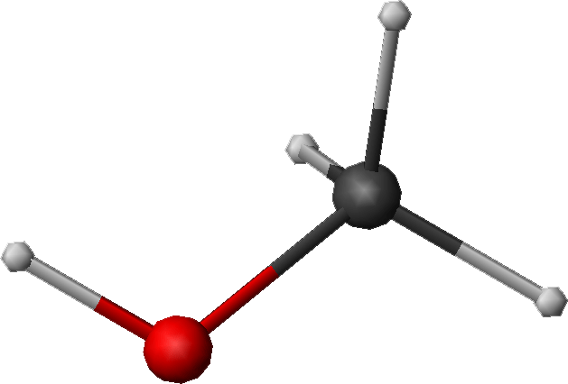
Cartesian coordinate system
z
Atom x (Å) y (Å) z (Å)
C(1) 0.000000 0.000000 0.000000
O(2) 0.000000 0.000000 1.400000
H(3) 1.026719 0.000000 -0.363000
H(4) -0.513360 -0.889165 -0.363000
H(5) -0.513360 0.889165 -0.363000
H(6) 0.447834 0.775672 1.716667
z_{H(6)}
H(6)
O(2)
H(4)
C(1)
y_{H(6)}
x_{H(6)}
x
H(5)
y
H(3)

Slide 4
Internal coordinate system
The Z-matrix
atom bond bond dihedral reference
length angle angle atoms
i d_{ij} α_{ijk} β_{ijkl} j k l
C(1)
O(2) 1.400 1
H(3) 1.089 109.47 1 2
H(4) 1.089 109.47 120.0 1 2 3
H(5) 1.089 109.47 -120.0 1 2 3
H(6) 0.950 109.47 180.0 2 1 5
H(6)
O(2)
H(4)
C(1)
For a molecule/assembly consisting of n atoms there always are 3n-6 internal coordinates. However, these are constrained for ring systems.
H(5)
H(3)

Slide 5
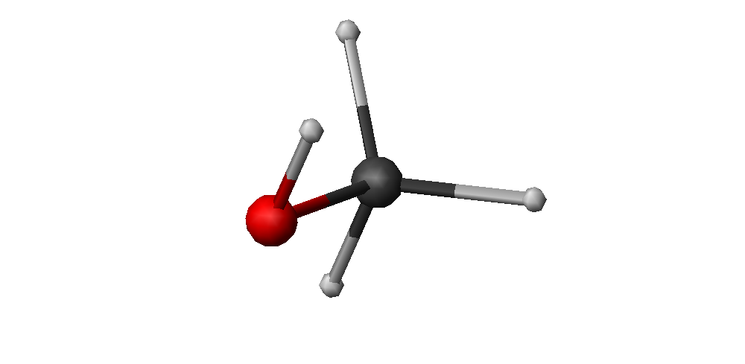
Bond length

Slide 6
Bond (valence) angle

Slide 7
Dihedral (torsional) angle
The C-O-H plane is rotated counterclockwise about the C-O bond from the H-C-O plane.

Slide 8
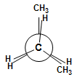
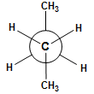
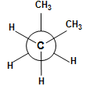
The Newman projection to illustrate rotation about a bond

Slide 9
Improper dihedral (torsional) angle

Slide 10




β=0º
β=180º
10
90^{ο}>β>0º
−90^{ο}<β<0º

Slide 11
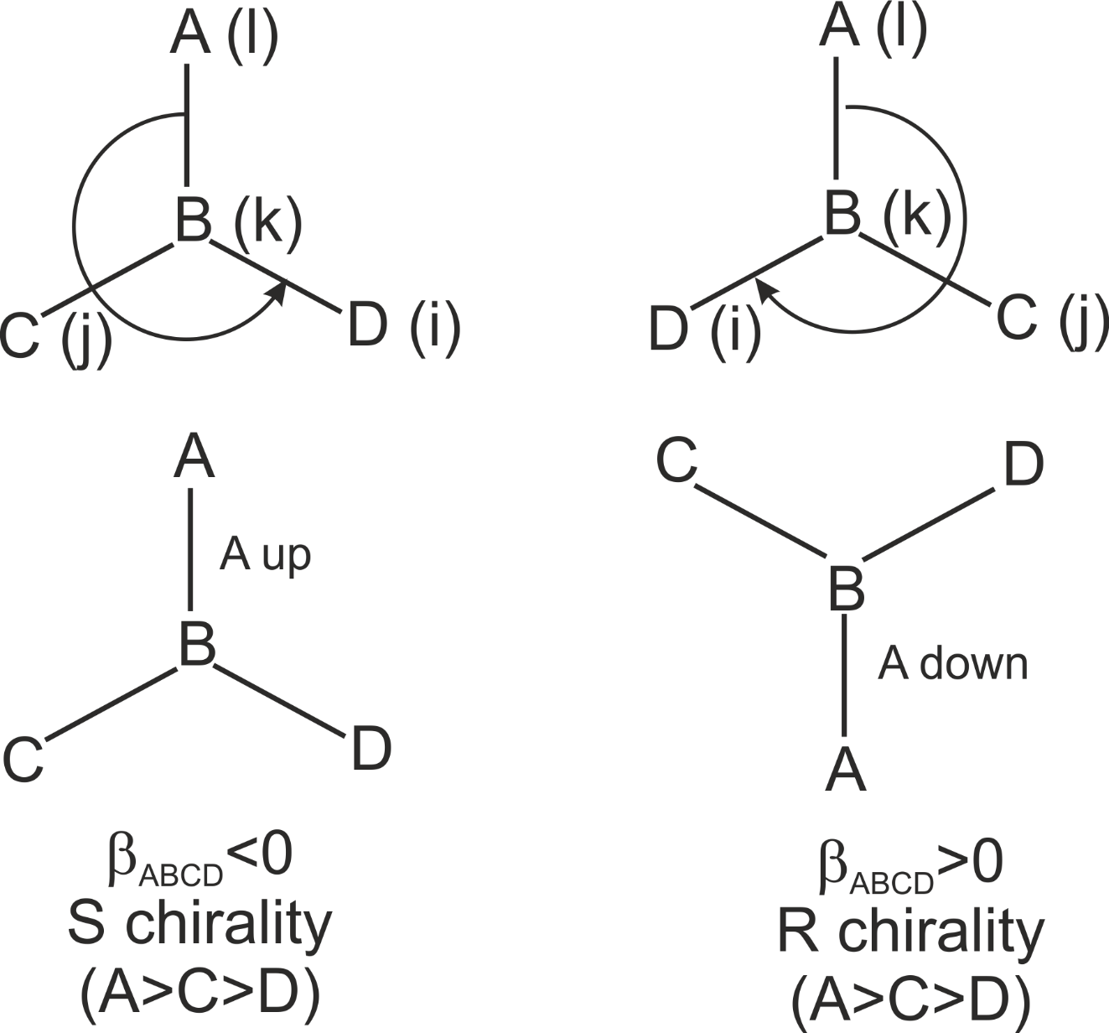
Improper dihedral angles and chirality

Slide 12
Flexibility of internal coordinates
Unchangeable (changes alter chemical identity):
Bond lengths.
Bong angles.
Improper dihedral angles (define chirality or planarity of sp² fragments).
Dihedral angles corresponding to rotations about double or partially-double bonds (define cis-trans isomers).
Changeable (define conformation or geometry of a molecular assembly):
Dihedral angles corresponding to rotations about single bonds (but mind ring systems).
Interatomic distances and angles relating one molecule/isolated atom to another.

Slide 13
Constraints: ring systems
n-2
n-1
n
α_{1 n n-1}
d_{1n}
α_{n 1 2}
1
Constraints
3
2

Slide 14
n-membered ring (single bonds): n-3 torsional angles
D.o.f. = (3-3)-3 = -3: very strained (e.g., cyclopropane)
D.o.f. = (4-3)-3 = -2: very strained (e.g., cyclobutane)
D.o.f. = (5-3)-3 = -1: strained (e.g., cyclopentane)
D.o.f. = (6-3)-3 = 0: not strained, rigid (e.g., cyclohexane)
D.o.f. = (7-3)-3 = 1: not strained, flexible (e.g., cyclohexane)

Slide 15
Bond length calculation
z_{j}
z_{i}
x_{i}
y_{i}
x_{j}
x_{j}

Slide 16
Bond angle calculation
j
α_{ijk}
i
k

Slide 17
Dihedral angle calculation
i
β_{ijkl}
k
j
l

Slide 18
The vector product of two vectors
θ

Slide 20
Some useful vector identities

Slide 21
i
α_{ijk}
180^{ο}−α_{ijk}
k
j

Slide 22
i
β_{ijkl}
k
j
l

Slide 23
β_{ijkl}
k
j
l

Slide 24
Improper torsional angles
l
j
β_{ijkl}
k
i’
jk
i
24

Slide 25
Calculation of Cartesian coordinates in a local reference frame from internal coordinates
z
H(5)
H(6)
d₂₆
α₄₂₆
C(1)
H(3)
β₃₄₂₆
O(2)
x
y
H(4)

Slide 26
Bringing the coordinates to the global coordinate system

Slide 27
Polymer chains
θ_{i+2}
θ_{i+2}
ω_{i+1}
θ_{i+1}
ω_{i+1}
i+1
i+1
d_{i+1}
d_{i+1}
i
i
d_{i}
p_{i-1}
ω_{i}
i-1
ω_{i-1}
ω_{i-1}
θ_{i-1}
θ_{i-1}
i-1
θ_{i}
d_{i-1}
d_{i-1}
i-2
i-2

Slide 28
For regular polymers (when there are „blocks” inside such as in the right picture, p_{i} is a full translation vector and T_{i-2}R_{i-1} is a full transformation matrix).

