Slide 1
Free energy calculations Generalized-ensemble sampling

Slide 2
Free energy calculations
Only relative free energies can be determined from simulations:
Free-energy difference between two systems („computational alchemy”)
Excess free energy (chemical potential)
Free-energy profile (potential of mean force)

Slide 3
Techniques
Direct counting of the occurences of the respective states in a canonical simulation
Thermodynamic integration
Particle insertion
Overlaping distribution method
Umbrella sampling
Histogram reweighting (weighted histogram analysis method; WHAM)

Slide 4
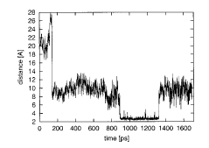
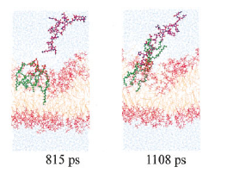
Free-energy differences from direct counting
d>d_{max}
d<d_{max}
A
B

Slide 5
Thermodynamic integration

Slide 6
Features of thermodynamic integration
Transformation from U_{I} to U_{II} can have any form, also non-linear.
Equilibration after changing λ is essential; otherwise hysteresis can occur.

Slide 7
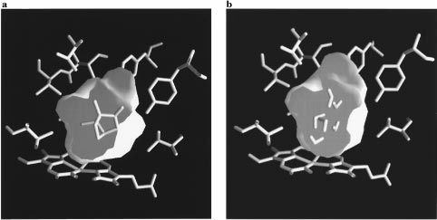
Protein-ligand binding
The active site of cytochrome P450cam with camphor bound (left) and six water molecules bound (right).
Helms and Wade, J. Am. Chem. Soc. 1998, 120, 2710-2713

Slide 8
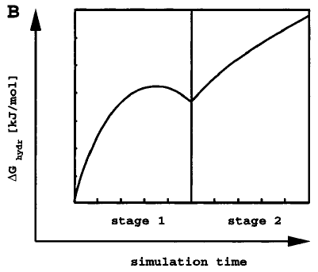
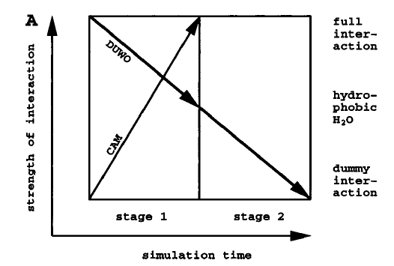
Protein-ligand binding
Helms and Wade, J. Am. Chem. Soc. 1998, 120, 2710-2713

Slide 9
Prediction of relative solvation energies
Martins, Souza, Ramon, Fernandes, J. Chem. Theory Comput., 2014, 10, 3570–3577

Slide 10
Radial distribution functions
Potential of mean force

Slide 11
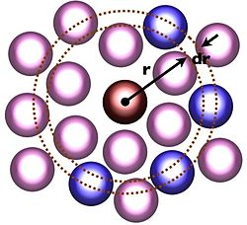
Calculation of radial distribution functions from MD simulations

Slide 12
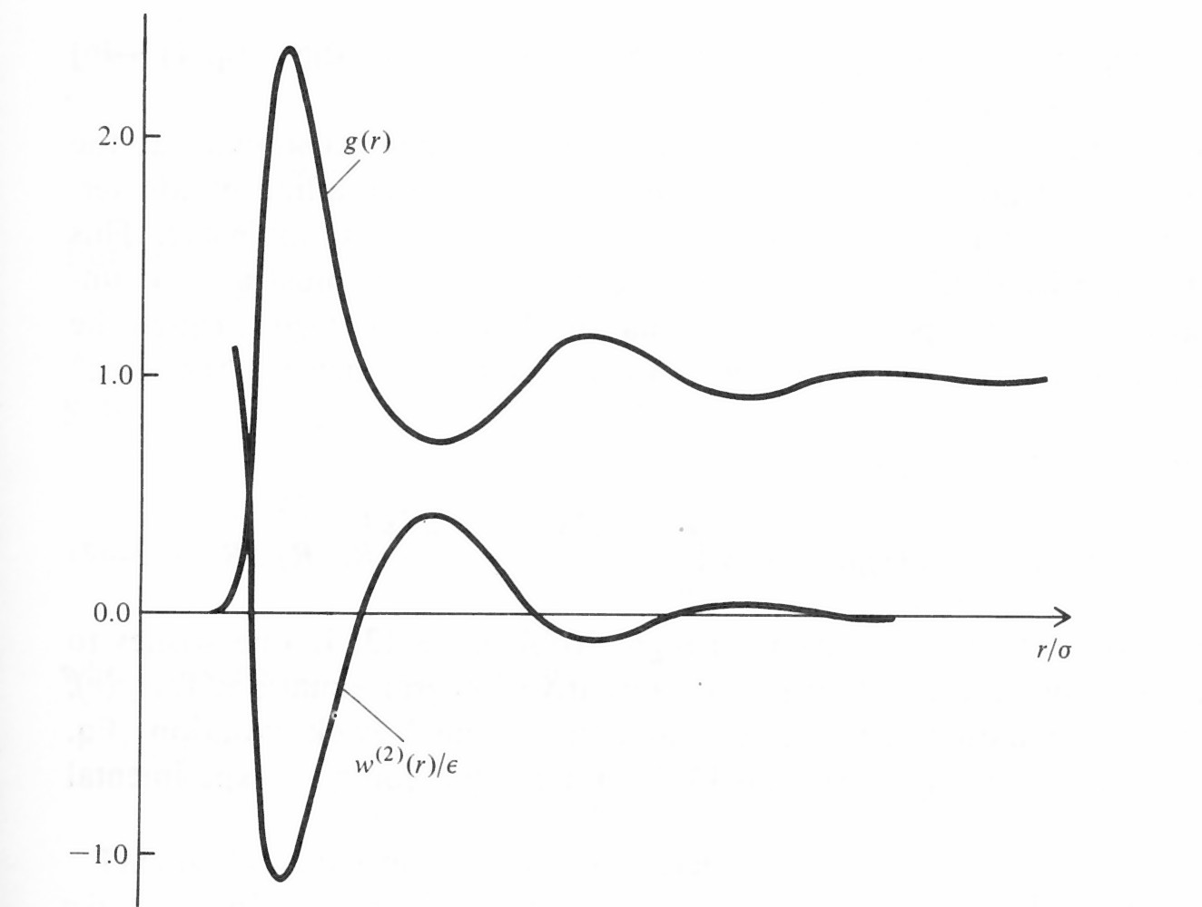
Plots of a radial distribution function and potential of mean force

Slide 13
Potential of mean force of two methane molecules in water

Slide 14
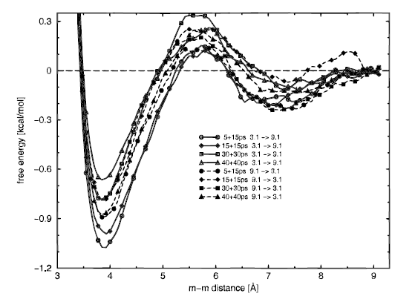
PMF curves obtained for methane dimer in water by thermodynamic integration for different equilibttion and data-collection time
Czaplewski et al., Prot. Sci., 2000, 9, 1235-1245

Slide 15
Particle-insertion method
B. Widom. J. Chem. Phys., 39, 2808 (1963) ; J. Phys. Chem., 86, 869 (1982)

Slide 16
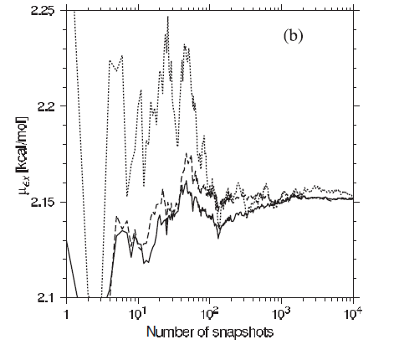
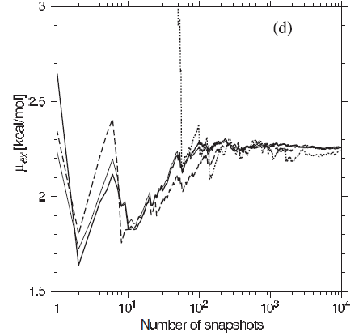
1000
10000
100000
1000000
insertions/snapshot
Helium atom
Methane molecule
Convergence of the chemical potential by particle-insertion method for the calculation of the free energy of hydration of neon and methane.
Czaplewski et al., Molecular Physics, 103, 3153–3167 (2005)

Slide 17
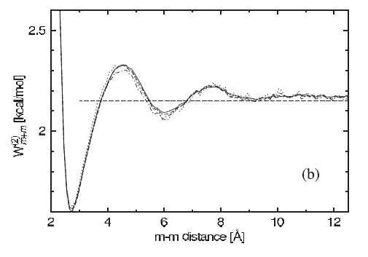
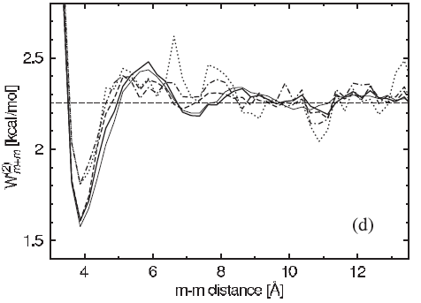
Potential of mean force by particle-insertion method
helium-helium
methane-methane
Czaplewski et al., Molecular Physics, 103, 3153–3167 (2005)

Slide 18
Umbrella sampling method (mainly for the calculation of the potentials of mean force
d
for the ith simulation
A series of canonical MD or MC simulations with restraint(s) imposed on the selected reaction coordinate(s) are carried out with different sets of restraints (windows). The restraints must then be removed from the final distribution.
G.M. Torrie, J.P. Valleau. J. Comp. Phys., 23, 187 (1977).

Slide 19
The Weighted Histogram Analysis Method (WHAM)
n_{m}(d) is the number of counts of in the bin centered at d in the m-th window ,
f_{m} is the „dimensionless free energy” of the m-th window.
The equations for P’s and f’s are iterated until self-consistence.
Kumar et al., J. Comput. Chem., 13, 1011 (1992).

Slide 20
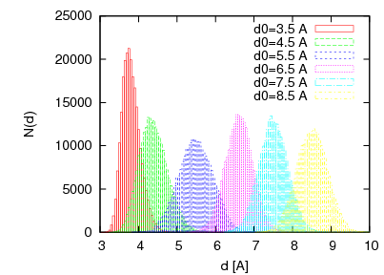
Methane-methane distance histograms from umbrella-sampling MD simulations with TIP3P water with windows centered at 3.5, 4.5,…, 9.5 A. The force constant k=2.0 kcal/mol*A².
Czaplewski et al., Prot. Sci., 2000, 9, 1235-1245

Slide 21
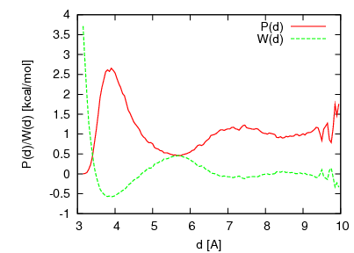
The radial-distribution function and PMF obtained after applying WHAM to the histograms from umbrella-sampling simulations
g(d)
g(d)
Czaplewski et al., Prot. Sci., 2000, 9, 1235-1245

Slide 22
Generalized-ensemble sampling
Designed to „walk” in the energy space
Energy barriers can be overcome
Reliable thermodynamic, mechanical, and structural properties and their temperature profiles can be obtained
Most common non-Boltzmann sampling techniques:
Replica exchange (parallel tempering): both MC and MD
Multicanonical sampling (also known as entropy sampling): more suitable for MC

Slide 23
Replica exchange method
N independent MC or MD trajectories are simulated
Every M steps, the temperature is exchanged between trajectories, as per Boltzmann probability
Multiplexing: several trajectories are run at a temperature
R.H. Swendsen & J.-S. Wang, Phys.Rev.Lett. 57, 2607, 1986 first paper.
Hansmann, U. H. E. Chem. Phys. Lett. 281, 140–150, 1997 MC, biomolecules
Y. Sugita & Y. Okamoto, Chem.Phys.Lett., 314, 141, 1999 MD, biomolecules
Y.Rhee V.Pande, Biophys. J. 84, 775, 2003 MREMD

Slide 24
REMD and MREMD - illustration
single
multiplexed
R.H. Swendsen & J.-S. Wang, Phys.Rev.Lett. 57, 2607, 1986 first paper.
Hansmann, U. H. E. Chem. Phys. Lett. 281, 140–150, 1997 MC, biomolecules
Y. Sugita & Y. Okamoto, Chem.Phys.Lett., 314, 141, 1999 MD, biomolecules
Y.Rhee V.Pande, Biophys. J. 84, 775, 2003 MREMD

Slide 25
Scheme of the replica-exchange algorithm
T1
T2
T3
T4
Molecule1
Molecule2
Molecule3
Molecule4
Evolve
Evolve
Evolve
Evolve
E1
T1
Molecule1
E2
T2
Molecule2
E3
T3
Molecule3
E4
T4
Molecule4
Exchange
Exchange
T1
Molecule1
T2
Molecule2
T4
Molecule3
T3
Molecule4
Each trajectory can be run independenty until exchange is attempted (parallelizable)

Slide 26
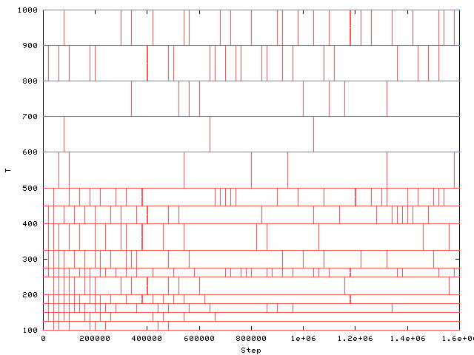
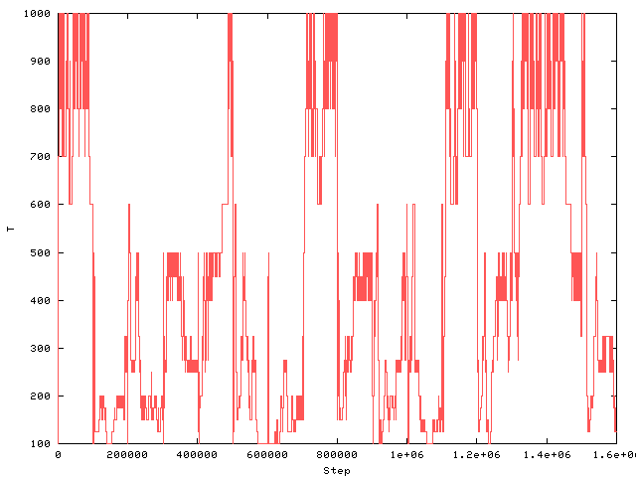
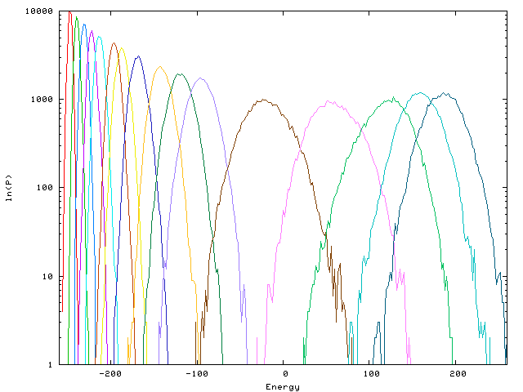
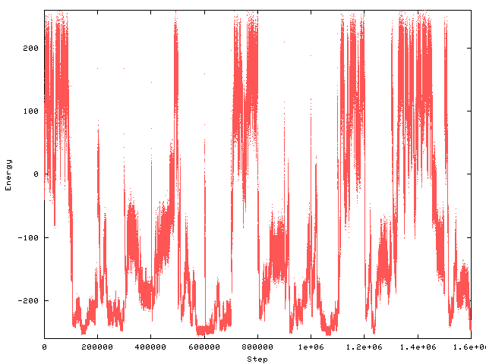
T
T
MD step
MD step
energy
ln(P)
energy
MD step

Slide 27
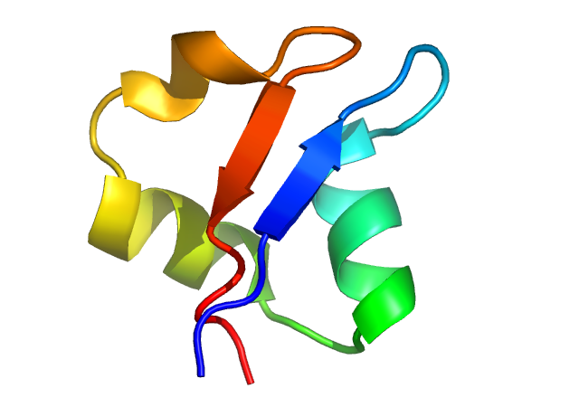
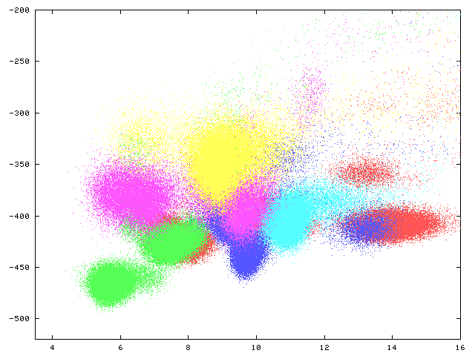
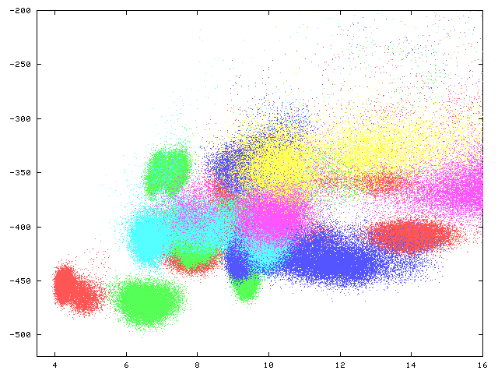
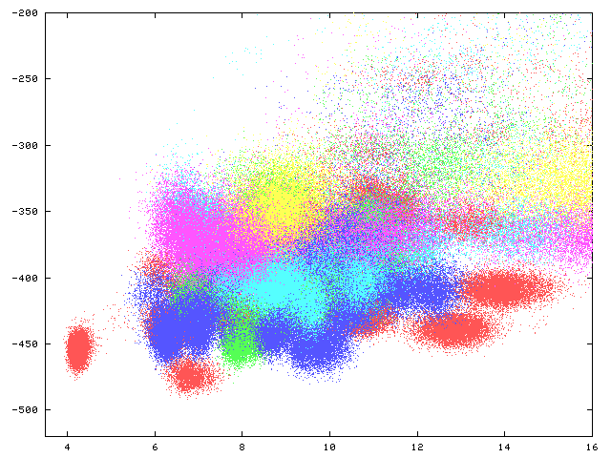
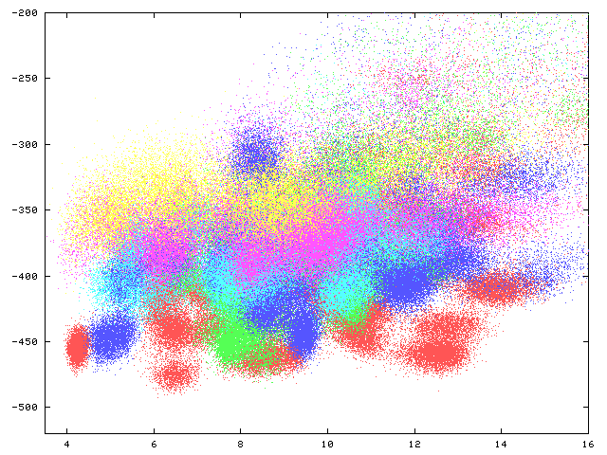
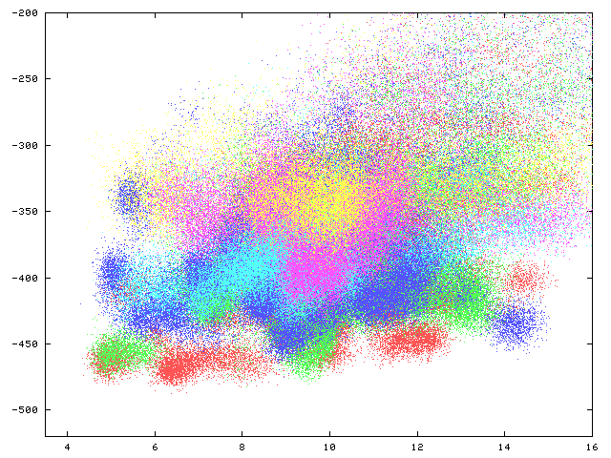
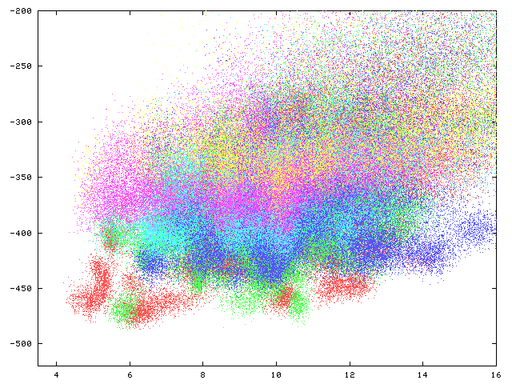
Independent canonical simulations
energy
300 350 400 500 600 700
rms
temperature
10
20
40
80
160
320

Slide 28
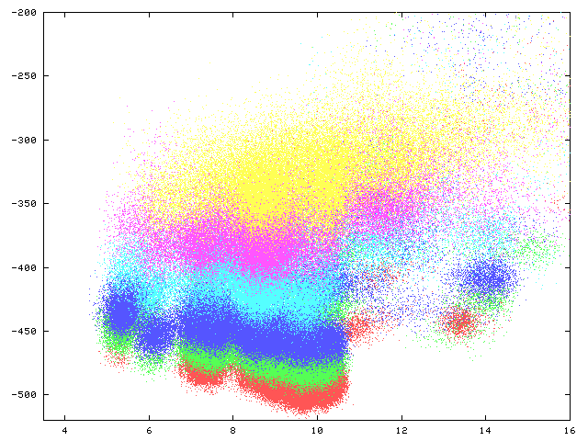
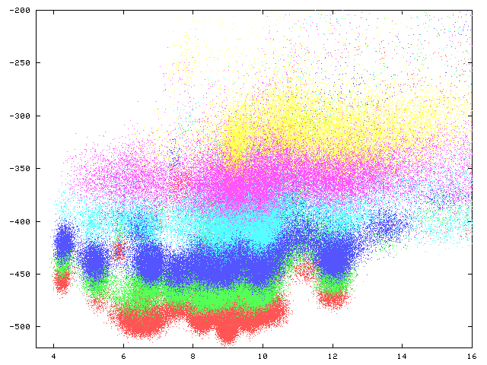
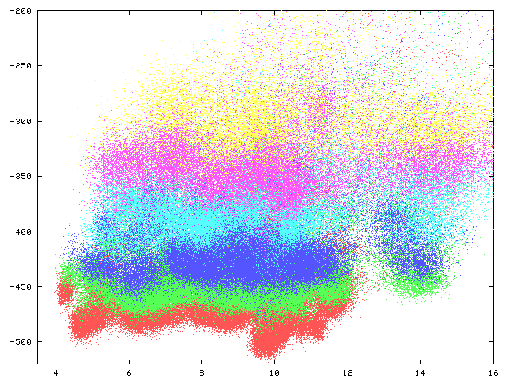
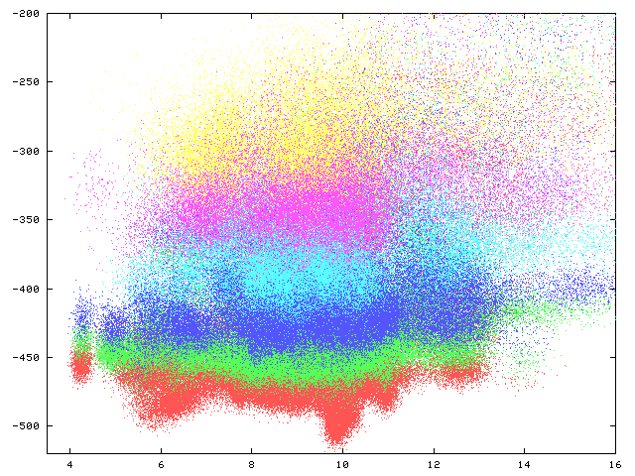
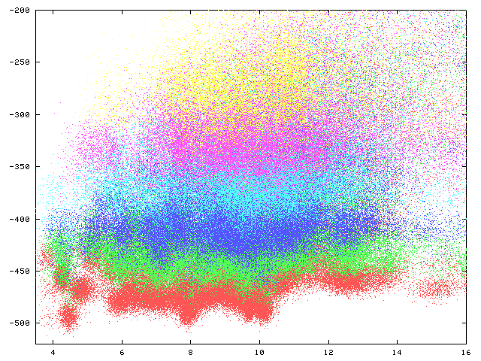
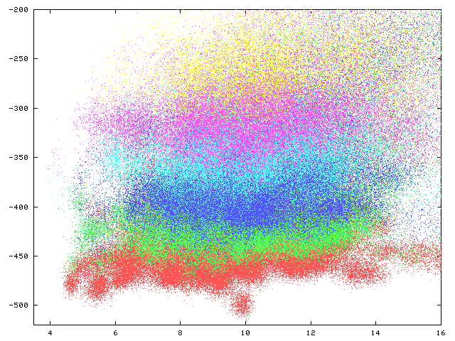
Multiplexed replica exchange
10
20
40
80
160
320
energy
300 350 400 500 600 700
1E0G
48aa
rms
temperature

Slide 29
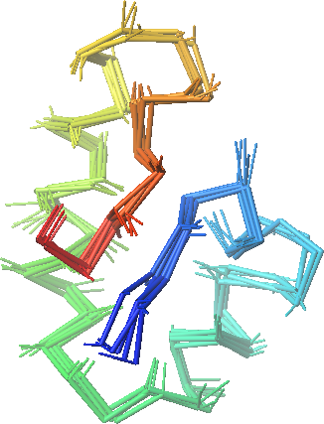
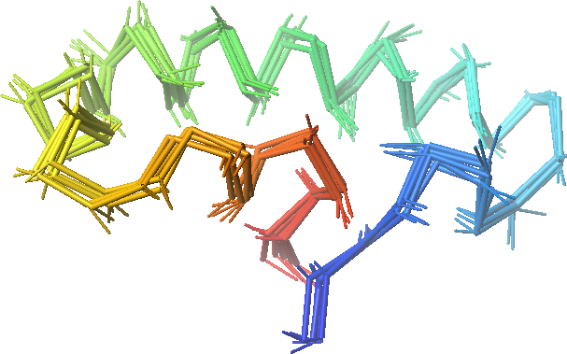
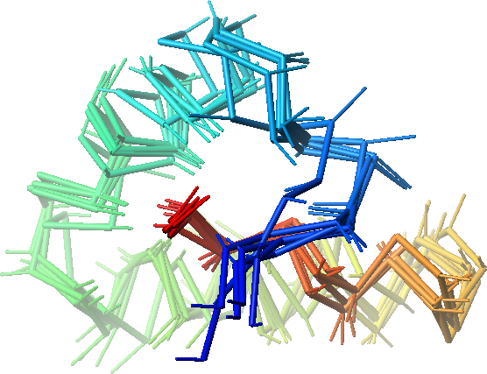
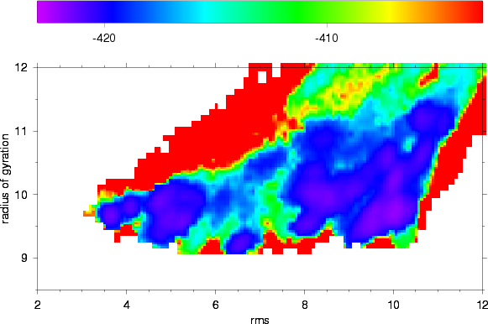
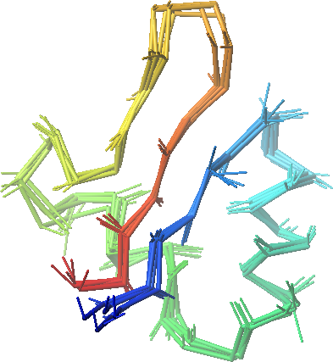
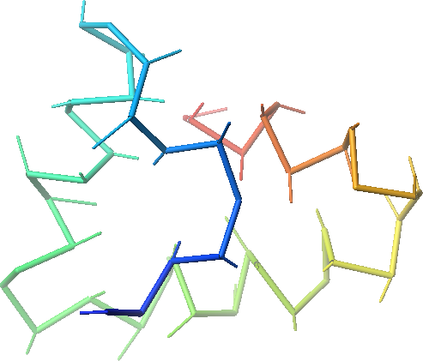
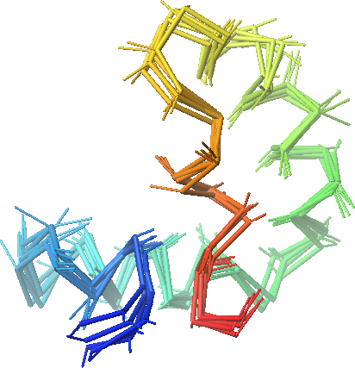
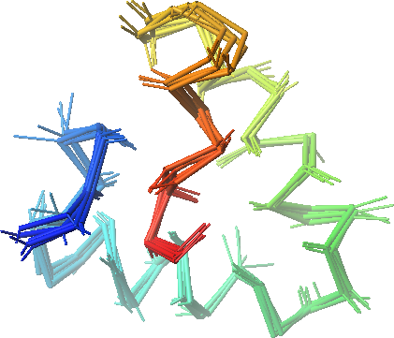
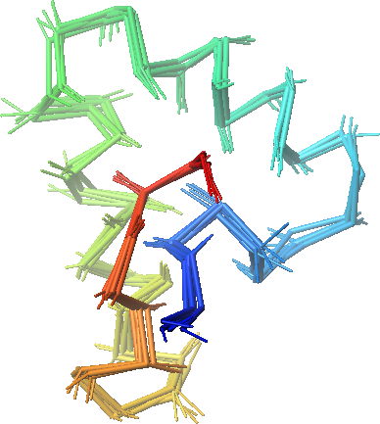

Slide 30
Replicas can be run not only in temperature but also in Hamiltonian in order to overcome energy barriers. Common ways are:
Altering the well-depth of selected Lennard Jones potentials.
Altering restraints; this can be considered a generalized umbrella-sampling method.

Slide 31
WHAM is an excellent technique to process the results of (M)REMD simulations carried out at multiple temperatures and with altered energy functions.
R – number of sets of simulations carried out at different temperatures and with different potentials
n_{m} – number of counts of ξ sets (conformations) in mth series of simulations; usually ξ denotes a single conformation, thus N(ξ)=1.

Slide 32
With ω(ξ), the probability of any conformation can be computed at any temperature and with any variant of the energy function.

Slide 33
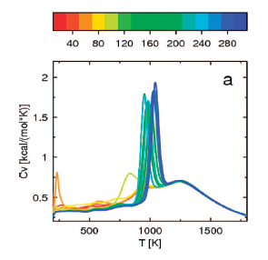
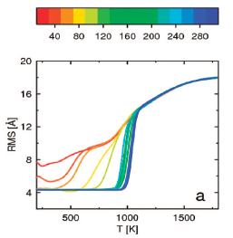
Convergence of the heat-capacity and C^{α}-RMSD from the experimental structure curve calculated from MREMD simulations for 1E0G protein with the UNRES coarse-grained force field.
Color scale: # million steps.
Czaplewski et al., J. Chem. Theory Comput. 5, 627–640 (2009)

Slide 34
(M)REMD caveats:
(M)REMD does help ergodicity but does not guarantee ergoditicy, especially when the force field is bad.
Temperature/Hamiltonian distribution among replicas does matter. Should be more dense in the regions where „something” is supposed to happen (e.g., phase transition).
Don’t trade trajectory length for number of trajectories; the system needs to relax between exchanges.
Exchange frequency should be just right. Too frequent exchanges don’t allow the system to relax.
WHAM is an interpolation and not an extrapolation technique. If your lowest (M)REMD temperature is, e.g., 300 K, use of the results to compute quantities at 280 K makes no sense.

Slide 35
Multicanonical Methods B.A. Berg and T. Neuhaus, Phys. Rev. Lett. 68, 9, (1992)
Also known as
Entropy Sampling (J. Lee, Phys. Rev. Lett. 71, 211, 1993)
Adaptive Umbrella Sampling (C. Bartels and M. Karplus, J. Phys. Chem. B 102, 865, 1998)
The sampling weight factor is defined so that the probability distribution of the potential energy is uniform
System performs a random walk in energy space

Slide 36
Entropic-sampling simulations
Start with an arbitrary energy distribution (e.g., obtained by canonical simulation)
Use E_{mu}(E) as the cost function in sampling
Update E_{mu}(E) as follows
Stop when n(E)exp[-E_{mu}(E)] is close to a flat line.

Slide 37
Entropic-sampling simulations of a Potts spin model
J. Lee, Phys. Rev. Lett. 71, 211, 1993

Slide 38
Multicanonical sampling for MD
Start with initial E_{mu}(U(r^{N})) (e.g., from canonical or (M)REMD simulations)
Use E_{mu}(U(r^{N})) as the potential-energy function; compute the forces as
Note: E_{mu} has to be differentiated numerically.
Periodically update E_{mu}.

