Slide 1
Lecture 11
Coarse-Grained Models
of Biomolecules
Part I: Motivation, Principles, and History

Slide 2
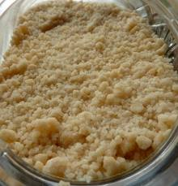
What is coarse-graining?
coarse-grained - composed of or covered with particles resembling meal in texture or consistency; "granular sugar"; "the photographs were grainy and indistinct"; "it left a mealy residue" of textures that are rough to the touch or substances consisting of relatively large particles; "coarse meal"; "coarse sand"; "a coarse weave"
coarse-grained - not having a fine texture; "coarse-grained wood"; "large-grained sand"- of textures that are rough to the touch or substances consisting of relatively large particles; "coarse meal"; "coarse sand"; "a coarse weave"
Based on WordNet 3.0, Farlex clipart collection. © 2003-2011 Princeton University, Farlex Inc.

Slide 3
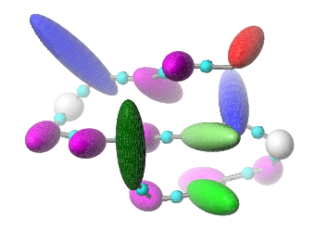
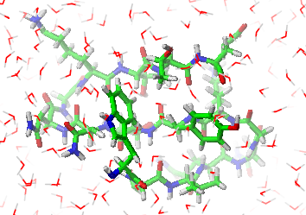
In Physics, Molecular Science, Molecular Modeling:
Coarse graining: reducing the representation of a system or a phenomenon.
Physicists prefer the term renormalization.

Slide 4
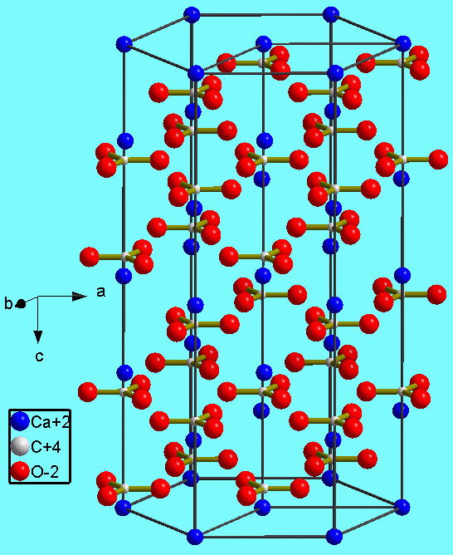
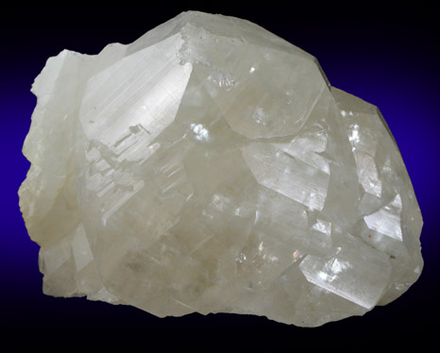
Coarse graining: from micro- to macro-scale
Calcite: specimen from Shullsburg District, Lafayette County, Wisconsin (courtesy of the Online Mineral Museum)
Calcite: crystallographic structure

Slide 5


Fine-grain structure does not matter in such applications…

Slide 6
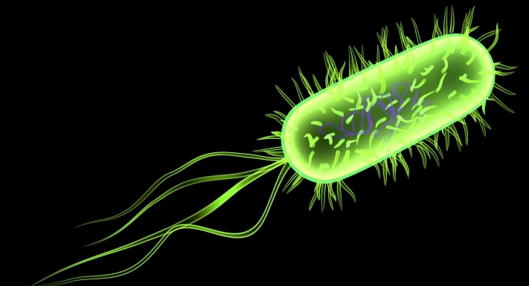
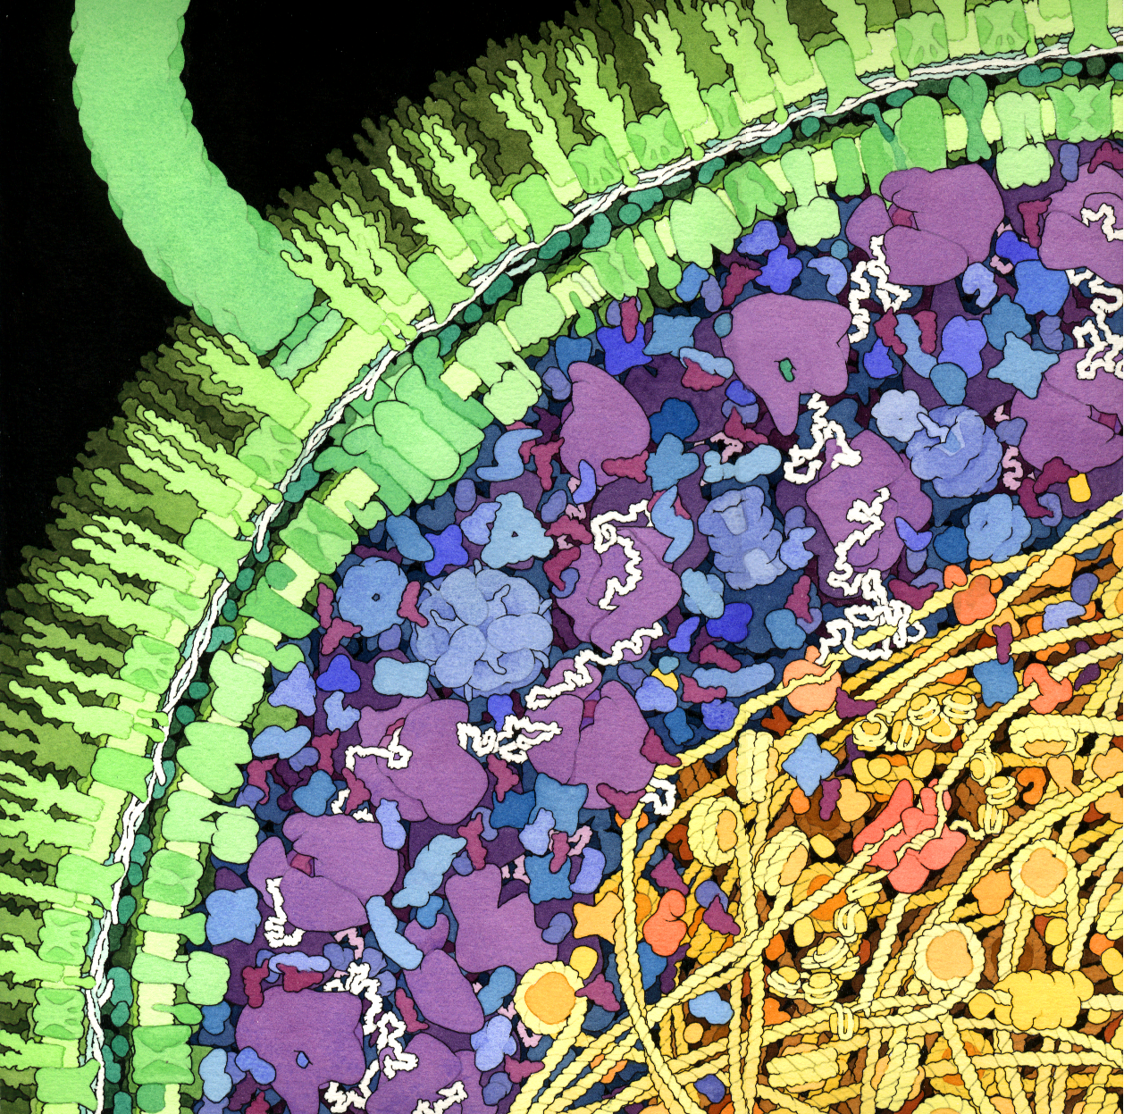
A cross-section of a small portion of an E. coli bacterium
Flagellar motor
Flagellum
Cell wall
Enzymes
m-RNA
Ribosomes
HU protein (bacterial nucleosome)
Cytop;lasm
DNA
Nucleoid
© David S. Goodsell 1999.
Molecular Grahics Laboratory
Scripps Research Institute, La Jolla, CA

Slide 7

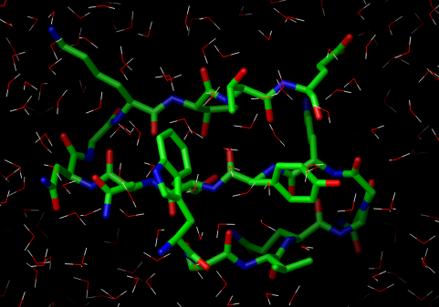
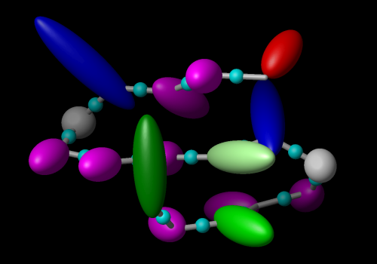
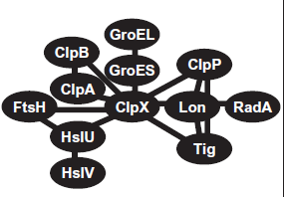
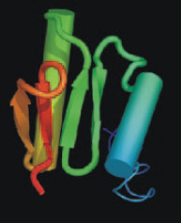
Fully-detailed
QM
Averaging over „less important” degrees of freedom
QM/MM
Averaging over individual components
Individual components
Atomistically-detailed
All-atom
United-atom
Description level
Residue level
Coarse-grained
System level
(Networks)
PDEs to describe reaction/diffusion
Molecule/domain level
Network graphs

Slide 8
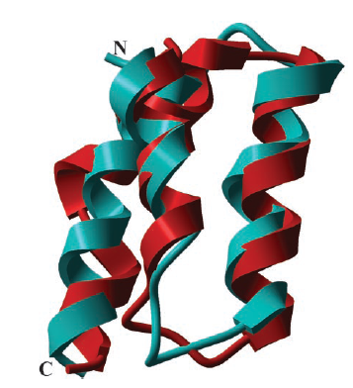
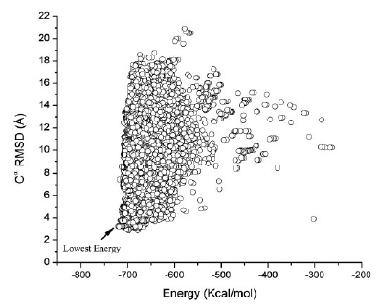
Global optimization of the energy surface of the N-terminal portion of the B-domain of staphylococcal protein A with all-atom ECEPP/3 force field + SRFOPT mean-field solvation model (Vila et al., PNAS, 2003, 100, 14812–14816)
Superposition of the native fold (cyan) and the conformation (red) with the lowest C^{α} RMSD (2.85 Å) from the native fold
Energy-RMSD diagram

Slide 9
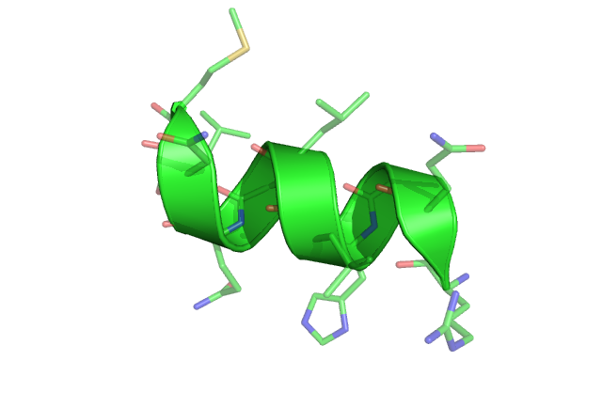
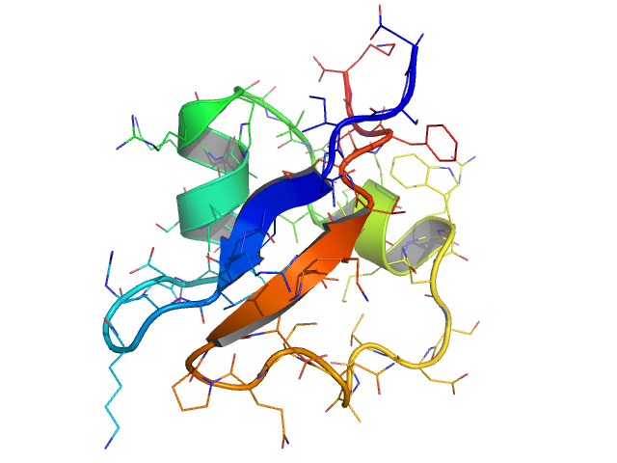
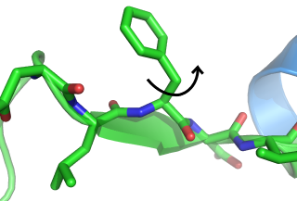
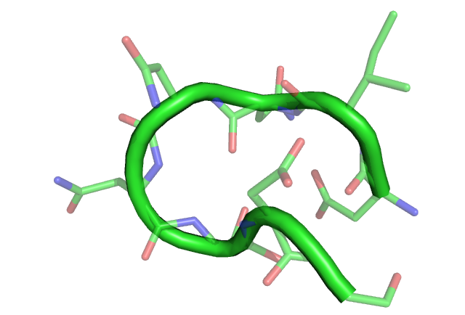
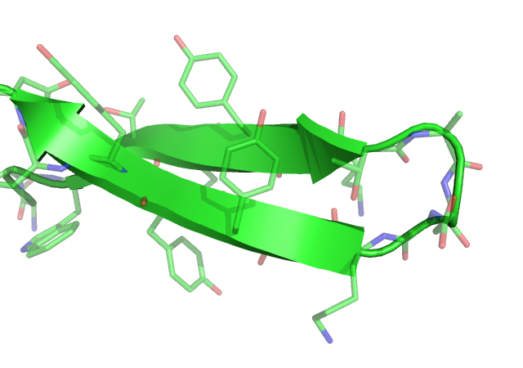
sidechain
rotation
helix
formation
protein
folding
10⁻¹⁵
femto
10⁻¹²
pico
10⁻⁹
nano
10⁻⁶
micro
10⁻³
milli
10⁰
seconds
bond
vibration
loop
closure
folding of
β-hairpins
all atom MD step

Slide 10
Time step Δt for some standard MD packages
MD Package | Explicit Solvent | Implicit Solvent
AMBERª | 1 fs | 2 fs
CHARMM^{b} | 3 fs | 4-5 fs
TINKER^{c} | 1 fs | 2 fs
ª http://amber.scripps.edu/
^{b} http://www.charmm.org/
^{c} http:// dasher.wustl.edu/tinker/

Slide 11
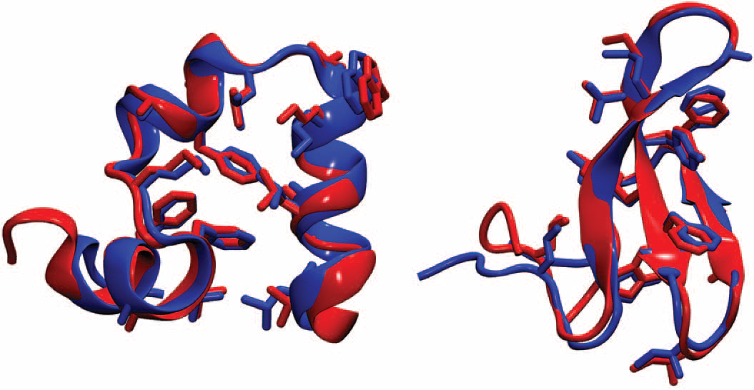
Folding proteins at x-ray resolution using a specially designed ANTON machine (x-ray: blue, last frame of MD) simulation (red): villin headpiece (left), a 88 ns of simulations, WW domain (right), 58 μs of simulations. Good symplectic algorithm; up to 20 fs time step.
D.E. Shaw et al., Science, 2010, 330, 341-346

Slide 12
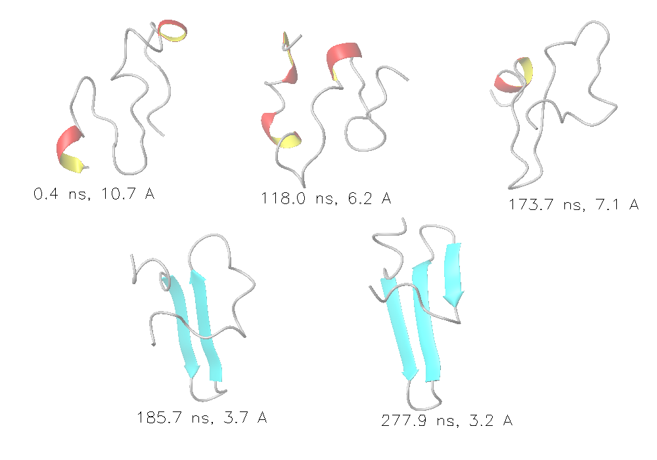
Folding the WW domain with the UNRES coarse-grained approach: 280 ns instead of 58 ms

Slide 13
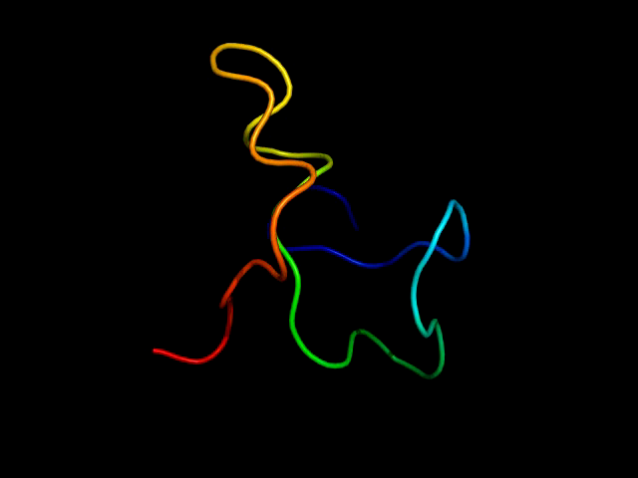

Slide 14
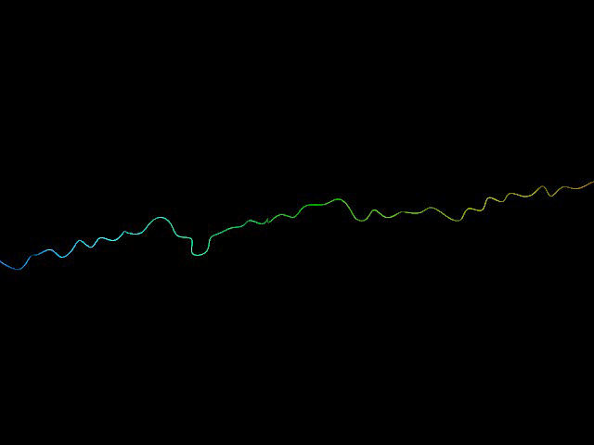

Slide 15
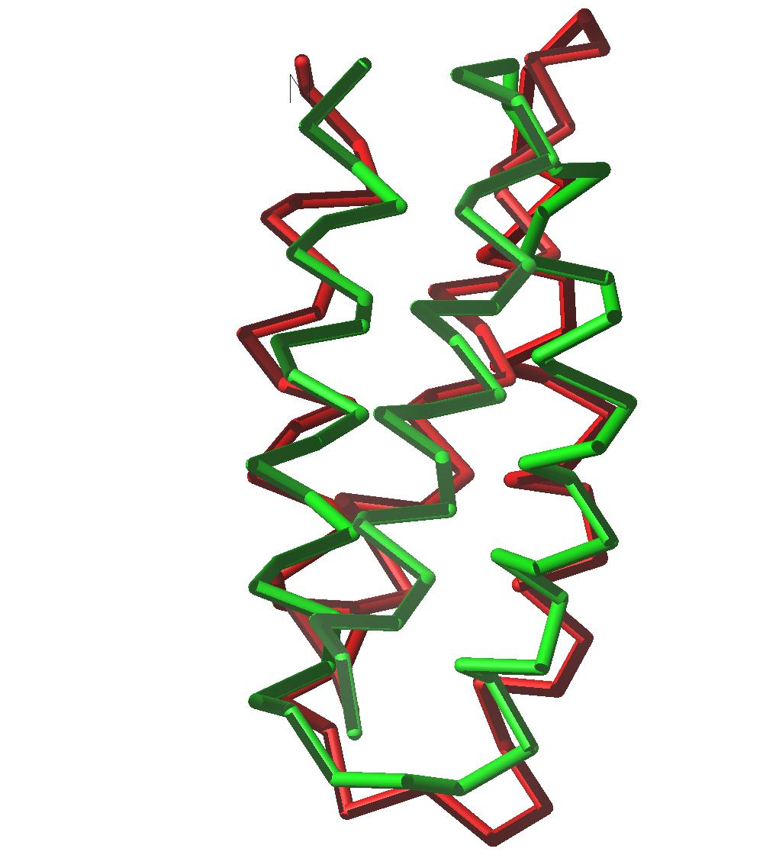
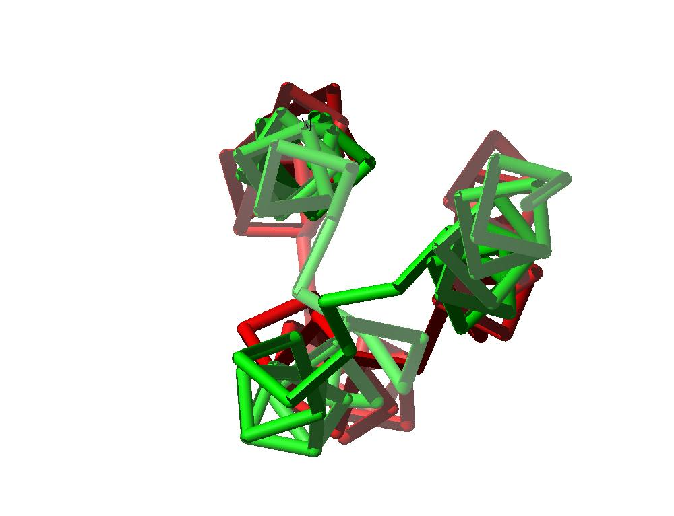
Coarse-grained approaches and accuracy
1LQ7; lowest-energy structure obtained with UNRES; Ca rmsd=2.1 Å
Ołdziej et al., J. Phys. Chem. B, 108, 16950, 2004

Slide 16
What is a force field?
A set of formulas (usually explicit) and parameters to express the conformational energy of a given class of molecules as a function of coordinates (Cartesian, internal, etc.) that define the geometry of a molecule or a molecular system.
Features:
Cheap
Fast
Easy to program
Restricted to conformational analysis
Non-transferable
Results sometimes unreliable

Slide 17
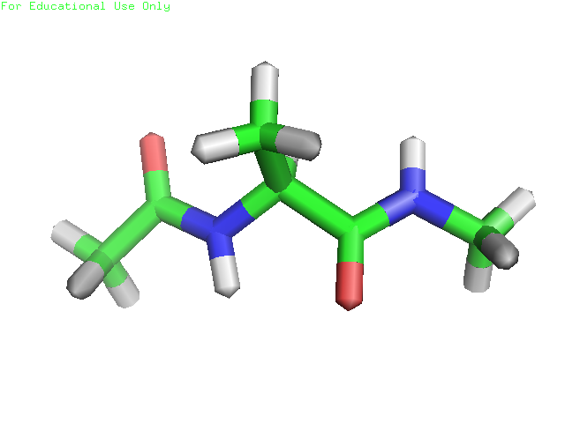
All-atom empirical force fields: a very simplified representation of the potential energy surfaces

Slide 18
Applications of force fields
Technique | Application
Local minimization | Refinement
Global minimization | Searching most stable (?) structures
Monte Carlo methods | Thermodynamical properties, ensemble averages
Molecular dynamics and extensions
 | Dynamical properties

Slide 19

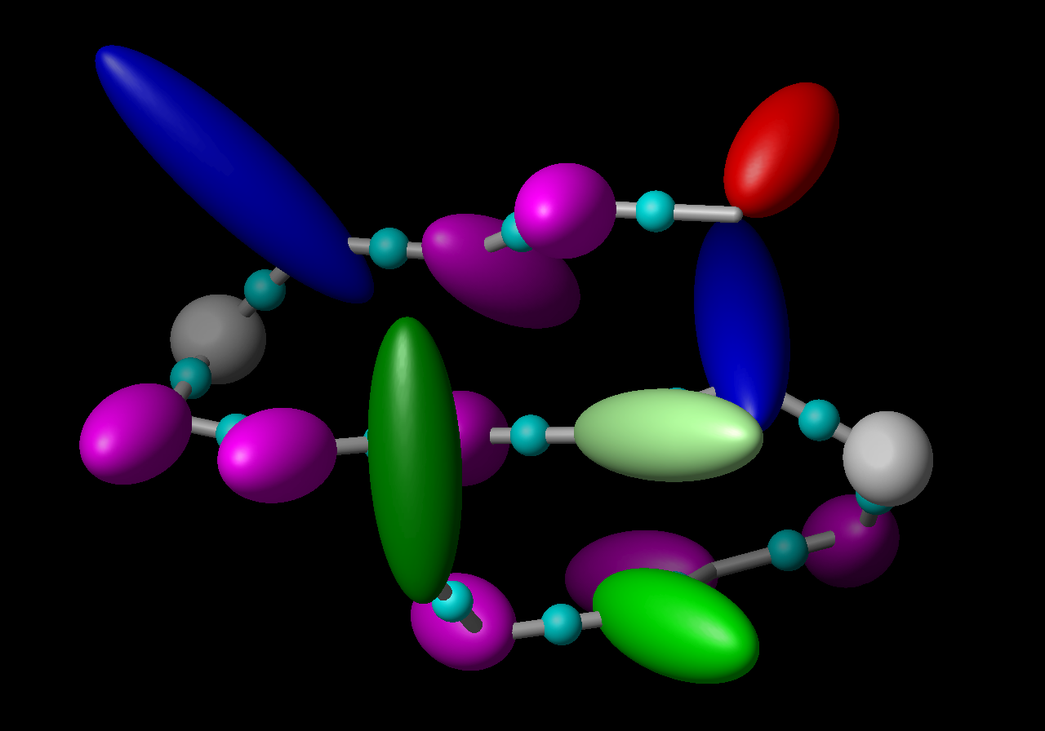
United-residue force fields
All-atom representation
of polypeptide chain in
solution (explicit water)
United-residue (UNRES) representation of polypeptide chain

Slide 20
Coarse-grained force fields: a general formula
Local terms
Pairwise terms
Multibody terms

Slide 21
Types of coarse-grained potentials
Physics-based potentials
  smoothing the energy surface by treating rigid objects as single interaction sites (e.g., the Kihara potentials),
  averaging out non-essential degrees of freedom,
  reproducing thermodynamic properties of small compounds.
Statistical potentials based on the „Boltzmann principle”
  database information implicit in the potentials,
  database information explicit in the potentials.
Arbitrary potentials (HP, HNP).
Structure-based potentials
  native secondary structure or other components of structure built in the potentials
  the native structure is the global minimum (Go-like potentials).
Elastic network potentials.

Slide 22
Applications of coarse-grained potentials
Prediction of 3D structure (proteins, nucleic acids, their complexes)
Large time- and size-scale molecular dynamics simulations
Computing thermodynamic properties and ensemble averages (thermodynamics of folding)

Slide 23
Protein coarse-grained potentials: 37 years
Infancy and Childhood
1975 Levitt & Warshel: a physics-based neo-classical force field (Nature 253:694-698).
1976 Tanaka & Scheraga: contact (on-lattice) statistical. potentials determined from the PDB (Macromolecules 9:945-950).
1976 Kuntz et al.: off-lattice statistical potentials (J. Mol. Biol. 106:983-994).
1981, 1984: Crippen & coworkers: statistical potentials (Int. J. Peptide Protein Res. 24:279-296; J. Comput. Chem. 8:972-981).
1985: Miyazawa & Jernigan: contact potentials, rigorous quasi-chemical approximation (Macromolecules 18:534-552).
1990: Crippen & Snow: Optimization of statistical potentials by maximization of energy gap (Biopolymers 29:1479-1489)
1990: Sasai & Wolynes: Application of theory of associative Hamiltonians to develop coarse-grained potentials (Phys. Rev. Lett. 65:2740-2743).

Slide 24
Youth and Maturity
1993: Jones & Thoronton: Potentials for fold recognition (J. Comput.-Aided Mol. Design 7:439-456).
1993: Koliński & Skolnick: On-lattice statistical potentials: successful folding simulations (J. Chem. Phys. 98:7420-7433).
1993: First version of UNRES: successful structure prediction (Liwo et el., Protein Sci. 2:1715-1731)
1998: First successful blind ab initio protein-structure predictions in CASP3 (Skolnick group, Scheraga group).
2001: Rigorous formulation of coarse-grained force fields through cluster-cumulant expansion (Liwo et al., J. Chem. Phys. 115:2323-2347)
2004: Kolinski: CABS force field for on-lattice simulations of proteins (Acta Biochim. Pol. 51:349-371).
2007: Voth and coworkers: Multiscale coarse-graining based on force matching (J. Phys. Chem. B 111:4116-4127)
2008: Marrink and coworkers: MARTINI off-lattice force field based on thermodynamic data (J. Chem. Theor. Comput. 4:819-834).

Slide 25
J. Mol. Biol. (1976) 104, 59-107
A Simplified Representation of Protein Conformations for
Rapid Simulation of Protein Folding
MICHAEL LEVITT
Weizmann Institute of Science, Rehovoth, Israel
and
Medical Research Council Laboratory of Molecular Biology
Hille Road, Cambridge, England-f
(Received 12 December 1975, and in revised form 19 February 1976)

Slide 32
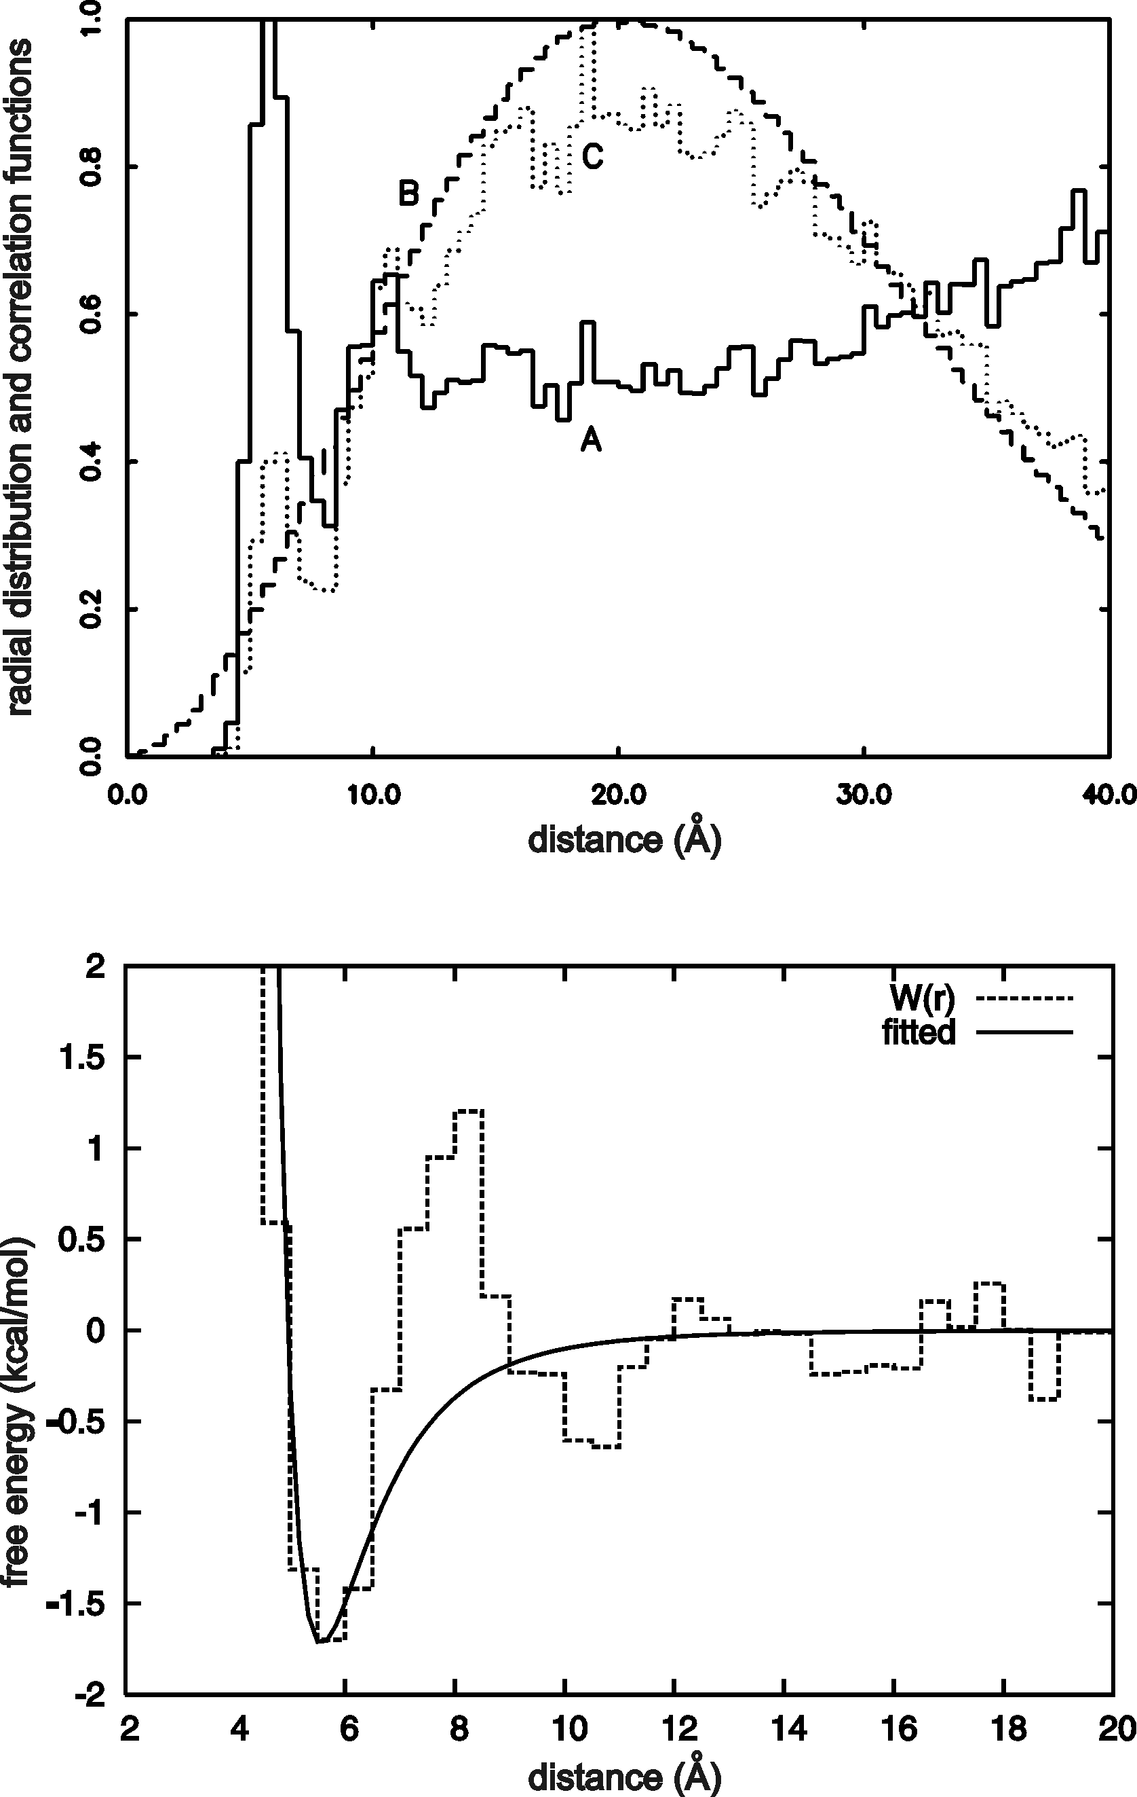
Statistical potentials
x – geometric variable
p – type(s) of site(s)
s – sequence context
Leu-Leu pair, statistics from PDB

Slide 34
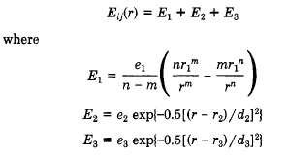

Slide 36
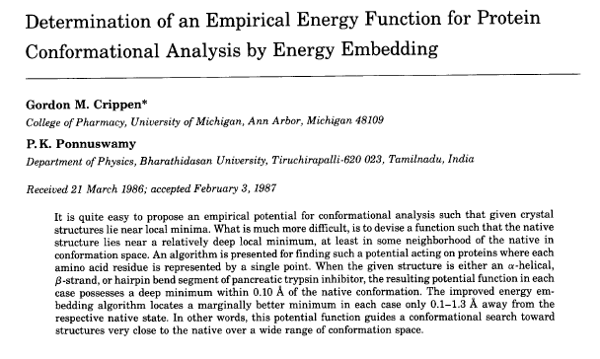

Slide 39
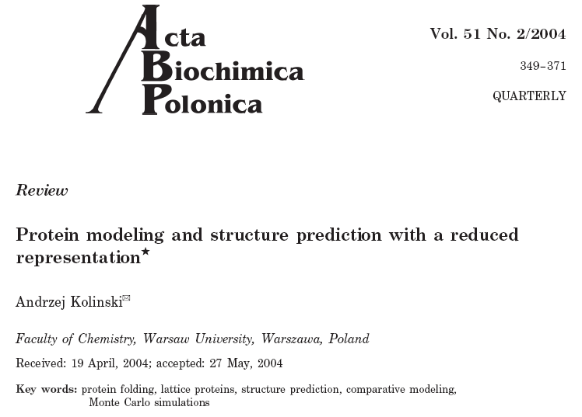

Slide 41
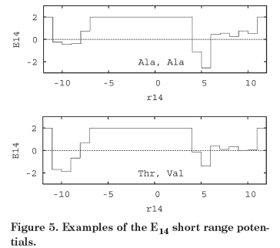

Slide 42
