Slide 1
Lecture 12
Coarse-Grained Models
of Biomolecules
Part II: Physics-based force fields:
MARTINI, UNRES, MSCG

Slide 2
From Schrödinger equation to analytical all-atom potentials

Slide 3
Figure 3b).
The Born-Oppenheimer approximation

Slide 4
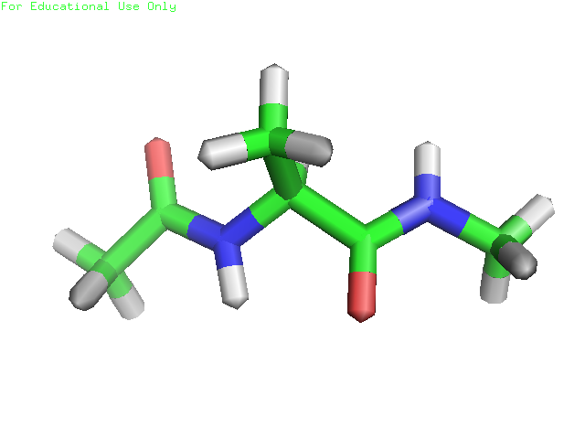
All-atom empirical force fields: a very simplified representation of the potential energy surfaces

Slide 5
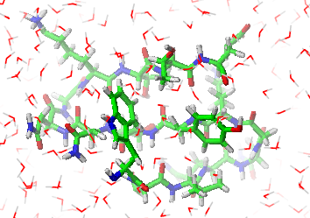
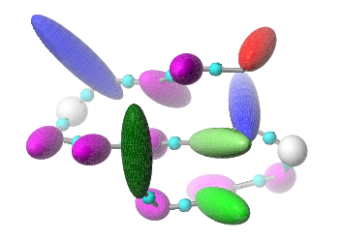
Prototype of the effective energy function (U) in physics-based coarse-grained modeling
F: Restricted Free Energy (RFE); Potential of Mean Force (PMF)

Slide 6
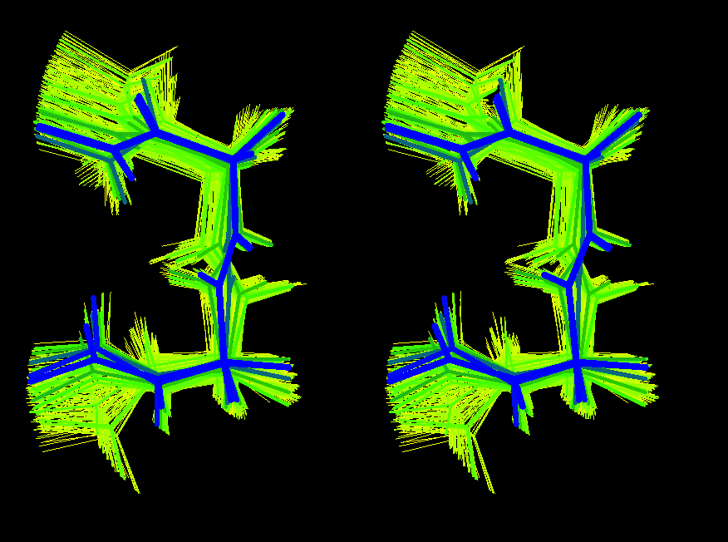
Illustration of the “composition” of the statistical ensemble of, say, a β-turn model corresponding to an UNRES chain used to compute the RFE.

Slide 7
The probability density of a coarse-grained conformation to occur can be computed directly as the Boltzmann factor of the coarse-grained energy. The free energy is consistent with that computed from all-atom energy.

Slide 8
The ensemble averages of quantities that depend on coarse-grained coordinates only (e.g., the C^{α}-RMSD in UNRES) calculated with the effective coarse-grained energy function correspond to ensemble averages at the all-atom level.

Slide 9
What if a quantity depends on both X and Y (e.g., the radius of gyration, proton-proton distance, etc? Doable but requires some extra-parameterization…

Slide 10
Average Energy and Heat Capacity

Slide 11
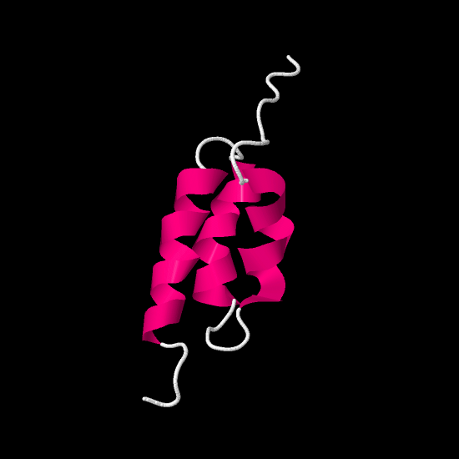
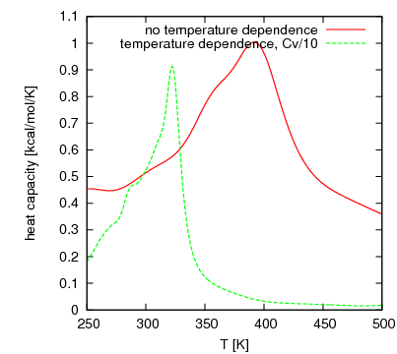
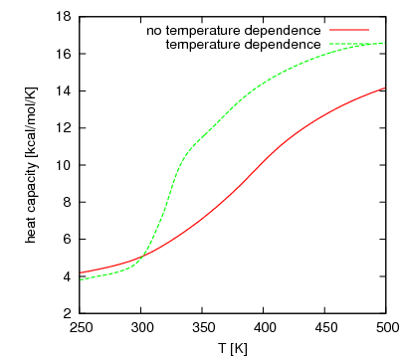
Temperature dependence of coarse-grained force fields
The N-terminal part of the B-domain of staphylococcal protein A; coarse-grained simulations with UNRES

Slide 12
Expressing the total PMF
Sum of neo-classical expressions (Levitt & Warshel, 1975; Levitt, 1976; MARTINI force field)
Sum of statistical potentials (Tanaka & Scheraga, 1976; CABS force field)
Factor expansion (UNRES)
Force matching (Voth and coworkers, 2007)

Slide 13
Sum of neo-classical terms

Slide 14
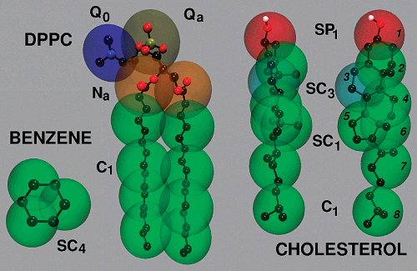
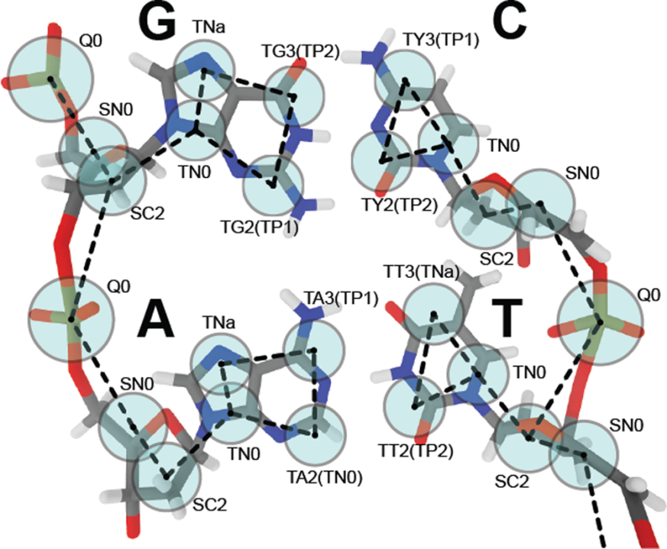
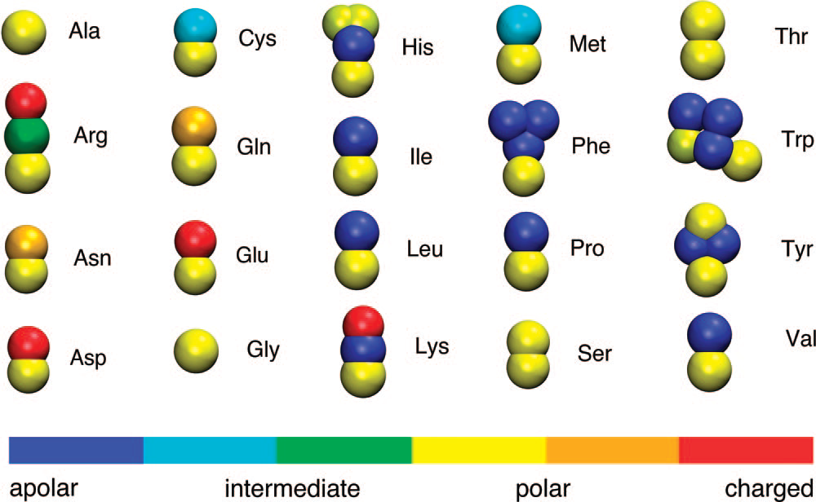
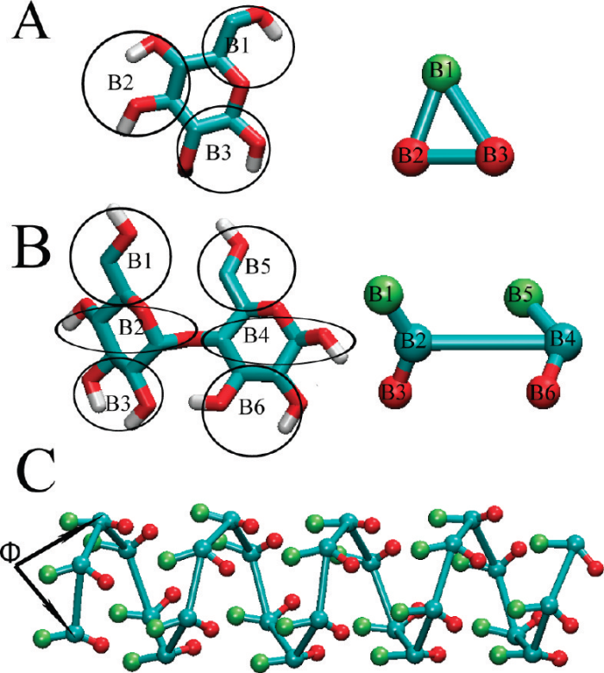
The MARTINI force field

Slide 15
Features of MARTINI
4-to-1 mapping; on average 4 heavy atoms+associated hydrogens are considered an interaction site.
Explicit water; 4 water molecule mapped onto a single site (however, „dry Martini” was developed).
4 main types of particles: polar (P), nonpolar (N), apolar (C), charged (Q); additionally hydrogen-bonding properties assigned: donor (d), acceptor (a), both (da), none (0).
Non-bonded interactions described by the LJ potential + charged-charged interactions described by the Coulombic potential.

Slide 16
Parameterization of MARTINI
Standard VDW parameters depending on site type.
Local parameters from PMFs of all-atom MD
Validation by comparing with the distributions functions from all-atom MD and experimental data (thermodynamic, NMR, etc.).

Slide 17
Applications of MARTINI
Lipid membrane characterization.
Lipid polymorfism.
Membrane fusion.
Protein-lipid interplay.
Self-assembly of peptides and proteins.
Peptide-induced memnbrane permealization.
Conformational changes in proteins.
Surfactant self-assembly.
Nanoparticles.

Slide 18
MARTINI references
S.-J. Marrink et al., J. Phys. Chem. B 2007, 111, 7812-7824 (lipids)
L. Monticelli et al., J. Chem. Theory and Comput. 2008, 4, 819–834 (proteins)
C.A. Lopez et al., J. Chem. Theory Comput. 2009, 5, 3195–3210 (carbohydrates)
J.J. Uusitalo et al., J. Chem. Theory Comput. 2015, 11, 3932−3945 (DNA)
C. Arnarez et al., J. Chem. Theory Comput. 2015, 11, 260−275 („dry” Martini; implicit sovent)
S.-J. Marrink and D.P. Tieleman, Chem. Soc. Rev., 2013, 42, 6801-6822 (overview and perspectives)

Slide 19
Factor expansion of the PMF
Define the coarse-grained interaction sited as well as the coarse-grained and fine grained degrees of freedom.
Express the all-atom energy as a sum over components within and between interaction sites.
Factor out F(X) and determine approximate functional expressions for the factors.
Parametrize the expressions from QM or MM RFE surfaces.
Calibration to reproduce properties of training systems (native protein structure, thermodynamic properties, etc.).

Slide 20
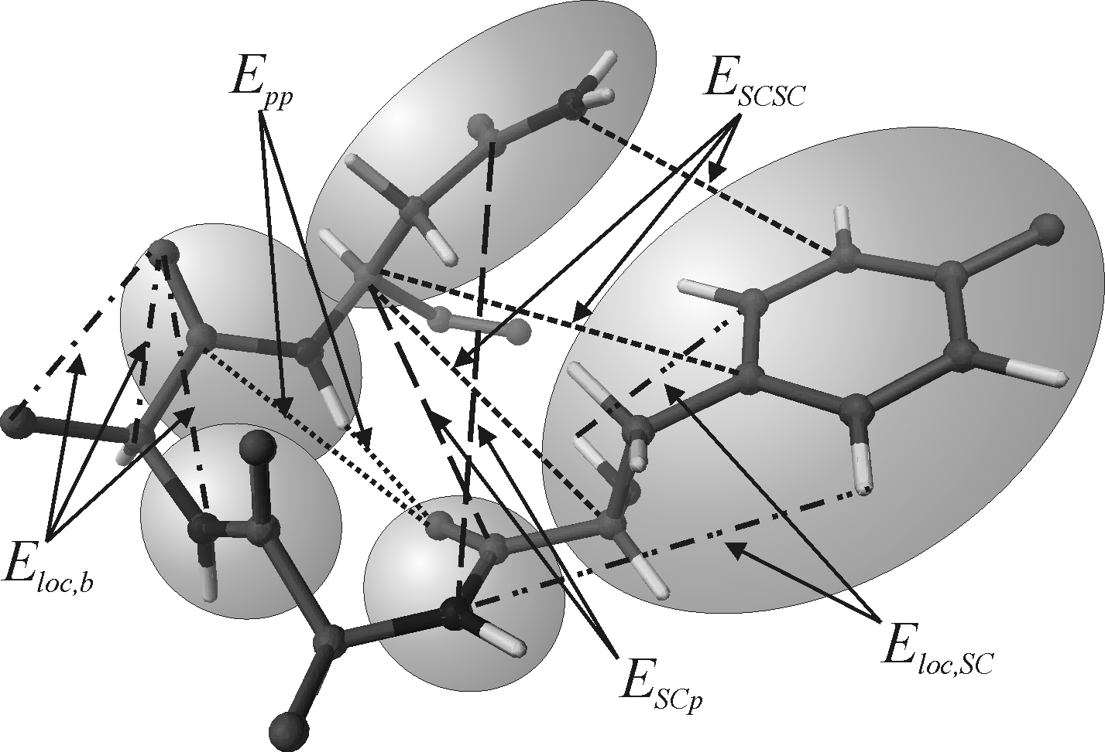
Definition of coarse-grained sites and energy partition

Slide 21
PMF in terms of component energies

Slide 22
Factorization of the PMF
A. Liwo, C. Czaplewski, H.A. Scheraga, J. Chem. Phys., 115, 2323-2347 (2001).

Slide 23
Examples of the factors
- [ + ]

Slide 24
Expansion of the RFE factors in the generalized cumulant series

Slide 25
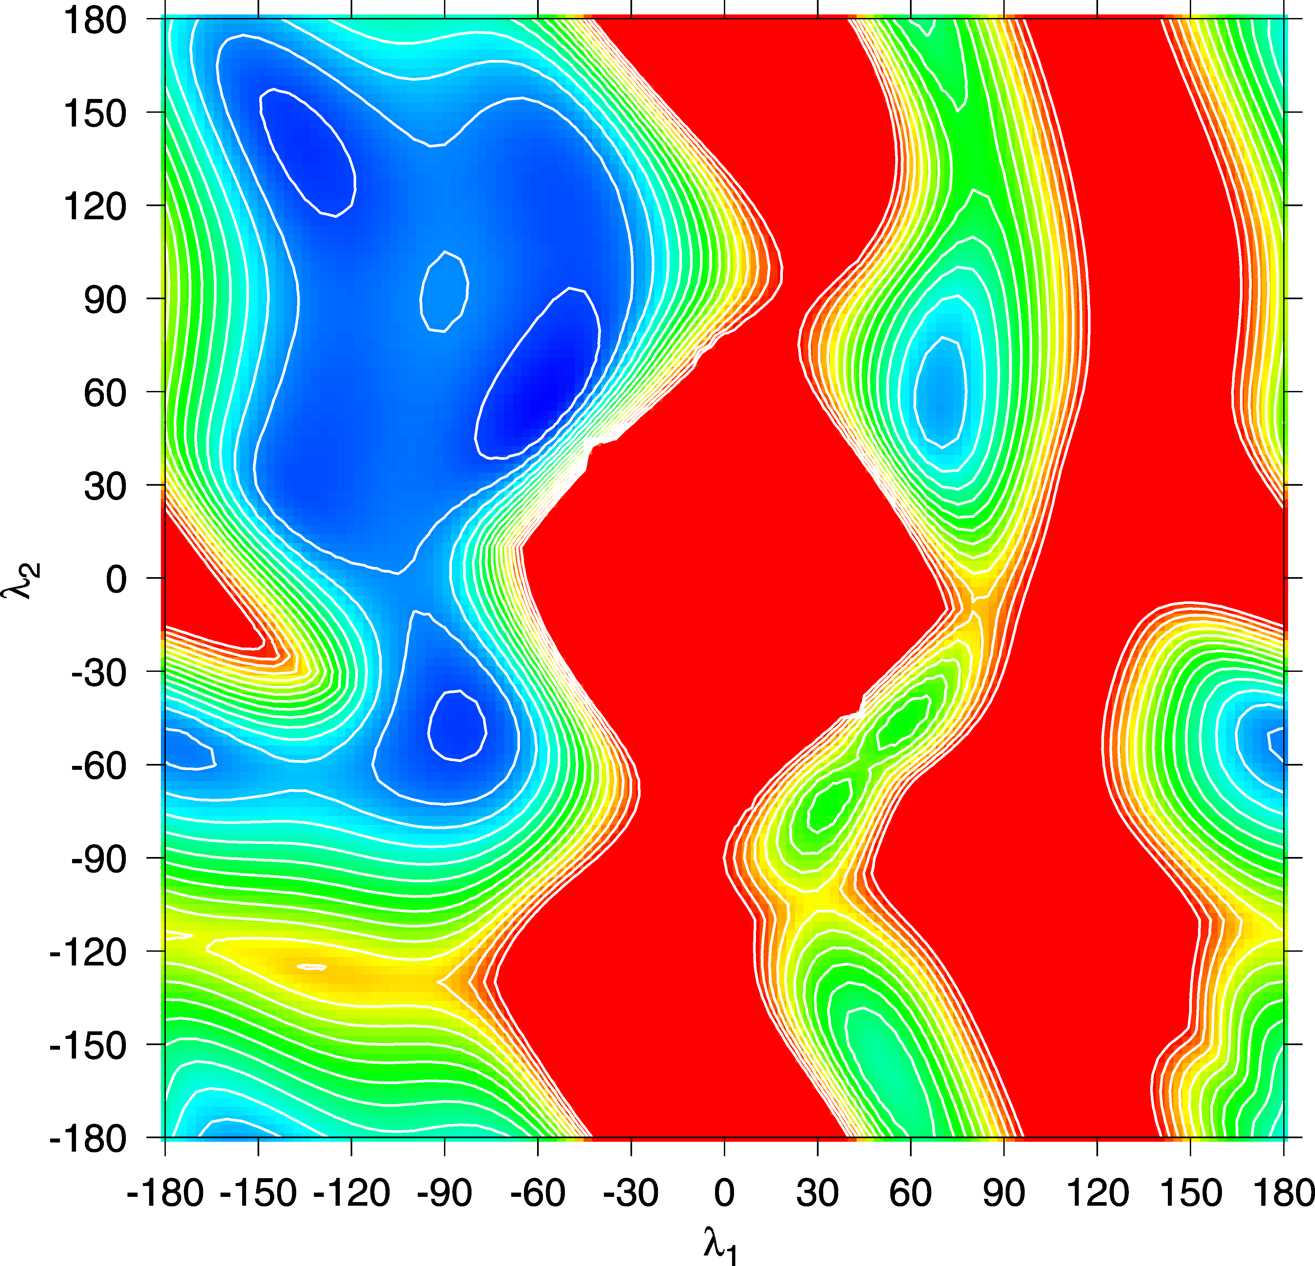
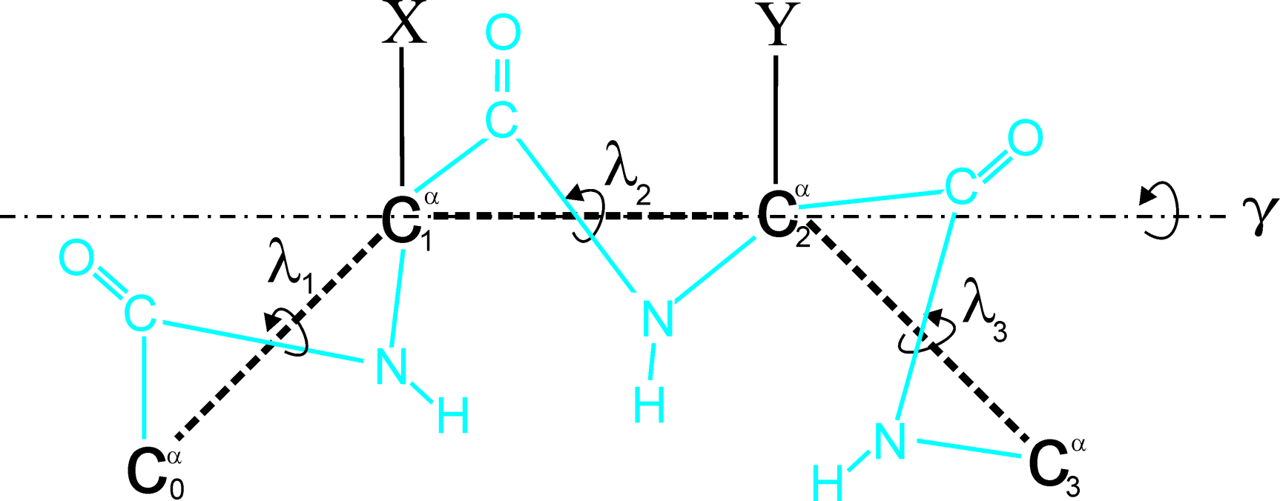
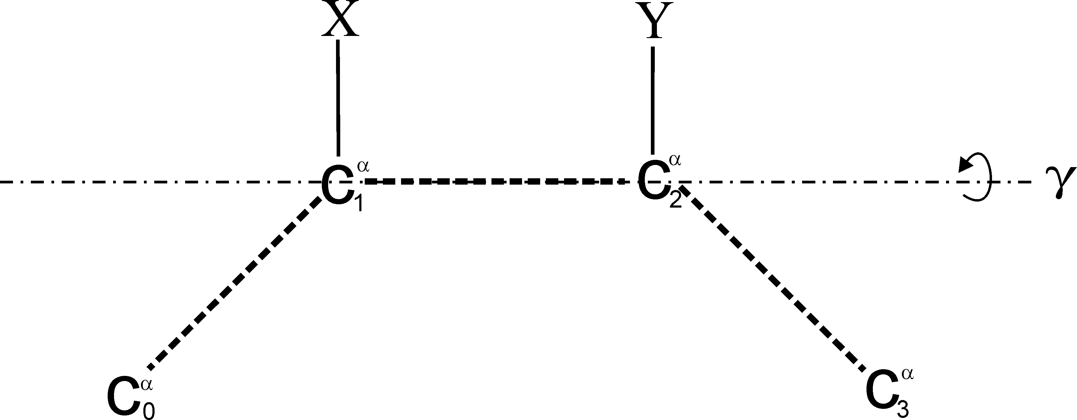
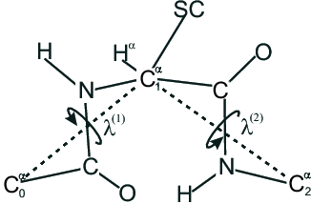
Example: torsional potentials for the rotation about the C^{α}…C^{α} virtual bonds

Slide 26
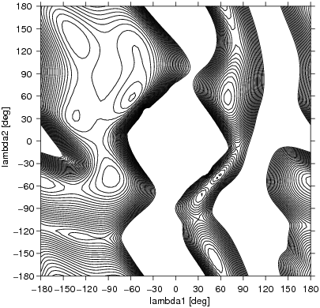
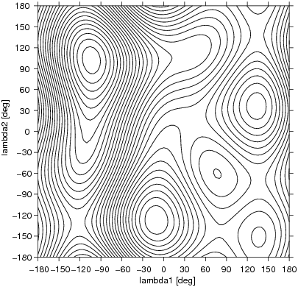
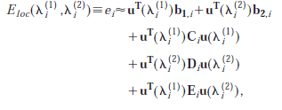

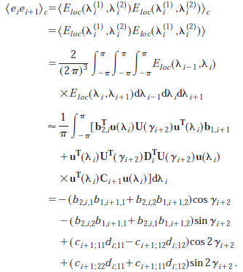
X=Y=Ala; ECEPP3 force field
Liwo et al., J. Chem. Phys., 115, 2323 (2001)

Slide 27
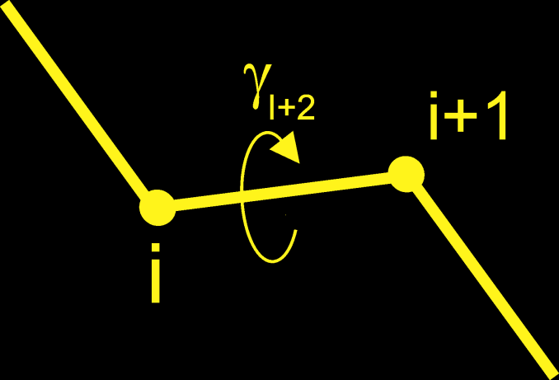
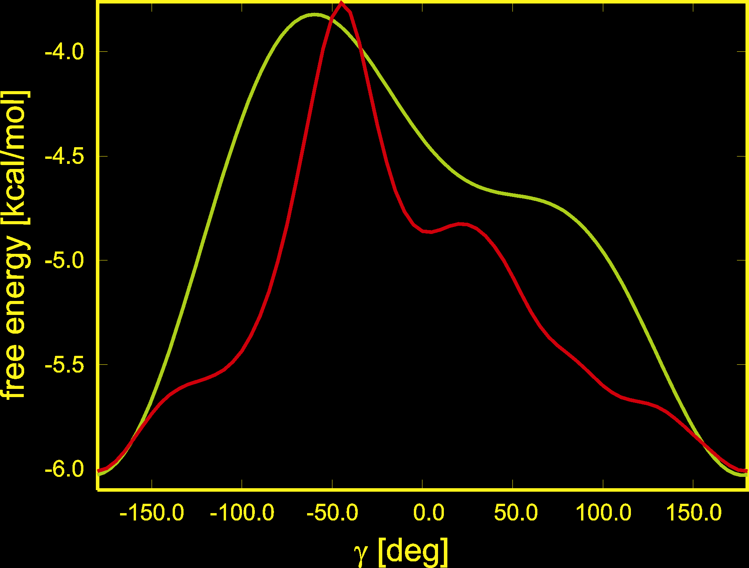
Can we trust this truncated expansion for the RFE ?
Comparison of the torsional RFE curves of the rotation about the C^{α}...C^{α} virtual bond in Ac-Ala-Ala-NHMe calculated by numerical integration (red) and directly from cumulant expansion (green)

Slide 28
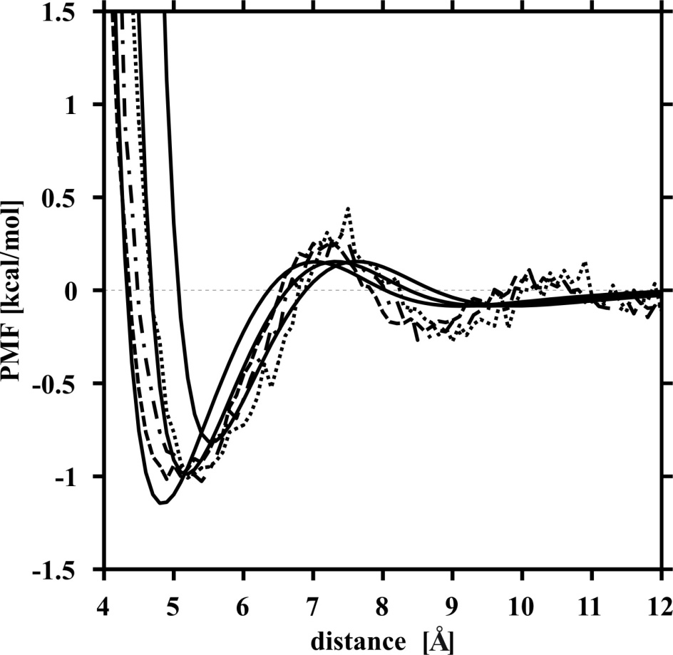
Step 4: Parameterization of functional expressions for RFE factors
Example: SC-SC interaction potentials
Method: Umbrella-sampling MD of models of side-chain pairs in water; WHAM to compute PMFs from simulation results.
Makowski et al., J.Phys.Chem. B, 111, 2925 (2007).
U_{SCSC}(Val-Val) (solid lines: fitted)

Slide 29
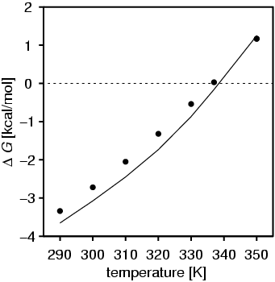
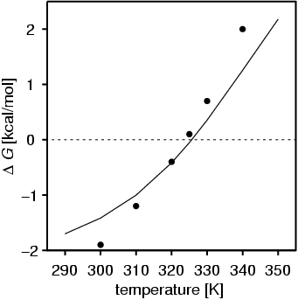
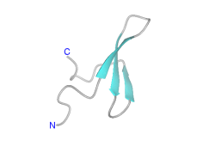
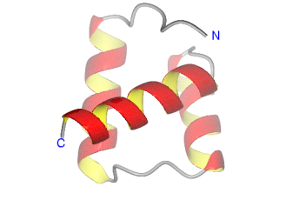
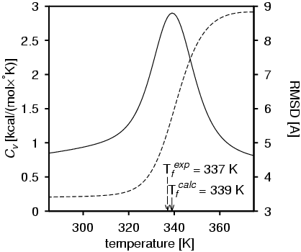
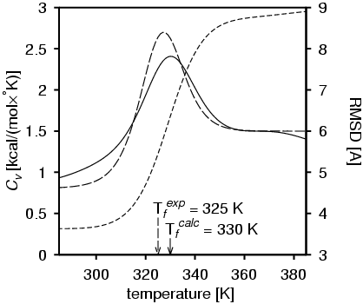
Step 5: Calibration of the force field
1E0L (37 residues)
1ENH (54 residues)

Slide 30
UNRES energy function
The w’s (energy-term weights) are determined by potential-function optimization. All other parameters are determined by fitting model energy surfaces or (some of them) PDB data; however, they can be refined by potential-function optimization.
Liwo et al., Phys.Chem. Chem. Phys., 2011, 13, 16890-16901; in Voth G, editor, Coarse-Graining of Condensed Phase and Biomolecular Systems, Taylor & Francis, 2008, Chapter 8, pp. 107-122.

Slide 31
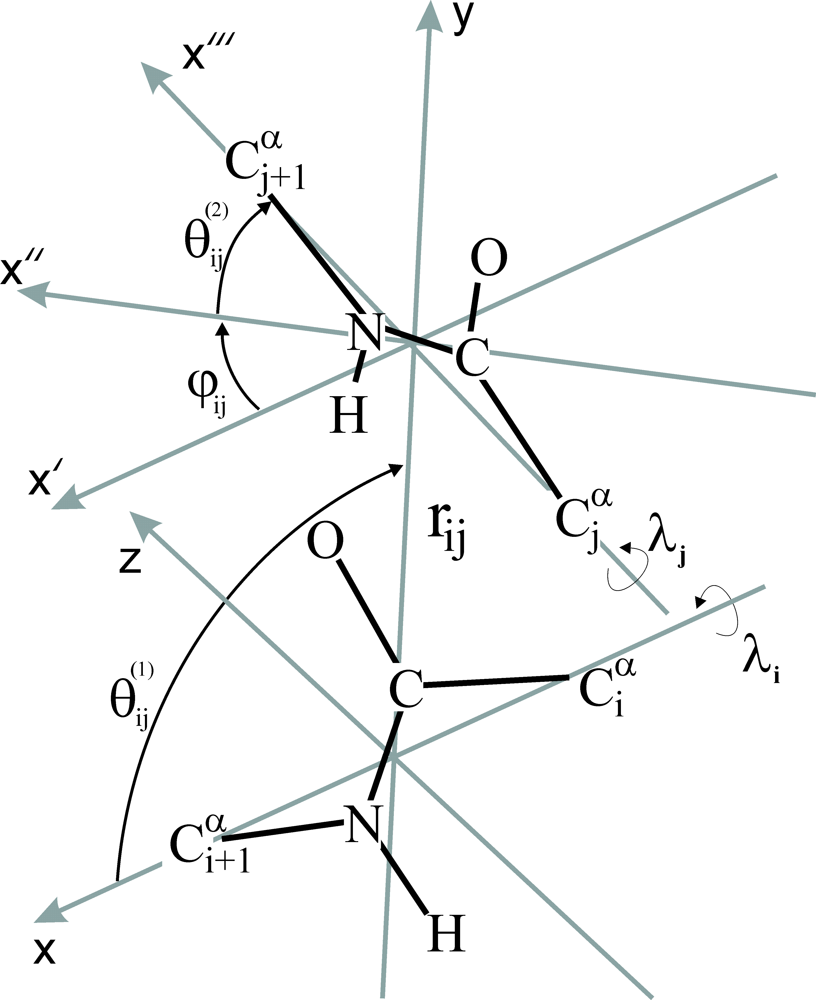
Interactions between backbone peptide groups
μ_{j}
p_{j}
μ_{i}
p_{i}

Slide 32
Analytical expression for the Upp term in UNRES
O
C
C
C
N
H
insignificant

Slide 33
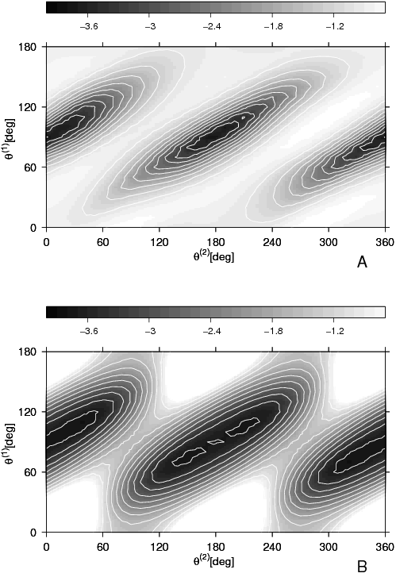
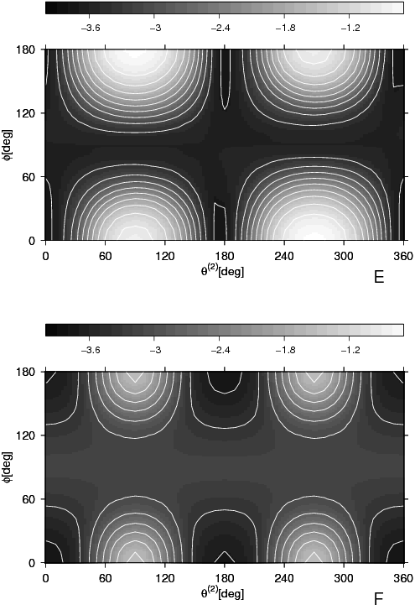
captures the orientation dependence of backbone hydrogen bonding interactions
Approx.
PMF
PMF
Liwo et al., Prot. Sci., 2, 1697 (1993); J. Phys. Chem. B 108, 9421 (2004)

Slide 34
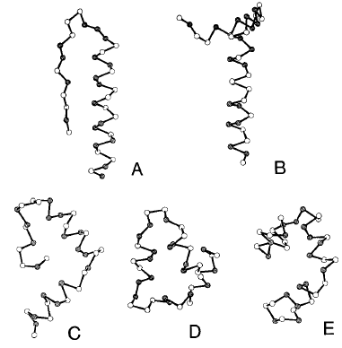
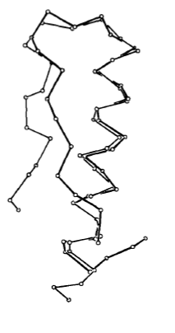
Test with avian pancreatic polypeptide (APP)
Virtual bond lengths and angles fixed
SC-SC potentials from MJ contact energies torsional potentials from ECEPP/2 energy surfaces
Conformational search with Monte Carlo by Minimization (MCM)
Lowest-energy structures
Superposition
(rmsd=3.8 Å)
Liwo et al., Prot. Sci., 2, 1715 (1993)

Slide 35
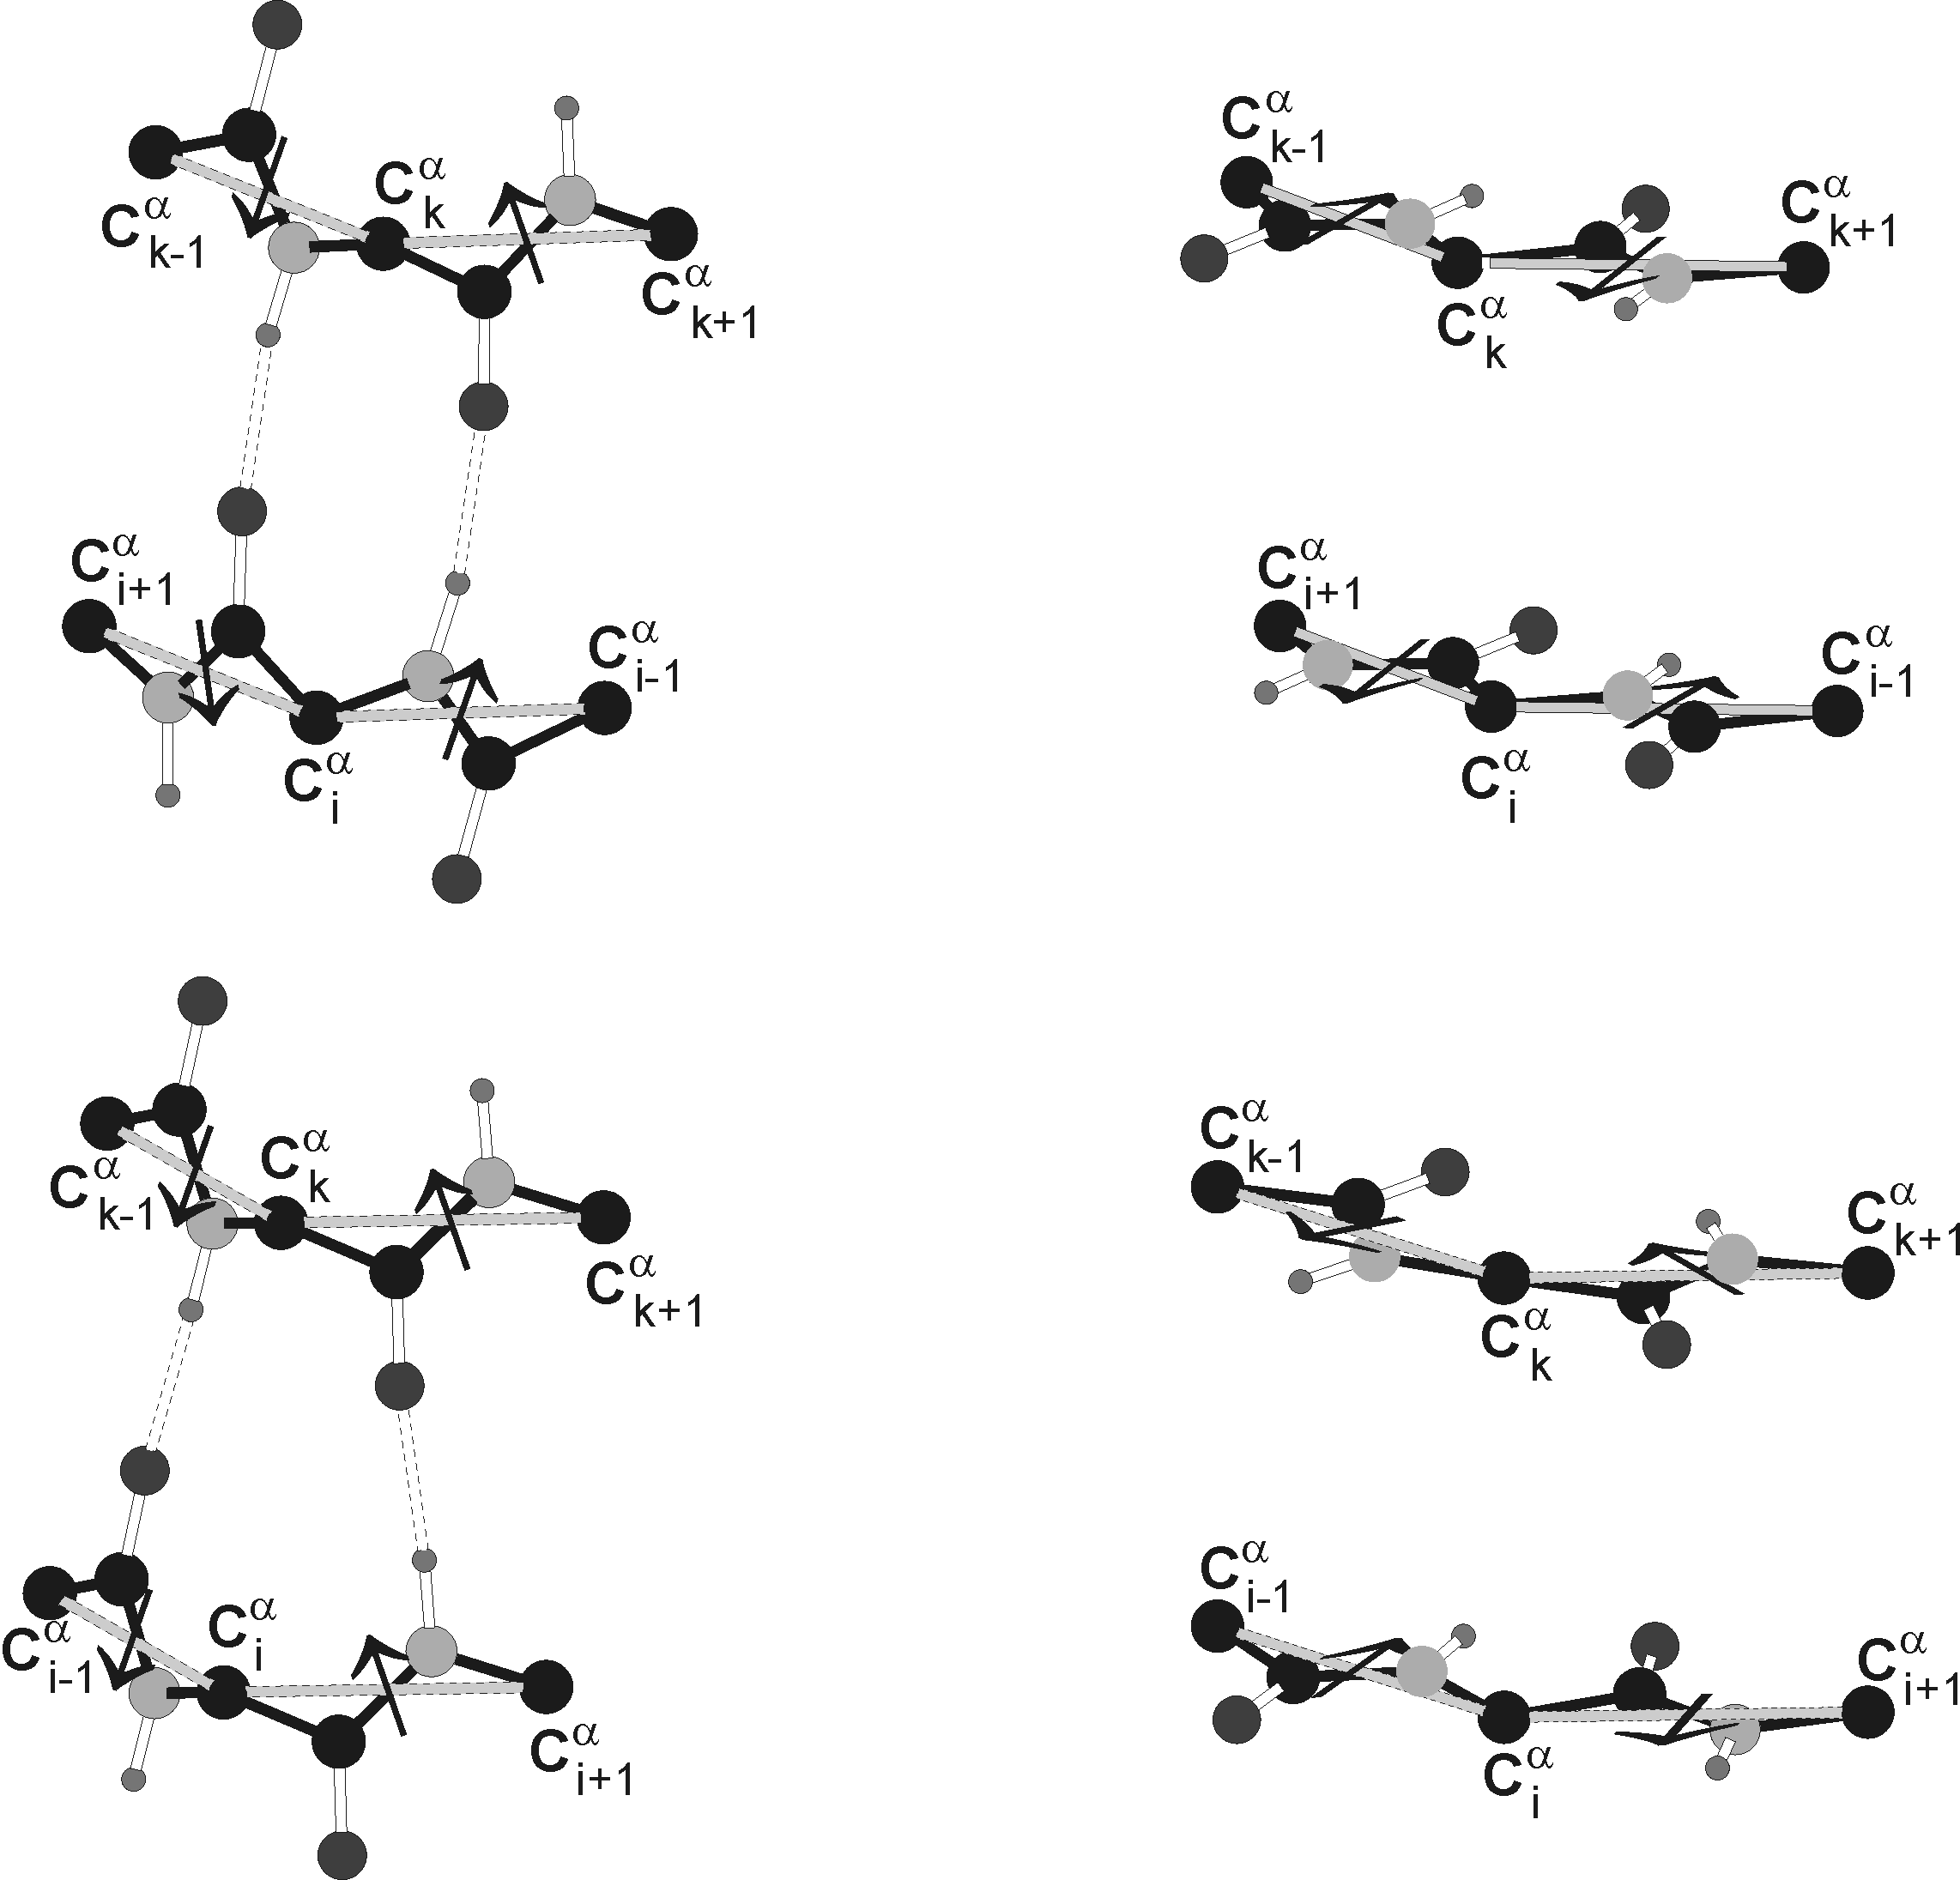
Illustration of the four-body terms in UNRES

Slide 36
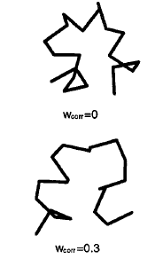
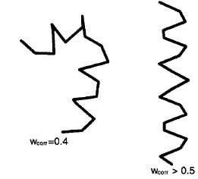
Effect of 4-body backbone-correlation terms on lowest-energy strcutures of Ac-Ala₂₀-NHMe simulated with UNRES
Liwo et al., J.Comput.Chem., 19, 259, 1998

Slide 37
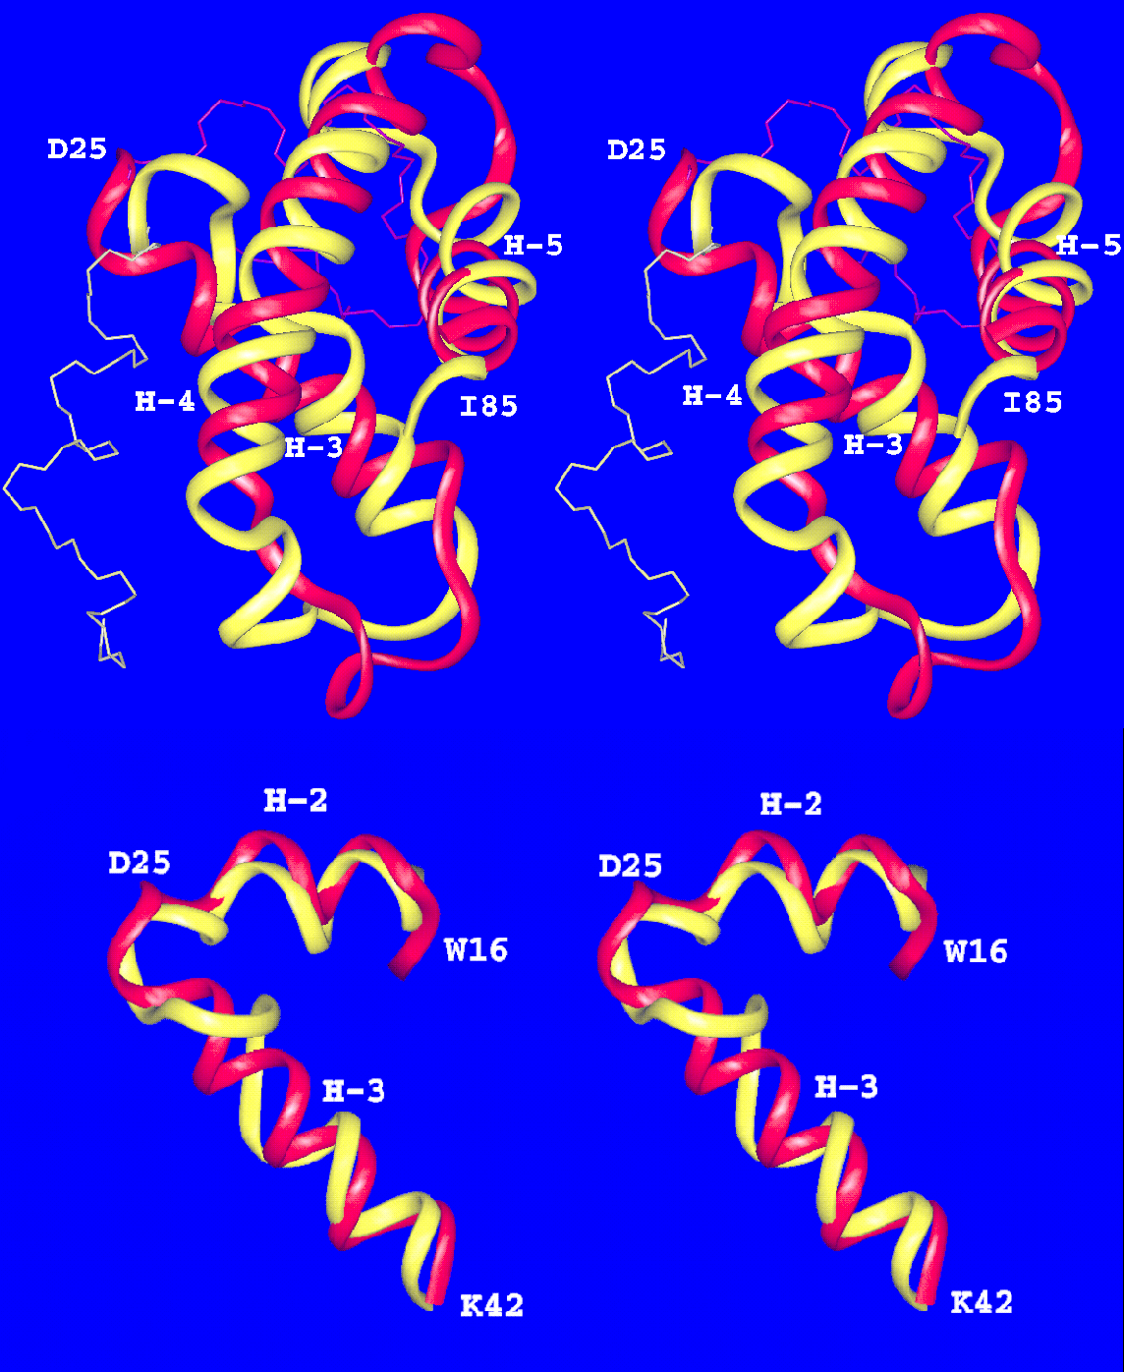
CASP3 target T0061 (HDEA)
RMSD=4.2 Å for 61 residues (80%, residues 25-85)
RMSD=2.9 Å for 27 residues (36%, residues 16-42)

Slide 38
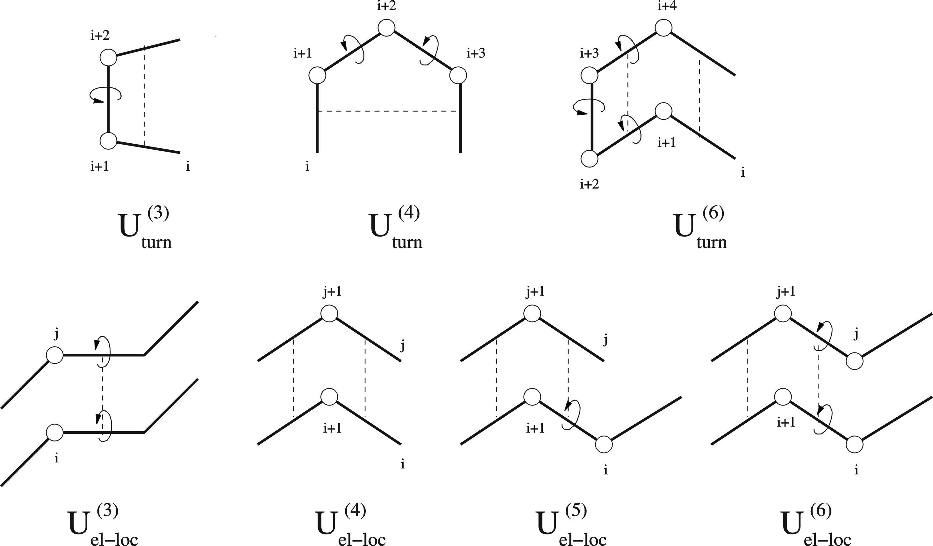
Multibody terms to describe backbone-local backbone-electrostatic correlation in UNRES

Slide 39
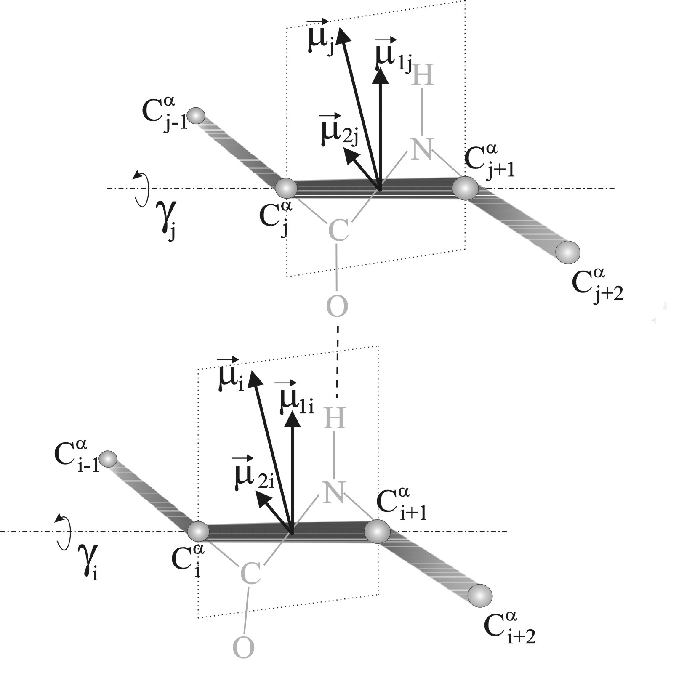
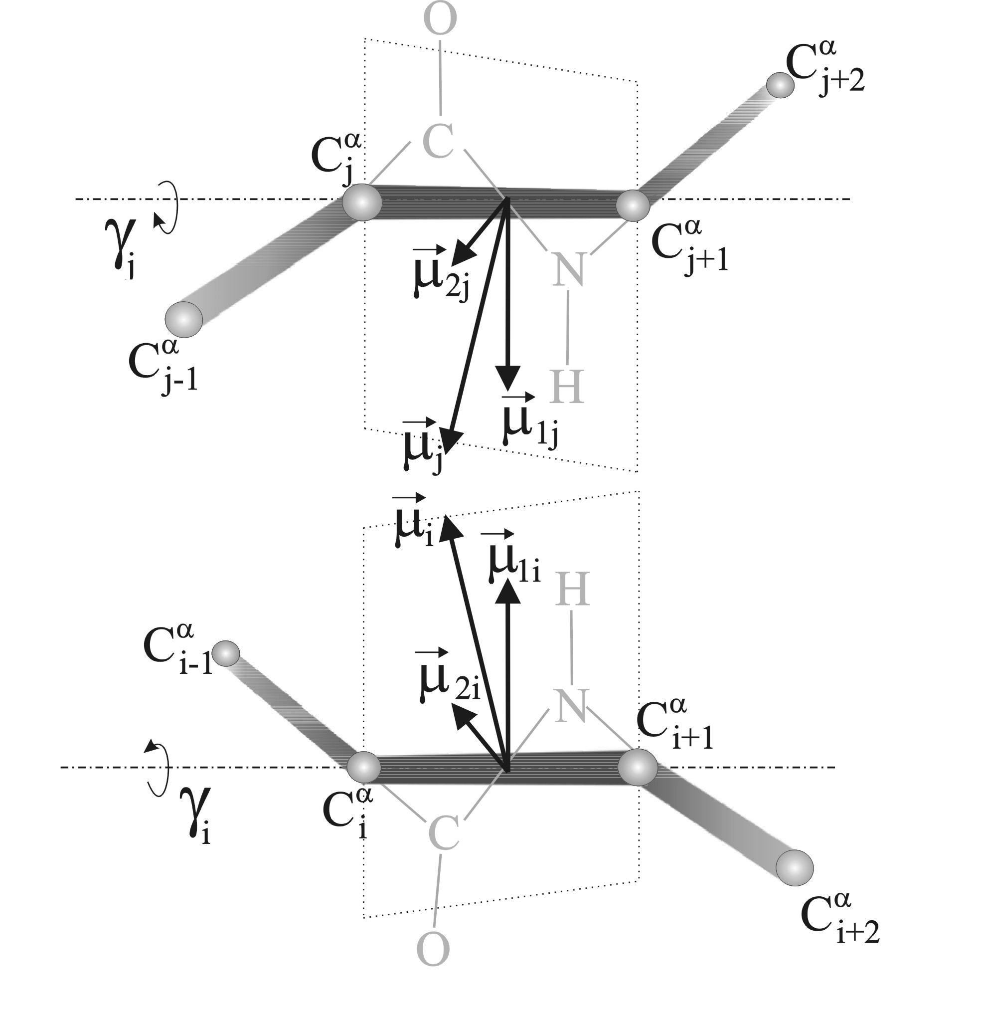
Illustration of the third-order correlation terms in UNRES

Slide 40
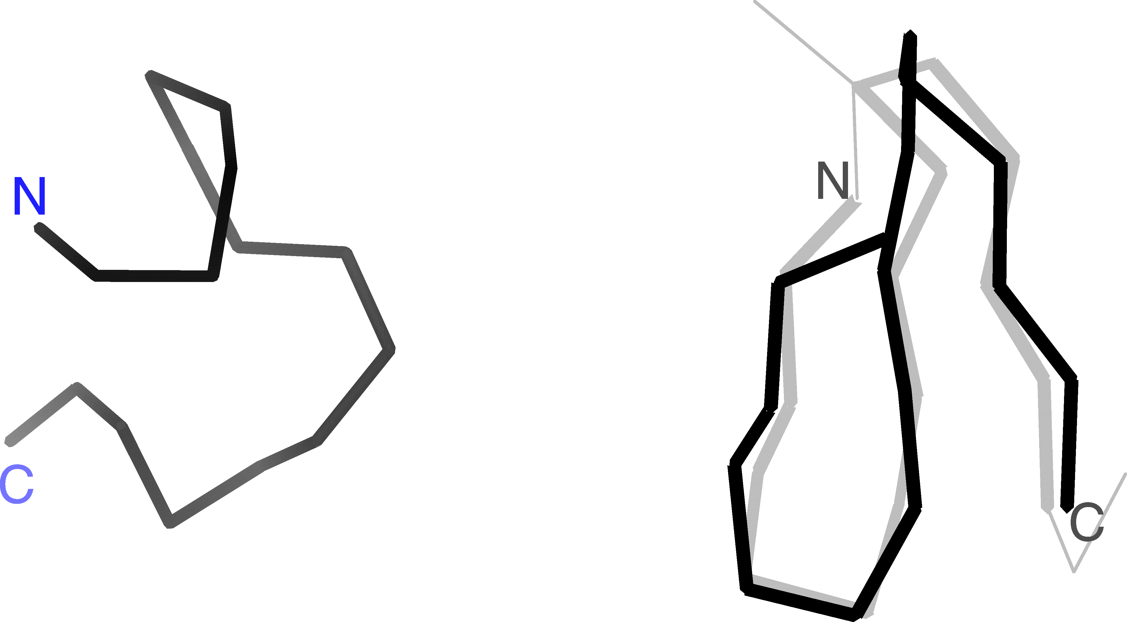
Effect of backbone-local – bacbkbone-electrostatic correlations on force field ability to reproduce β-structure
Without correlation terms
With correlation terms
Liwo et al., J. Chem. Phys., 115, 2323 (2001)

Slide 41
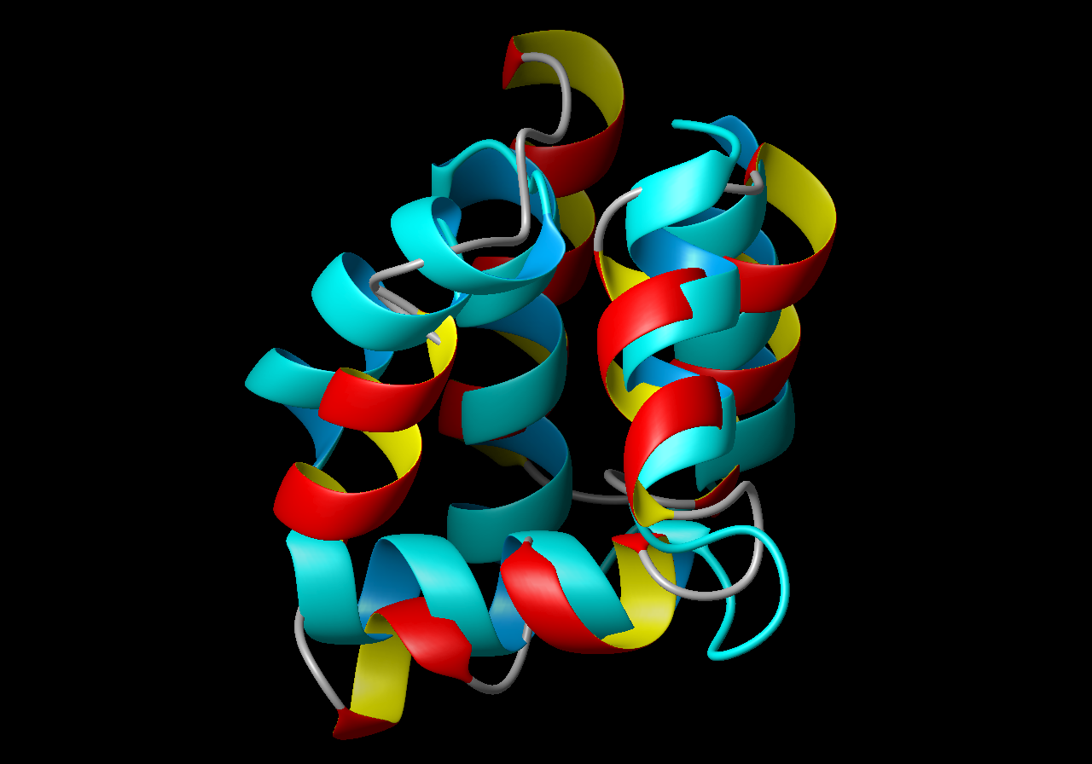
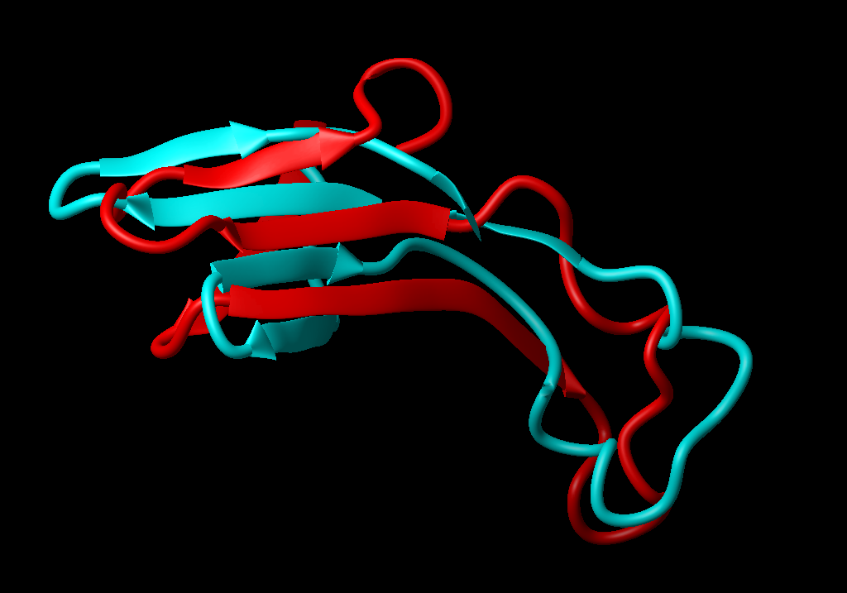
CASP4 Target T0102, RMSD=4.2Å, native, calculated
AS48, Bacteriocin AS-48, E. faecalis, 70 residues, cyclic
CASP4 Target T0126
Superposition of a 57 residue fragment of model 1 (from residue 66) and the experimental structure. C^{α} RMSD 6.5 Å.

Slide 42
Applications of UNRES
Energy-based prediction of protein structures
  Global minimization of the effective energy function
  Determination the most probable ensemble of folded structures
Investigation of protein-folding patways and protein-folding kinetics (coarse-grained molecular dynamics)
Investigation of functionally-important motions of large proteins and protein systems
Investigation of protein-folding thermodynamics (extensions of coarse-grained molecular dynamics)

Slide 43
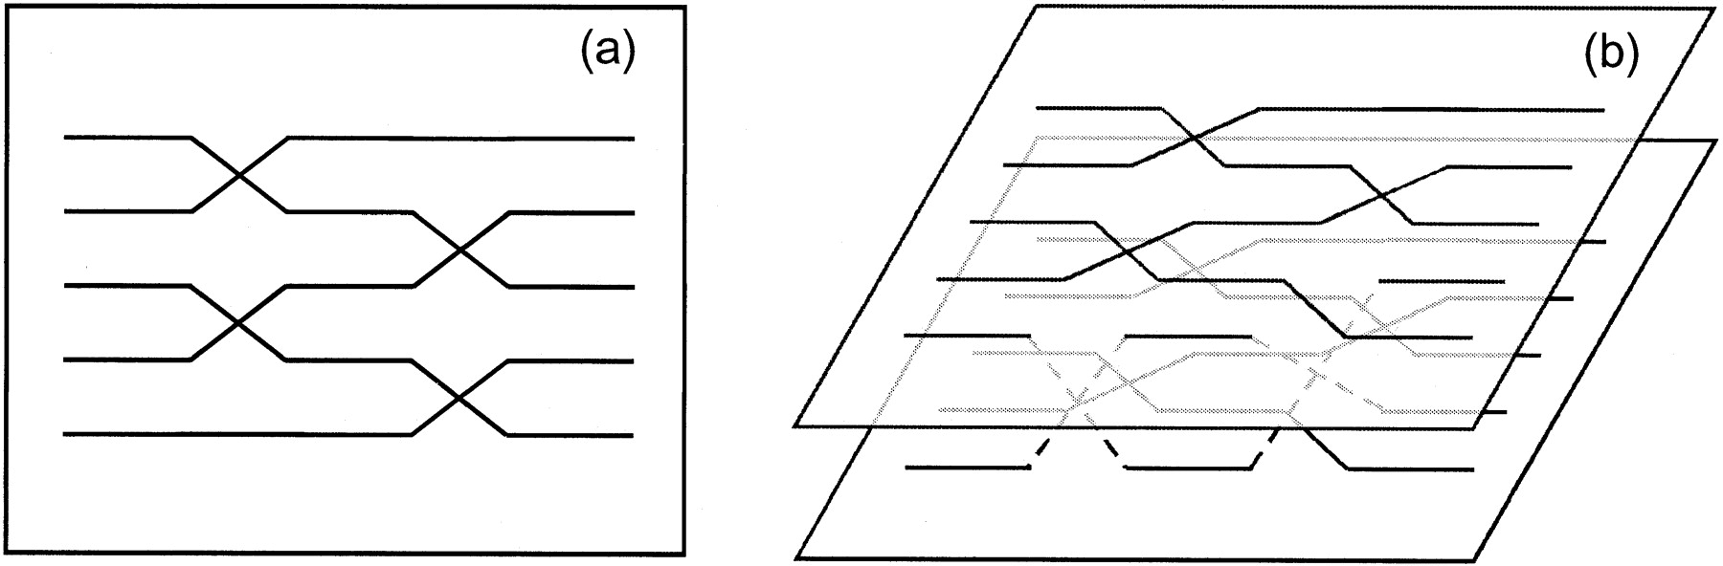
Regular and multiplexed replica exchange algorithm
N independent replicas are simulated independently for a reasonably long time using standard canonical MC or MD
exchange of two neighboring replicas is attempted according to following probability:
regular
multiplexed
Y.Rhee V.Pande, Biophys. J. 84, 775, 2003
Notes:
In the REMD method, n replica systems, each in the canonical ensemble, and each at a different temperature, are simulated. At given intervals, swaps, or exchanges, of the configurational variables between systems are accepted
with the Metropolis criteria.
The multiplexed variant of the RE method (MREMD) developed by Pande differs from the original RE method in that several trajectories are run at a given temperature and exchanges are performed between any replicas with neighboring temperatures.

Slide 44
The Weighted Histogram Analysis Method (WHAM)
R – number of sets of simulations carried out at different temperatures and with different potentials
n_{m} – number of counts of ξ sets (conformations) in mth series of simulations.

Slide 45
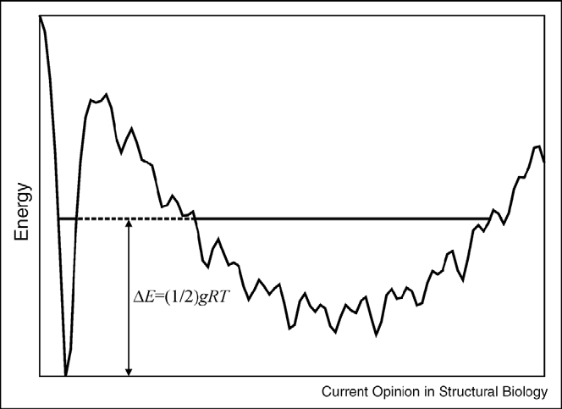
Why does the global minimum of the PES not always characterize the most stable structure?

Slide 46
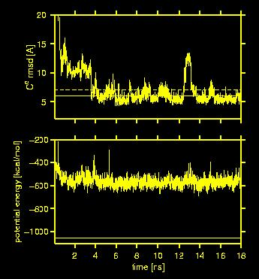
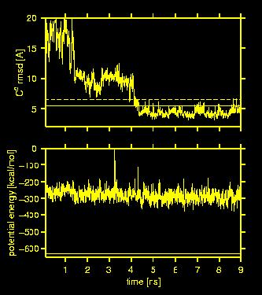
1CLB
1E0G
C^{α}RMSD [Ǻ]
C^{α}RMSD [Ǻ]
potential energy [kcal/mol]
potential energy [kcal/mol]
time [ns]
time [ns]
Lowest potential energy

Slide 47
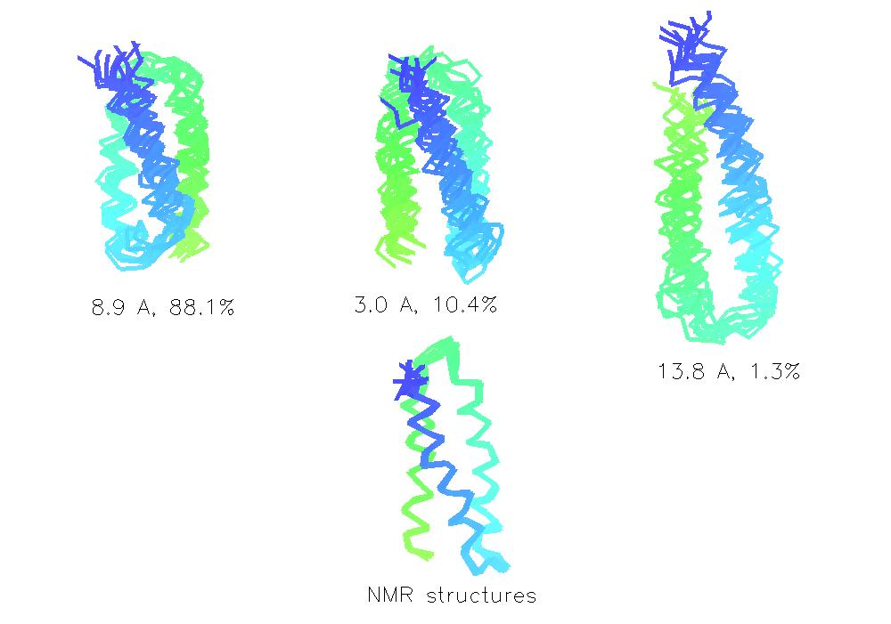
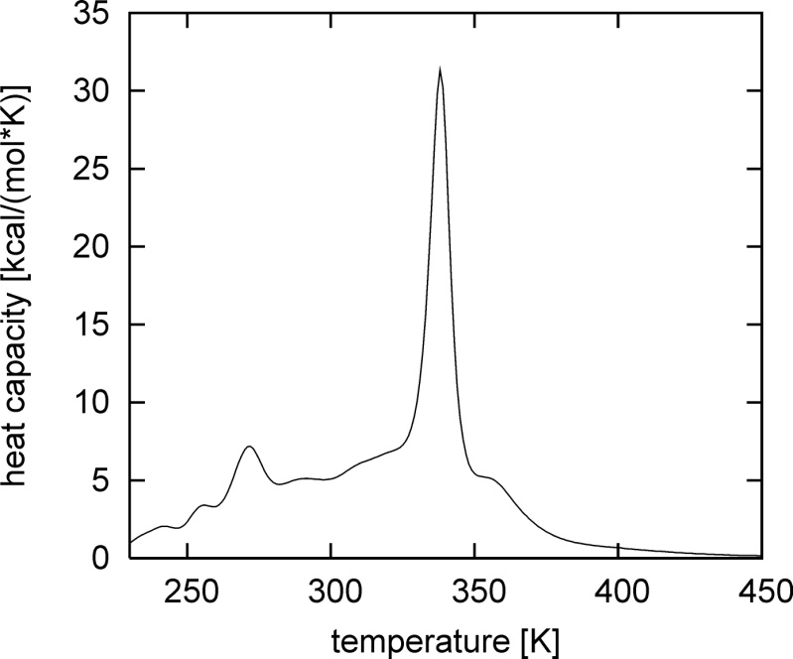
Clusters of 1LQ7 at T=300K (force field optimized on 1GAB)

Slide 48





The folding pathway of the LDL receptor-binding domain
of human apolipoprotein E (PDB code: 1LPE; 143 residues)
simulated with the UNRES/MD approach. The chain is colored
blue to red from the N- to the C-terminus.

Slide 49

Experimental structure of 1BDD (red) and most probable conformations (green) at T = 280 K
N

Slide 50

Thermodynamics and ensemble averages

Slide 51

Protein A @ the folding-transition temperature
Experimental (reference)
rmsd=5.3 Å
Native topology
rmsd=9.5 Å
Native topology
rmsd=8.7 Å
„mirror image” topology
rmsd=9.8 Å
„mirror image” topology
Maisuradze et al., JACS, 2010

Slide 52

Representative structures of PICK1 (blue) bound to the BAR domain obtained in UNRES/MREMD simulations (colored from purple to red from the N- to the C-terminus).
He et al., J. Mol. Biol. 2011, 405, 298-314.

Slide 53

Snapshots from the canonical MD trajectory of a Hsp70 chaperone from E. coli (DnaK) run with the UNRES force field. The chain is colored blue to red from the N- to the C-terminus.
E. Gołaś et al., J. Chem. Theor. Comput., submitted

Slide 54

Experimental structure of open Hsp70 conformation (1bq9; Mayer et al., Molecular Cell 48, 863-874) determined AFTER our simulations were published
UNRES structure (Gołaś et al., J. Chem. Theor. Comput., 2012, 8, 1750-1764)

Slide 55


NARES-2P (nucleic acids)

Slide 56
Effective energy function

Slide 57



Local terms

Slide 58



Base-base interaction terms

Slide 59

Phosphate-phosphate interaction potential
A pair of interacting P(OMe)₂O₂⁻ in water + counter-ions
Umbrella-sampling MD
WHAM to compute PMF

Slide 60

MREMD simulations: simple DNAs
9BNA (2 x 12)
<rmsd> = 4.5 Å
rmsd_{m} = 2.6 Å
2JKY (2 x 21)
<rmsd> = 8.1 Å
rmsd_{m} = 4.2 Å

Slide 61

MREMD simulations: simple RNAs
2KPC (17)
<rmsd> = 5.1 Å
rmsd_{m}=4.2 Å
2KX8 (44)
<rmsd> = 9.7 Å
rmsd_{m}=6.0 Å

Slide 62
Comparison of experimental and NARES-2P calculated melting temperatures of DNAs
T (ºC)
Exp. data from C.B. Hughesman, R.F.B. Turner and C. Haynes, Biochemistry 50, 2642 (2011); 50, 5354 (2011).

Slide 63
Comparison of experimental and NARES-2P calculated enthalpies of melting of DNAs
Exp. data from C.B. Hughesman, R.F.B. Turner and C. Haynes, Biochemistry 50, 2642 (2011); 50, 5354 (2011).

Slide 64
Comparison of experimental and NARES-2P calculated entropies of melting of DNAs
Exp. data from C.B. Hughesman, R.F.B. Turner and C. Haynes, Biochemistry 50, 2642 (2011); 50, 5354 (2011).

Slide 65


Slide 66
The Multiscale Coarse Graining Method
(Force Matching) (Voth and coworkers)
The prototype of the CG energy function is the RFE.
Coordinates of the centers of masses of the CG sites are the CG degrees of freedom.
The sites interact with pairwise central potentials.
A force field is parameterized by least-square fitting of the CG forces to the average forces acting on the CG sites determined by MD simulations of a given system.
Explicit water (a single site per each water molecule).

Slide 67
Average Forces

Slide 68
Approximations and Fitting
Each dφ/dr_{IJ} is represented by values on a grid in r_{IJ,,} a spline, or as a linear combination of analytical functions. The values on the grid or the coefficients of spline/analytical function are determined by solving a linear least—squares problem. Afterwards, the φ’s are obtained by integrating dφ/dr over r.

Slide 72


Slide 76
Thorpe et al., J. Phys. Chem.B, 2008, 112, 20, 13079-13090

