Slide 1
Molecular dynamics (2) Langevin dynamics NVT and NPT ensembles

Slide 2
Langevin (stochastic) dynamics
Stokes’ law
γ_{i} – the friction coefficient of the ith atom
r_{i}, r_{w} – the radii of the ith atom and of water, respectively
η_{w} – the viscosity of water.
Wiener process

Slide 3
The average kinetic energy of Langevin MD simulation corresponds to absolute temperature T and the velocities obey the proper Gaussian distribution with zero mean and RT/m variance.
We can also define the momentary temperature T(t)

Slide 4
Integration of the stochastic equations of motion
(velocity-Verlet integrator)
Ricci and Ciccotti, Mol. Rhys., 2003, 101, 1927-1931.
Ciccotti and Kalibaeva, Phil. Trans. R. Soc. Lond. A, 2004, 362, 1583-1594.

Slide 5
When Δt and the friction coefficient are small, the exponential terms can be expanded into the Taylor series and the integrator becomes velocity-Verlet integrator with friction and stochastic forces

Slide 6
Brownian dynamics
Ignore the inertia term; assume that the motion results from the equilibrium between the potential and fritction+stochastic forces.
Advantage: first-order instead of second-order ODE.
Disadvantages: constraints must be imposed on bonds; energy often grows uncontrollably.

Slide 7
Andersen thermostat
Perform a regular integration step in microcanonical mode.
Select a number of particles, n, to undergo collision with the thermal bath.
Replace the velocities of these particles with those drawn from the Maxwell-Boltzmann distribution corresponding to the bath temperature T₀.

Slide 8
Berendsen thermostat:
derivation from Langevin equations
Therefore:

Slide 10
Berendsen thermostat
τ – coupling parameter
Δt – time step
E_{k} – kinetic energy
: velocities reset to maintain the desired temperature
: microcanonical run
Berendsen et al., J. Chern. Phys., 1984, 81(8) 3684-3690

Slide 11
Pressure control (Berendsen barostat)
L – the length of the system (e.g., box sizes)
β – isothermal compressibility coefficient
τ – coupling parameter
Δt – time step
p₀ – external pressure

Slide 12
Extended Lagrangian method to control temperature and pressure
Lagrange formulation of molecular dynamics
A physical trajectory minimizes L (minimum action principle). This leads to Euler equations known from functional analysis:

Slide 13
Nose Hamiltonian and Nose Lagrangian
s – the coordinate that corresponds to the coupling with the thermostat
Q – the „mass” of the thermostat
g – the number of the degrees of freedom (=3N)

Slide 14
Equations of motion (Nose-Hoover scheme)

Slide 15
Velocity-Verlet algorithm

Slide 16
The NH thermostat has ergodicity problem
velocity
position
position
position
Microcanonical
Andersen thermostat
Nose-Hoover thermostat
Test of the NH thermostat with a one-dimensional harmonic oscillator

Slide 17
Nose-Hoover chains

Slide 18
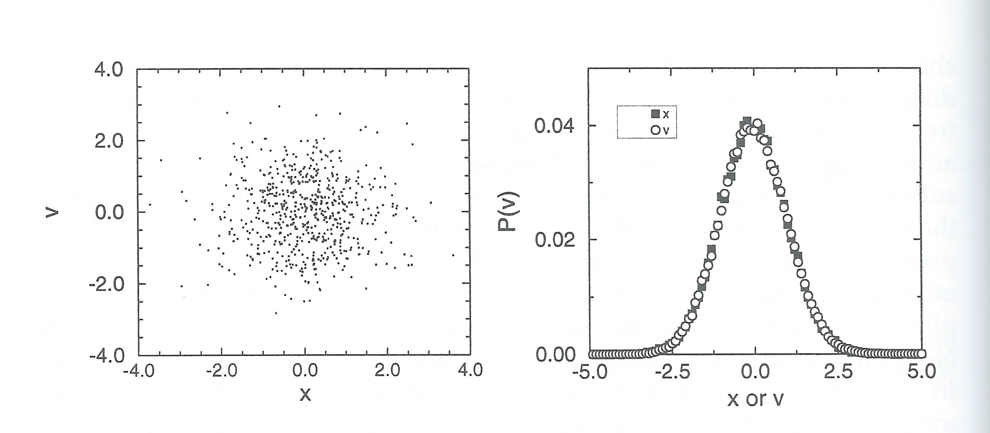
Improvement of ergodicity for the NH chains thermostat
Test with a one-dimensional harmonic oscillator

Slide 19
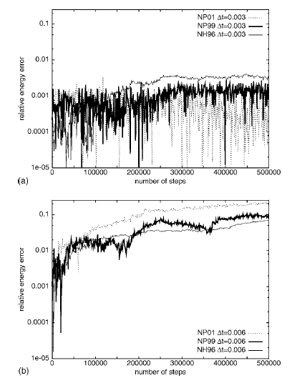
Relative extended energy errors for the 108-particle LJ fluid
Kleinerman et al., J. Chem. Phys., 2008, 128, 245103

Slide 20
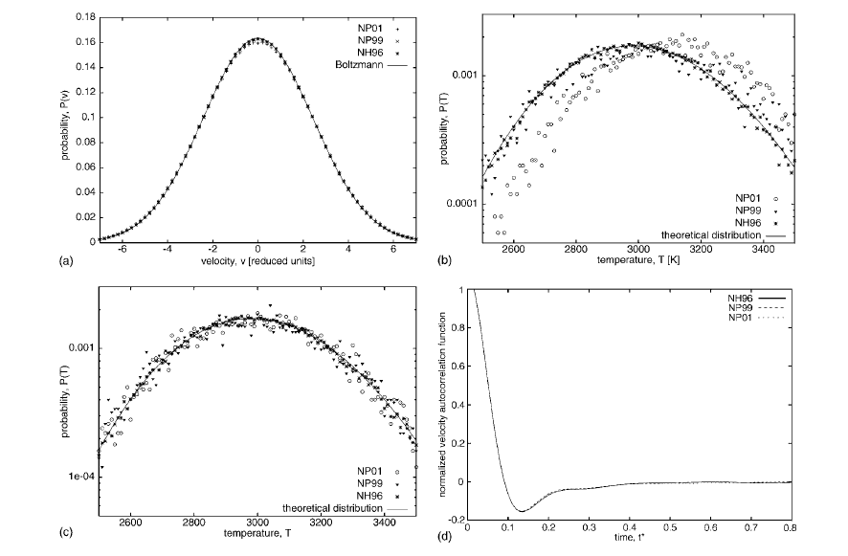
Performance of Nose-Hoover thermostat
for the Lennard-Jones fluid
Kleinerman et al., J. Chem. Phys., 2008, 128, 245103

Slide 21
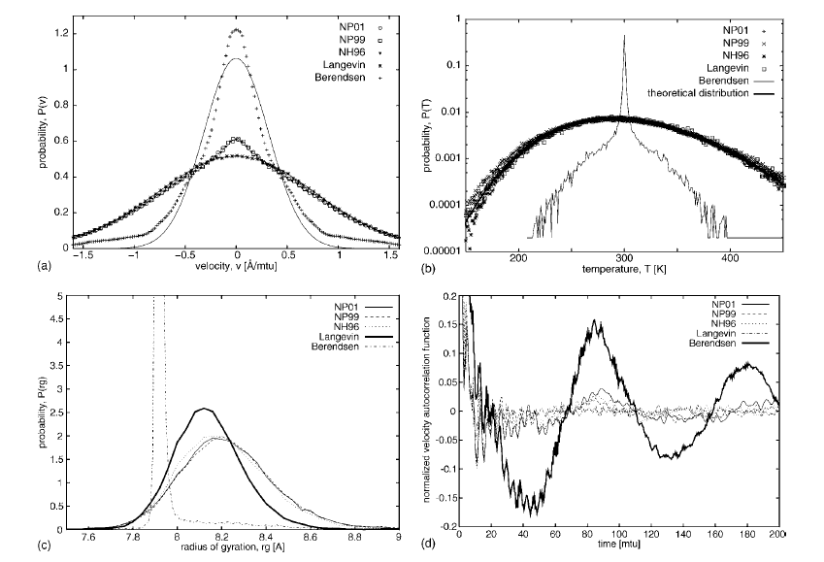
Performance various termostat on decaalanine chain
Kleinerman et al., J. Chem. Phys., 2008, 128, 245103

Slide 22
Extended system for pressure control
(Andersen barostat)
W the „mass” corresponding to the barostat (can be interpreted as the mass of the „piston”)
V is the volume of the system

Slide 23
Isothermal-isobaric ensemble
d is the dimension of the system (usually 3)
g is the number of degrees of freedom
W the „mass” corresponding to the barostat
Q is the”mass” corresponding to the thermostat
Martyna, Tobias, and Klein, J. Chem. Phys., 1994, 101(5), 4177-4189

Slide 24
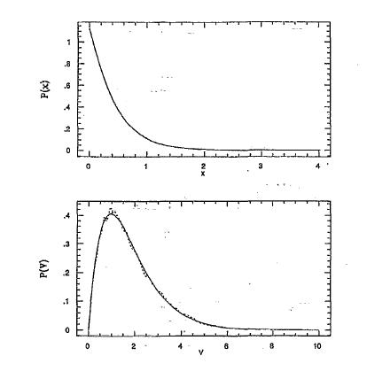
Martyna-Tobias-Klein NPT algorithm:
tests with model systems
Model 1-dimensional system: position distribution
Model 3-dimensional system: volume distribution
Martyna, Tobias, and Klein, J. Chem. Phys., 1994, 101(5), 4177-4189

Slide 25
The Langevin piston method (stochastic)
Feller, Zhang, Pastor, and Brooks, J. Chem. Phys., 1994, 103(11), 4613-4621

Slide 26
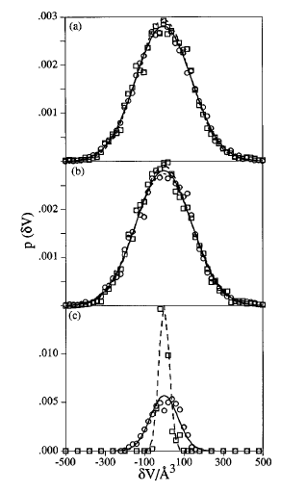
W=5
W=25
W=225
Extended Hamiltonian method
γ=0 ps⁻¹
γ=20 ps⁻¹
γ=50 s⁻¹
Langevin piston method (W=25)
τ_{p}=1 ps
τ_{p}=5 ps
Berendsen barostat
Feller, Zhang, Pastor, and Brooks, J. Chem. Phys., 1994, 103(11), 4613-4621

