Slide 1
Molecular dynamics (3) Equations of motion for (semi) rigid molecules. Restrained MD.

Slide 2
Reasons to introduce (semi) rigid treatment
The motions involving the deformations of the X-H bonds are largely decoupled from other motions.
Treat large systems (torsional-angle dynamics, quaternion dynamics).
Treat explicit solvent molecules. If flexible, whole dynamics concentrates on the concerted low-frequency vibrations of solvent bonds.

Slide 3
Example: TIP3P water
0.9572 Å
0.9572 Å
0.9572 Å
0.9572 Å
104.52º
1.8533 Å
These are CONSTRAINTS and have to be satisfied EXACTLY during an MD simulations.
RESTRAINTS are satisfied only APPROXIMATELY through introduction of a penalty function.

Slide 4
How do we introduce constraints?
Solve the equations of motion in the generalized coordinates that imply satisfying the constraints (e.g., dihedral angles).
Solve the equations of motion subject to holonomic constraints (functions of coordinates).
Both methods require the application of the Lagrange-Hamilton formalism.

Slide 5
Lagrange-Hamilton formulation of dynamics
Lagrangian
Euler’s equation for the trajectory q(t) that minimizes the Lagrangian.
Expression for the kinetic energy of a system composed of point masses.
For
We obtain
2nd Newton’s law.

Slide 6
Holonomic constraints: formulation

Slide 7
Holonomic constraints: Lagrangian extremal
We apply the Lagrange multiplier method to incorporate the constraints into the functional.

Slide 8
Holonomic constraints: equations of motion
The multipliers λ₁,λ₂,…, λ_{m} are functions of t; therefore, the equations of motions constitute a system of 3N+m algebro-differential equations with 3N+m unknowns. Algorithms for their solution are coupled with integration scheme.

Slide 9
Verlet scheme with constraints: the SHAKE algorithm
The multipliers λ₁, λ₂,…, λ_{m} are obtained by solving the equations for constraints.

Slide 10
Can be omitted (order of Δt⁴)

Slide 11
The SHAKE algorithm
Compute r_{i}’ for each atom. Initialize δr_{i}
Solve the equations for λs for each constraint independently.
Compute δr_{i}^{new}
||δr^{new}−δr^{old}||<tol
stop
Ryckaert, Ciccotti & Berendsen, J. Comp. Phys., 1977, 23, 321-341

Slide 12
The velocity Verlet version of SHAKE: RATTLE

Slide 14
The constraints on r(t+Δt) and v(t+Δt) are functions of λs.
As in SHAKE, only the linear terms are considered.
Equations for λs are solved constraint-wise, as in SHAKE until convergence.
Andersen, J. Comp. Phys., 1983, 52, 24-34

Slide 15
LINCS (LiNear Constraint Solver)
The first and second derivatives of the constraints are zero.

Slide 16
The first and second derivatives of the constraints are zero.

Slide 18
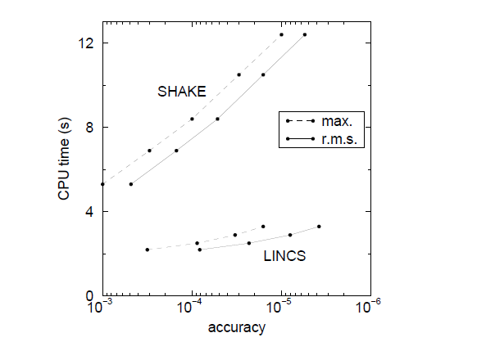
Hess, Bekker. Berendsen, Fraaije, J. Comput. Chem. 1997

Slide 19
Rigid-body dynamics
The motion is separated into the motion of the centers of masses and body-reference rotations of the rigid bodies.

Slide 20
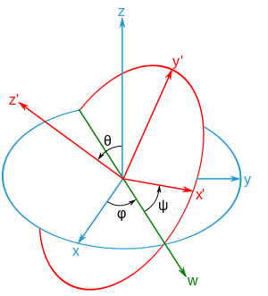
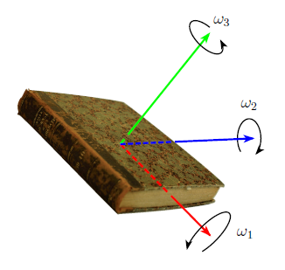
Angular velocities (in body-based frame)
Singular if sin θ = 0

Slide 21
Quaternion properties

Slide 22
Quaternion equations of motion

Slide 23
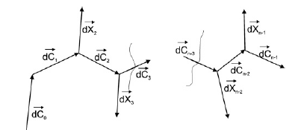
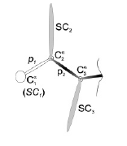
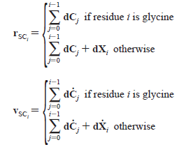
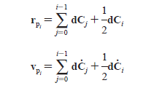
UNRES: constraints imposed by placing united peptide groups exactly in the middle between C^{α} atoms
Khalili, Liwo, Rakowski, Grochowski, Scheraga, J. Phys. Chem. B, 2005, 109, 13785-13797

Slide 24
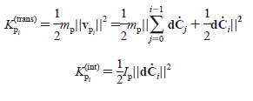
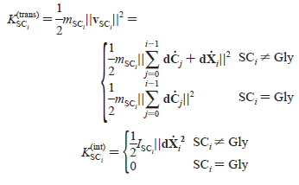

Slide 25
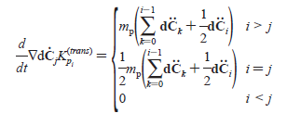
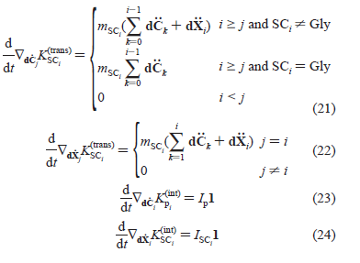

Slide 26
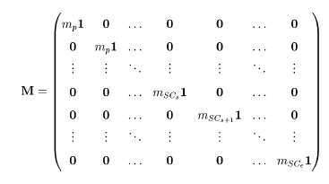
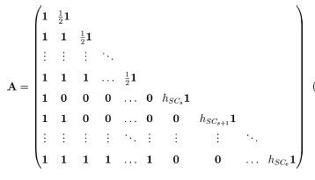
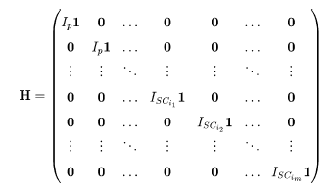

Slide 27
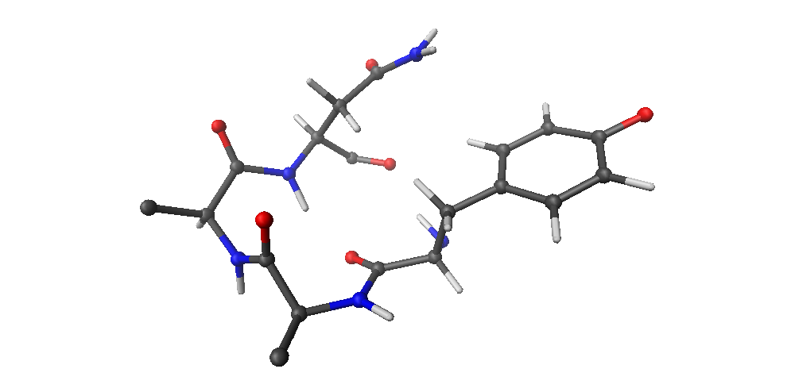
Restrained dynamics
Distance restraint
Dihedral-angle restraint

Slide 28
Flat-bottom restraints (AMBER)
V
x₁
x₂
x₃
x₄
x

Slide 29
Time-averaged restraints

Slide 30
Flat-bottom quartic restraints

Slide 31
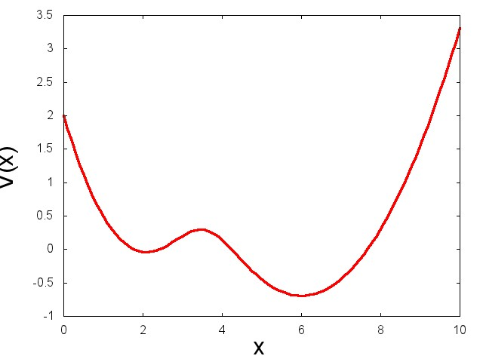
Harmonic and log-Gaussian restraints
e.g. in umbrella sampling
e.g. in Modeller to reconcile restraints from different templates

Slide 32
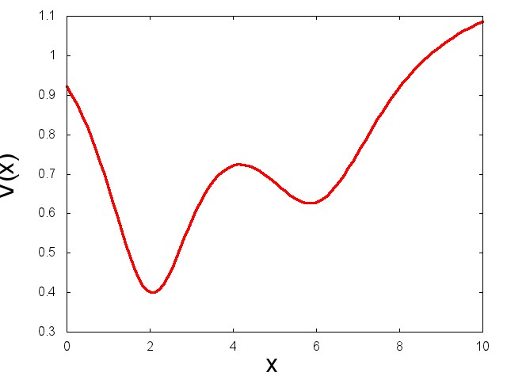
Lorentzian restraints

