Slide 1
Coarse-Grained Models for Proteins

Slide 2
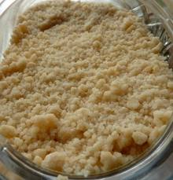
What is coarse-graining?
coarse-grained - composed of or covered with particles resembling meal in texture or consistency; "granular sugar"; "the photographs were grainy and indistinct"; "it left a mealy residue" of textures that are rough to the touch or substances consisting of relatively large particles; "coarse meal"; "coarse sand"; "a coarse weave"
coarse-grained - not having a fine texture; "coarse-grained wood"; "large-grained sand"- of textures that are rough to the touch or substances consisting of relatively large particles; "coarse meal"; "coarse sand"; "a coarse weave"
Based on WordNet 3.0, Farlex clipart collection. © 2003-2011 Princeton University, Farlex Inc.

Slide 3
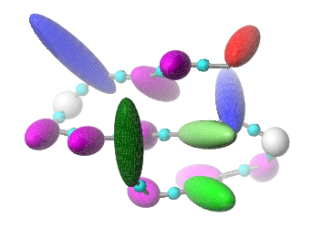
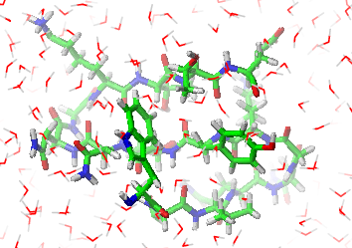
In Physics, Molecular Science, Molecular Modeling:
Coarse graining: reducing the representation of a system or a phenomenon.
Physicists prefer the term renormalization.

Slide 4
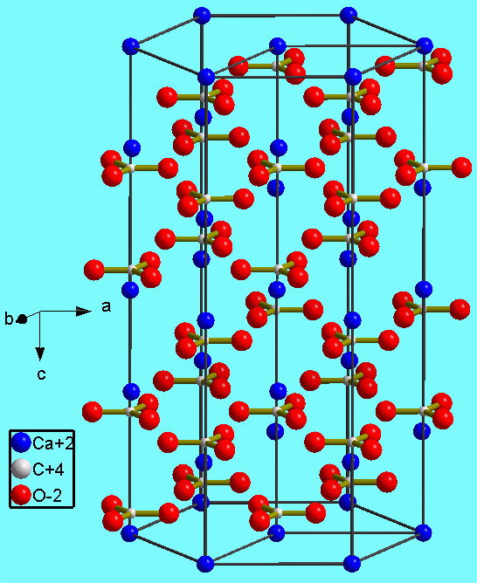
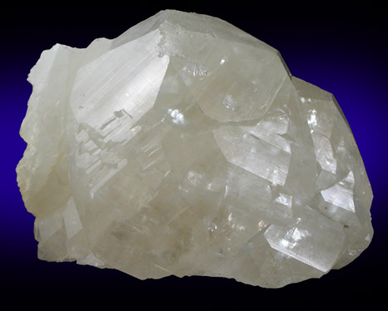
Coarse graining: from micro- to macro-scale
Calcite: specimen from Shullsburg District, Lafayette County, Wisconsin (courtesy of the Online Mineral Museum)
Calcite: crystallographic structure

Slide 5


Fine-grain structure does not matter in such applications…

Slide 6
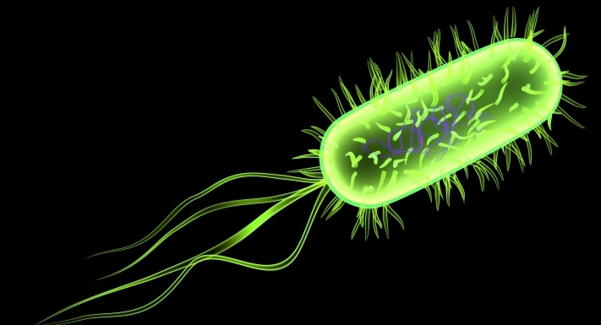
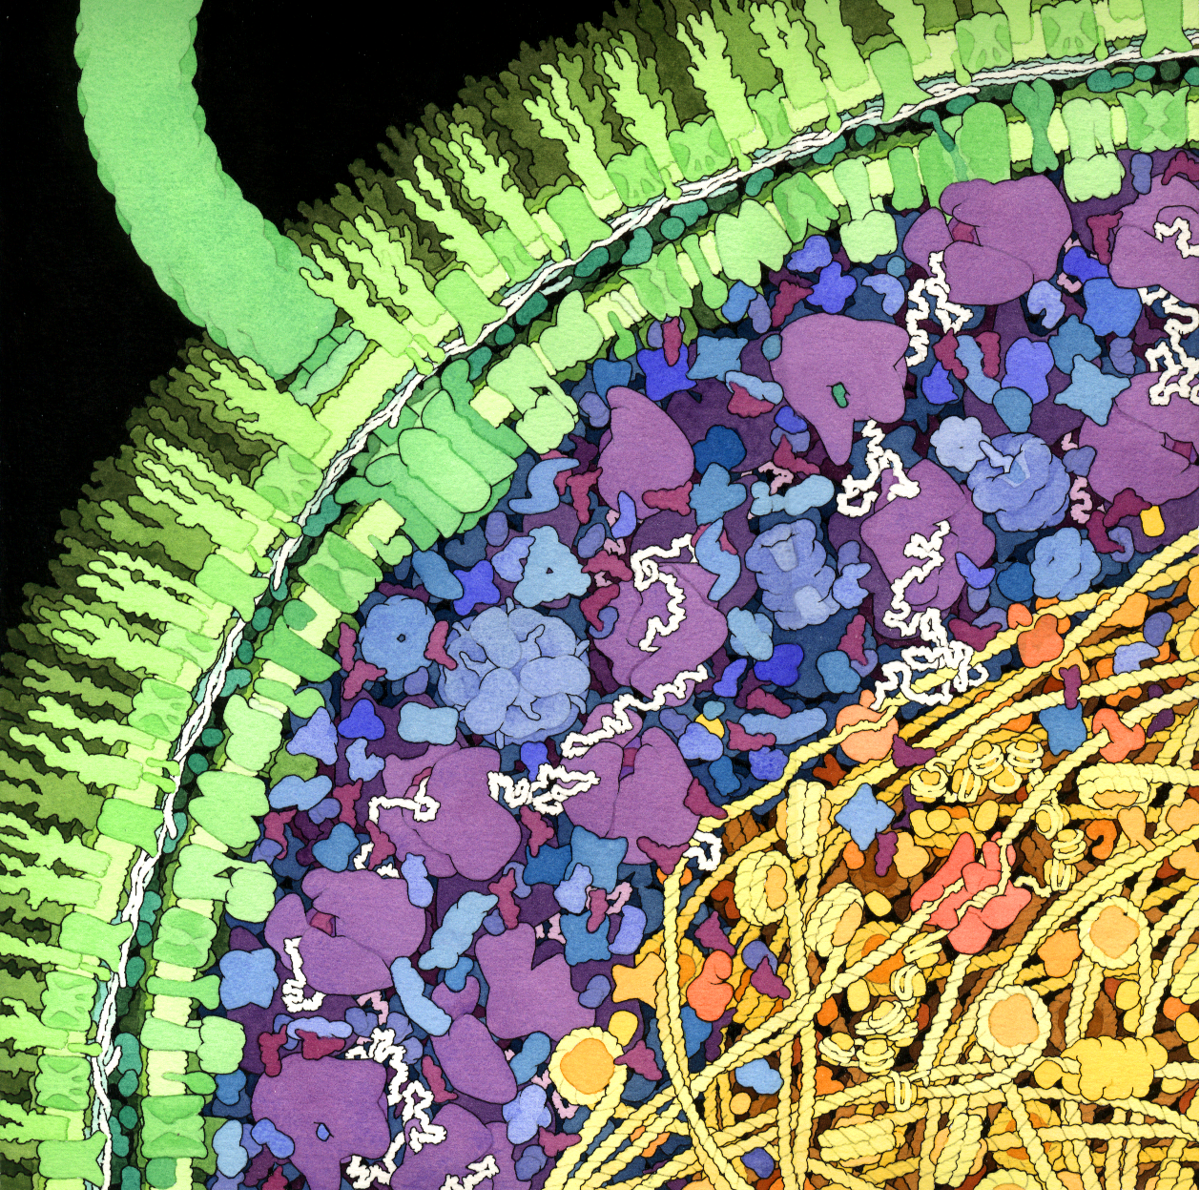
A cross-section of a small portion of an E. coli bacterium
Flagellar motor
Flagellum
Cell wall
Enzymes
m-RNA
Ribosomes
HU protein (bacterial nucleosome)
Cytop;lasm
DNA
Nucleoid
© David S. Goodsell 1999.
Molecular Grahics Laboratory
Scripps Research Institute, La Jolla, CA

Slide 7

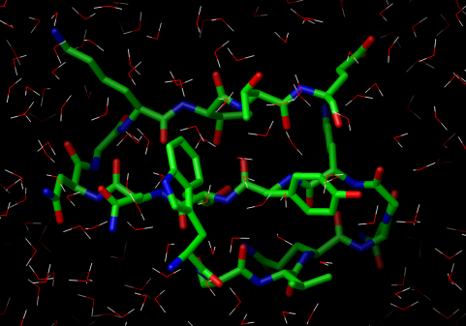
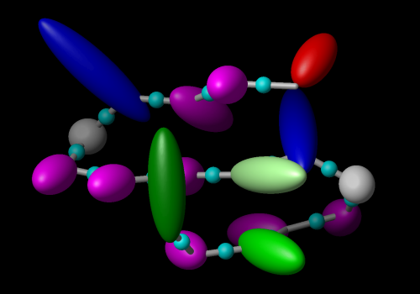
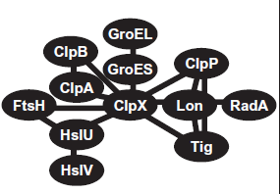

Fully-detailed
QM
Averaging over „less important” degrees of freedom
QM/MM
Averaging over individual components
Individual components
Atomistically-detailed
All-atom
United-atom
Description level
Residue level
Coarse-grained
System level
(Networks)
PDEs to describe reaction/diffusion
Molecule/domain level
Network graphs

Slide 8
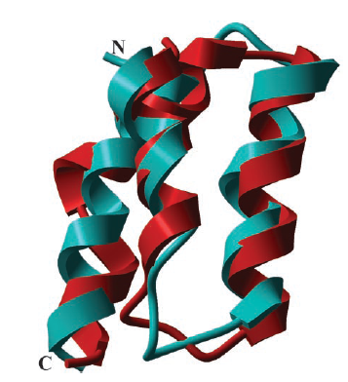
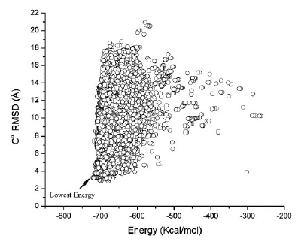
Global optimization of the energy surface of the N-terminal portion of the B-domain of staphylococcal protein A with all-atom ECEPP/3 force field + SRFOPT mean-field solvation model (Vila et al., PNAS, 2003, 100, 14812–14816)
Superposition of the native fold (cyan) and the conformation (red) with the lowest C^{α} RMSD (2.85 Å) from the native fold
Energy-RMSD diagram

Slide 9
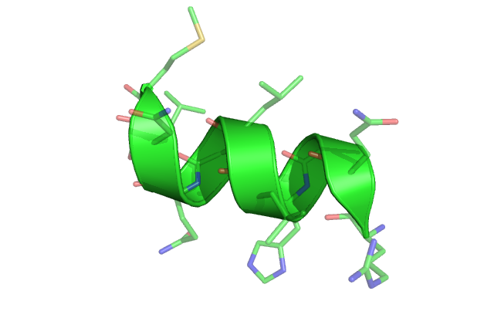
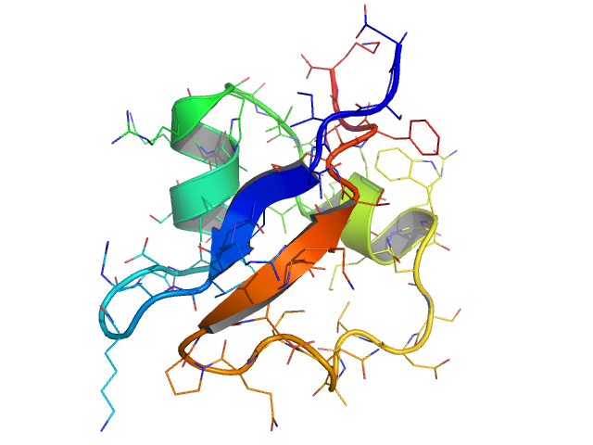
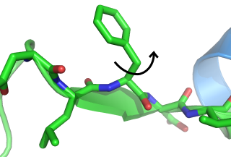
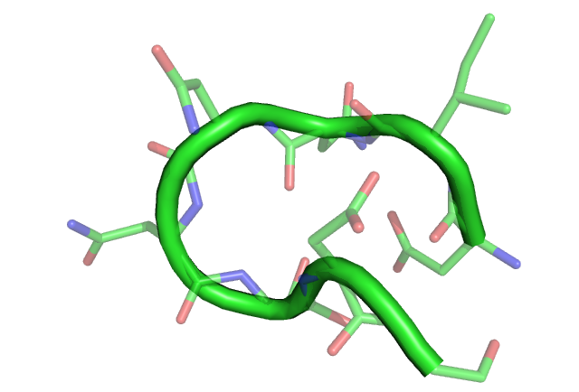
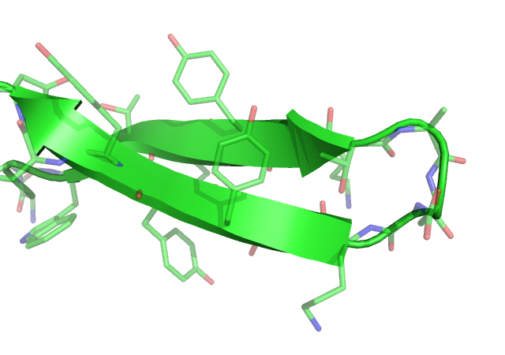
sidechain
rotation
helix
formation
protein
folding
10⁻¹⁵
femto
10⁻¹²
pico
10⁻⁹
nano
10⁻⁶
micro
10⁻³
milli
10⁰
seconds
bond
vibration
loop
closure
folding of
β-hairpins
all atom MD step

Slide 10
Time step Δt for some standard MD packages
MD Package | Explicit Solvent | Implicit Solvent
AMBERª | 1 fs | 2 fs
CHARMM^{b} | 3 fs | 4-5 fs
TINKER^{c} | 1 fs | 2 fs
ª http://amber.scripps.edu/
^{b} http://www.charmm.org/
^{c} http:// dasher.wustl.edu/tinker/

Slide 11
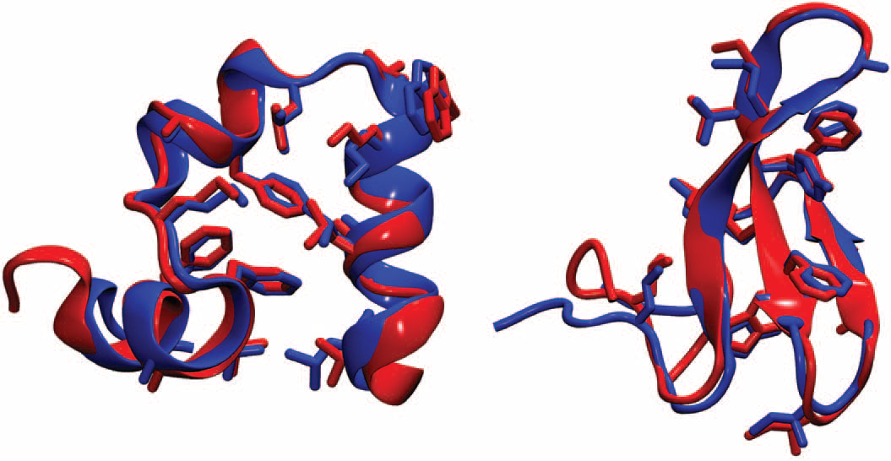
Folding proteins at x-ray resolution using a specially designed ANTON machine (x-ray: blue, last frame of MD) simulation (red): villin headpiece (left), a 88 ns of simulations, WW domain (right), 58 μs of simulations. Good symplectic algorithm; up to 20 fs time step.
D.E. Shaw et al., Science, 2010, 330, 341-346

Slide 12
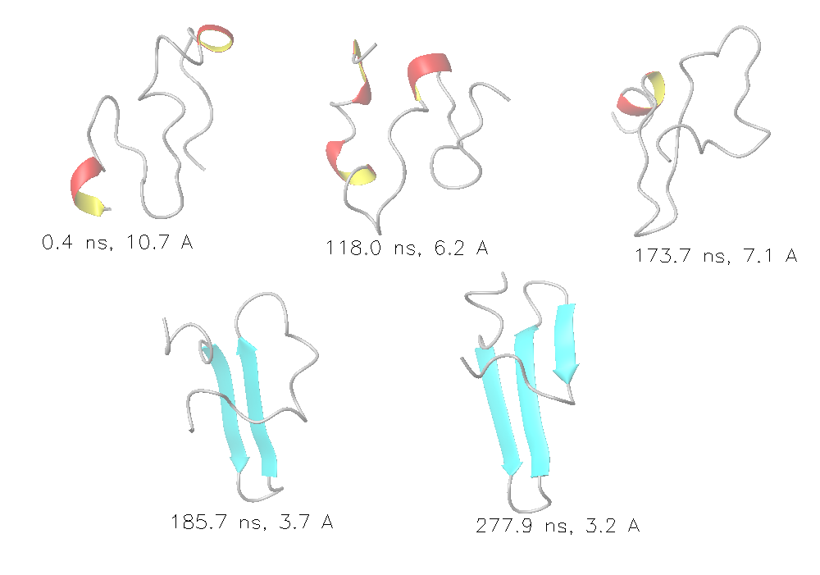
Folding the WW domain with the UNRES coarse-grained approach: 280 ns instead of 58 ms

Slide 13
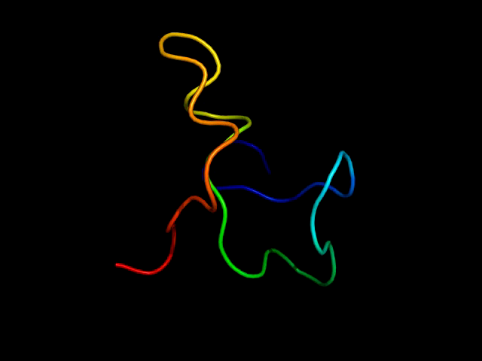

Slide 14
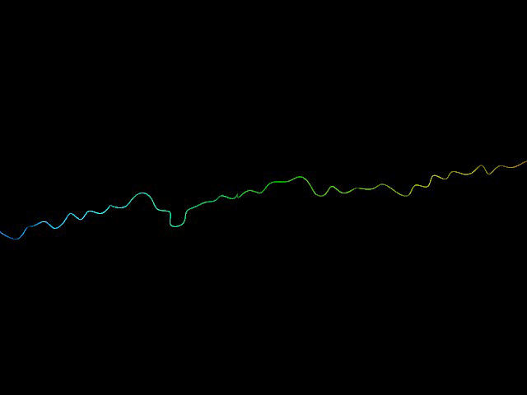

Slide 15
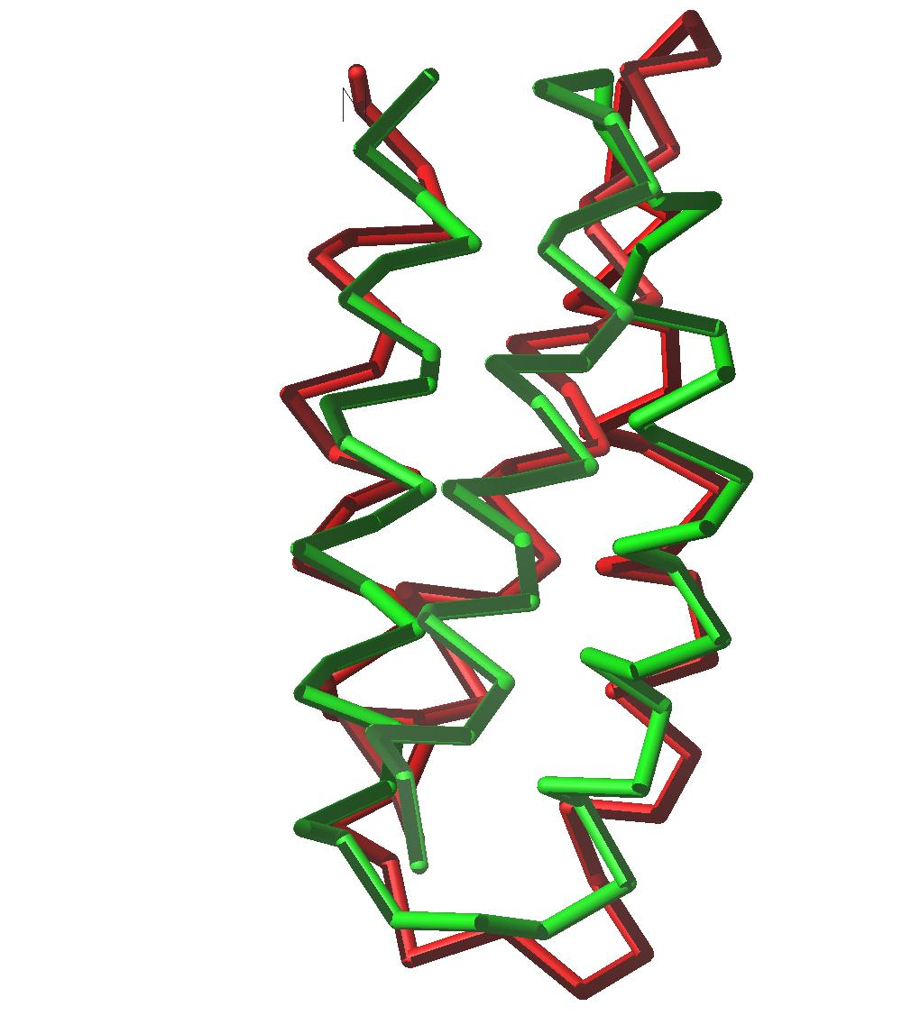
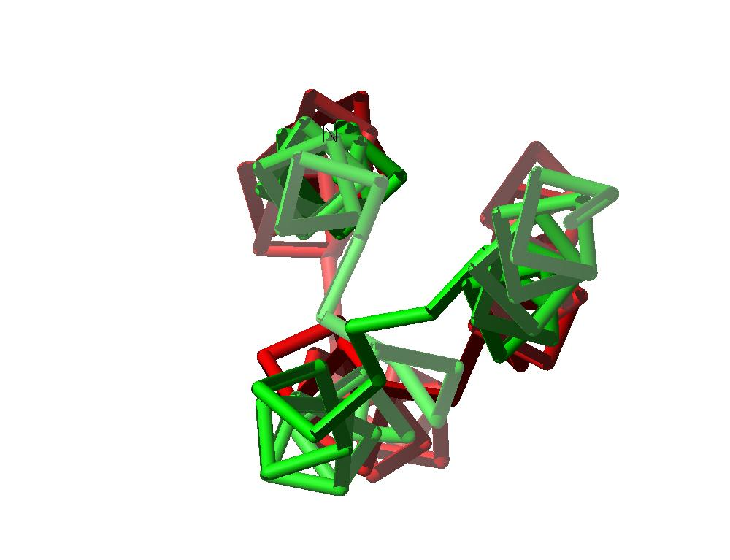
Coarse-grained approaches and accuracy
1LQ7; lowest-energy structure obtained with UNRES; Ca rmsd=2.1 Å
Ołdziej et al., J. Phys. Chem. B, 108, 16950, 2004

Slide 16

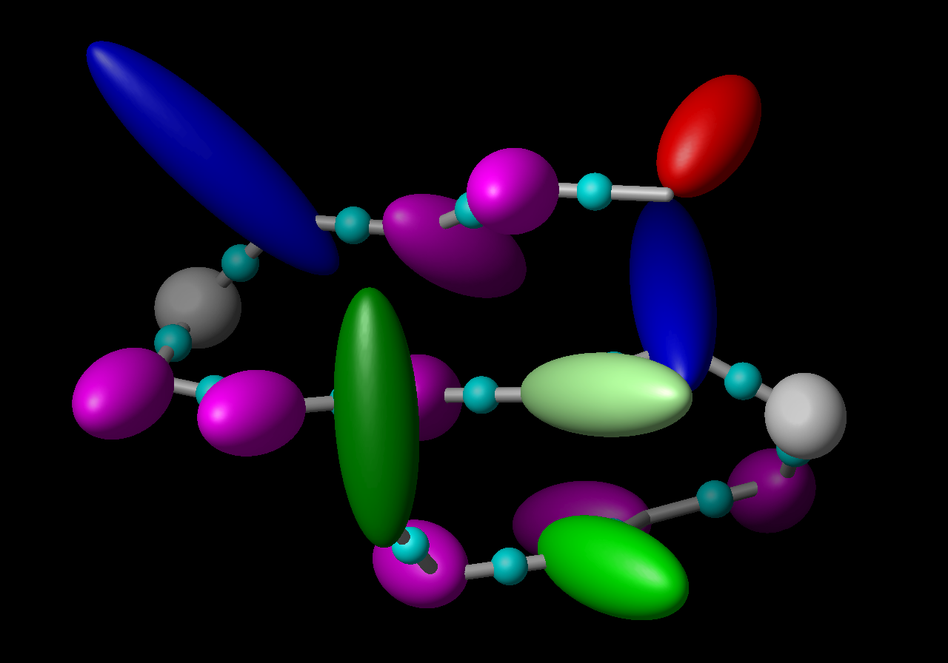
United-residue force fields
All-atom representation
of polypeptide chain in
solution (explicit water)
United-residue (UNRES) representation of polypeptide chain

Slide 17
Coarse-grained force fields: a general formula
Local terms
Pairwise terms
Multibody terms

Slide 18
Types of coarse-grained potentials
Physics-based potentials
  smoothing the energy surface by treating rigid objects as single interaction sites (e.g., the Kihara potentials),
  averaging out non-essential degrees of freedom,
  reproducing thermodynamic properties of small compounds.
Statistical potentials based on the „Boltzmann principle”
  database information implicit in the potentials,
  database information explicit in the potentials.
Arbitrary potentials (HP, HNP).
Structure-based potentials
  native secondary structure or other components of structure built in the potentials
  the native structure is the global minimum (Go-like potentials).
Elastic network potentials.

Slide 19
Applications of coarse-grained potentials
Prediction of 3D structure (proteins, nucleic acids, their complexes)
Large time- and size-scale molecular dynamics simulations
Computing thermodynamic properties and ensemble averages (thermodynamics of folding)

Slide 20
Protein coarse-grained potentials: 37 years
Infancy and Childhood
1975 Levitt & Warshel: a physics-based neo-classical force field (Nature 253:694-698).
1976 Tanaka & Scheraga: contact (on-lattice) statistical. potentials determined from the PDB (Macromolecules 9:945-950).
1976 Kuntz et al.: off-lattice statistical potentials (J. Mol. Biol. 106:983-994).
1981, 1984: Crippen & coworkers: statistical potentials (Int. J. Peptide Protein Res. 24:279-296; J. Comput. Chem. 8:972-981).
1985: Miyazawa & Jernigan: contact potentials, rigorous quasi-chemical approximation (Macromolecules 18:534-552).
1990: Crippen & Snow: Optimization of statistical potentials by maximization of energy gap (Biopolymers 29:1479-1489)
1990: Sasai & Wolynes: Application of theory of associative Hamiltonians to develop coarse-grained potentials (Phys. Rev. Lett. 65:2740-2743).

Slide 21
Youth and Maturity
1993: Jones & Thoronton: Potentials for fold recognition (J. Comput.-Aided Mol. Design 7:439-456).
1993: Koliński & Skolnick: On-lattice statistical potentials: successful folding simulations (J. Chem. Phys. 98:7420-7433).
1993: First version of UNRES: successful structure prediction (Liwo et el., Protein Sci. 2:1715-1731)
1998: First successful blind ab initio protein-structure predictions in CASP3 (Skolnick group, Scheraga group).
2001: Rigorous formulation of coarse-grained force fields through cluster-cumulant expansion (Liwo et al., J. Chem. Phys. 115:2323-2347)
2004: Kolinski: CABS force field for on-lattice simulations of proteins (Acta Biochim. Pol. 51:349-371).
2007: Voth and coworkers: Multiscale coarse-graining based on force matching (J. Phys. Chem. B 111:4116-4127)
2008: Marrink and coworkers: MARTINI off-lattice force field based on thermodynamic data (J. Chem. Theor. Comput. 4:819-834).

Slide 22
J. Mol. Biol. (1976) 104, 59-107
A Simplified Representation of Protein Conformations for
Rapid Simulation of Protein Folding
MICHAEL LEVITT
Weizmann Institute of Science, Rehovoth, Israel
and
Medical Research Council Laboratory of Molecular Biology
Hille Road, Cambridge, England-f
(Received 12 December 1975, and in revised form 19 February 1976)

Slide 29
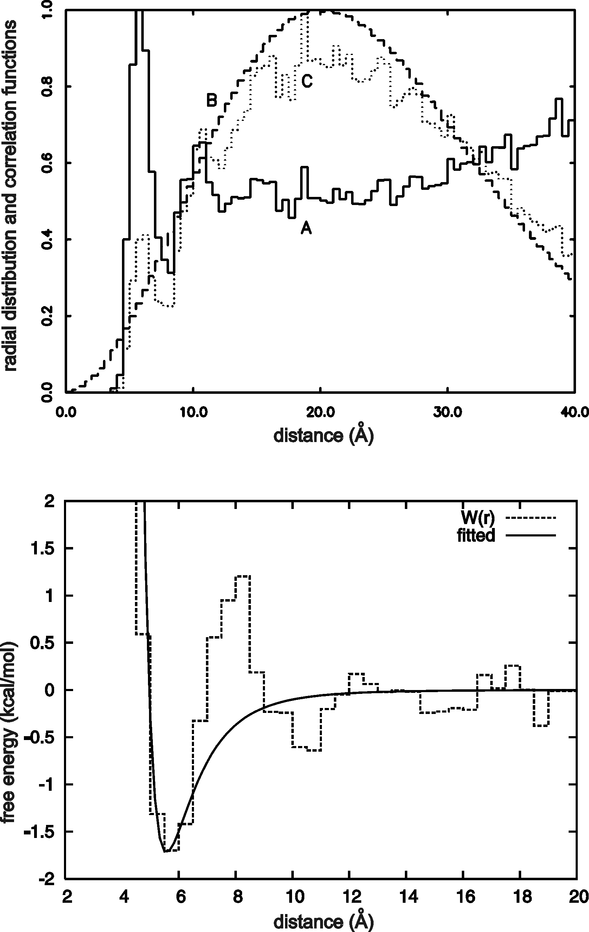
Statistical potentials
x – geometric variable
p – type(s) of site(s)
s – sequence context
Leu-Leu pair, statistics from PDB

Slide 31
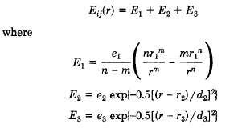

Slide 33
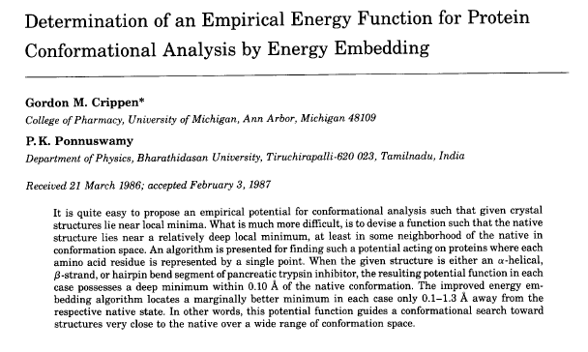

Slide 36
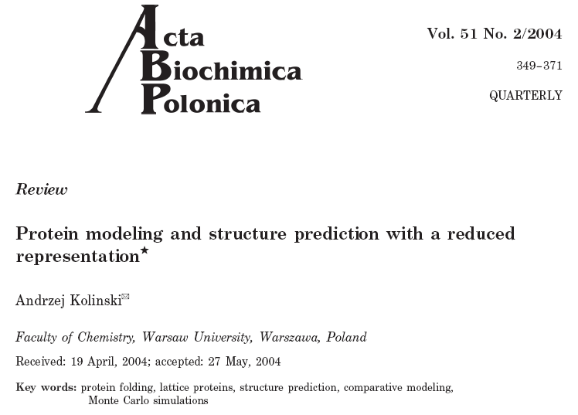

Slide 38
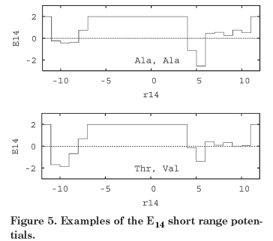

Slide 39
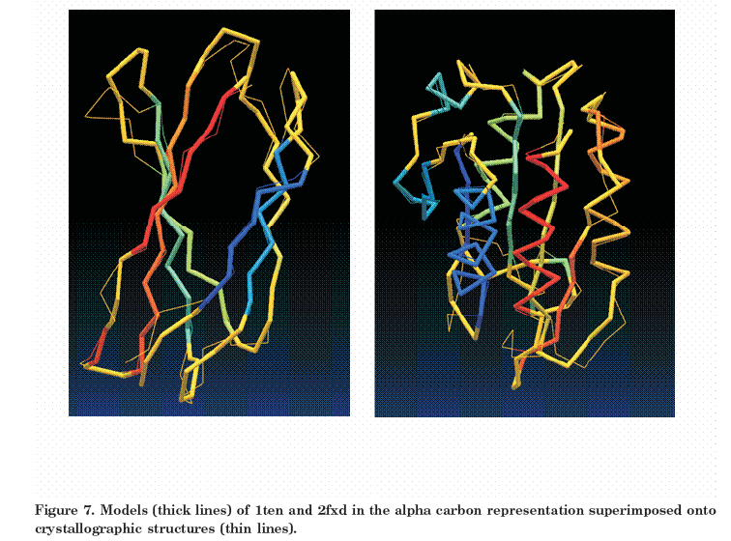

Slide 40
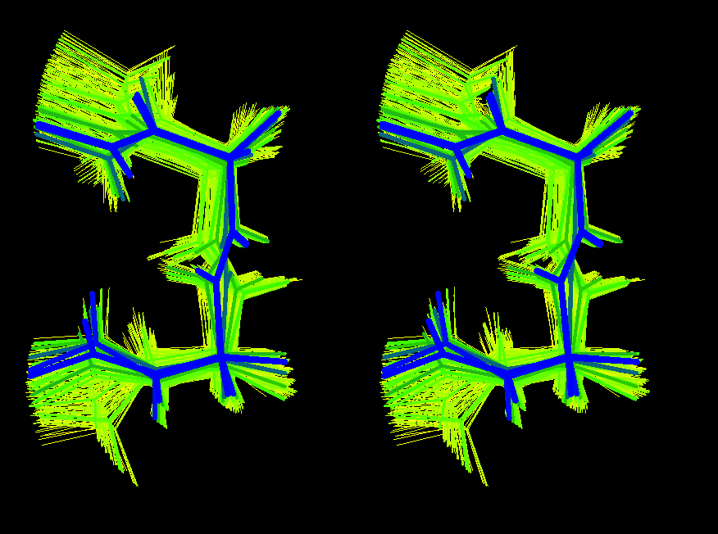
Illustration of the “composition” of the statistical ensemble of, say, a β-turn model corresponding to an UNRES chain used to compute the RFE.

Slide 41
The probability density of a coarse-grained conformation to occur can be computed directly as the Boltzmann factor of the coarse-grained energy. The free energy is consistent with that computed from all-atom energy.

Slide 42
The ensemble averages of quantities that depend on coarse-grained coordinates only (e.g., the C^{α}-RMSD in UNRES) calculated with the effective coarse-grained energy function correspond to ensemble averages at the all-atom level.

Slide 43
What if a quantity depends on both X and Y (e.g., the radius of gyration, proton-proton distance, etc? Doable but requires some extra-parameterization…

Slide 44
Average Energy

Slide 45
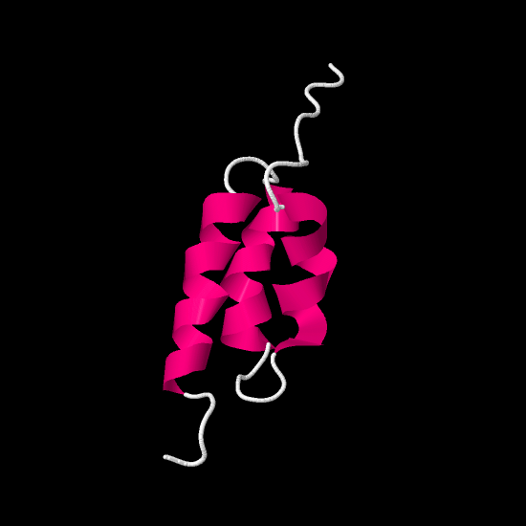
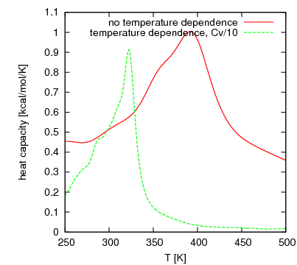
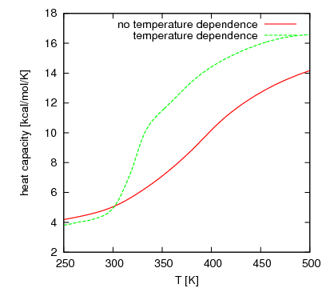
Temperature dependence of coarse-grained force fields
The N-terminal part of the B-domain of staphylococcal protein A; coarse-grained simulations with UNRES

Slide 46
Expressing the total PMF
Sum of neo-classical expressions (Pincus & Scheraga, 1981; MARTINI force field)
Sum of statistical potentials (Tanaka & Scheraga, 1976; CABS force field)
Factor expansion (UNRES)
Force matching (Voth and coworkers, 2007)

Slide 47
Sum of neo-classical terms

Slide 48
Statistical potentials
x – geometric variable
p – type(s) of site(s)
s – sequence context
Leu-Leu pair, statistics from PDB

Slide 49
Factor expansion
Define the coarse-grained interaction sited as well as the coarse-grained and fine grained degrees of freedom.
Express the all-atom energy as a sum over components within and between interaction sites.
Factor out F(X) and determine approximate functional expressions for the factors.
Parametrize the expressions from QM or MM RFE surfaces.
Complete the determination of the force field by calibrating to reproduce properties of training systems (native protein structure, thermodynamic properties, etc.).

Slide 50
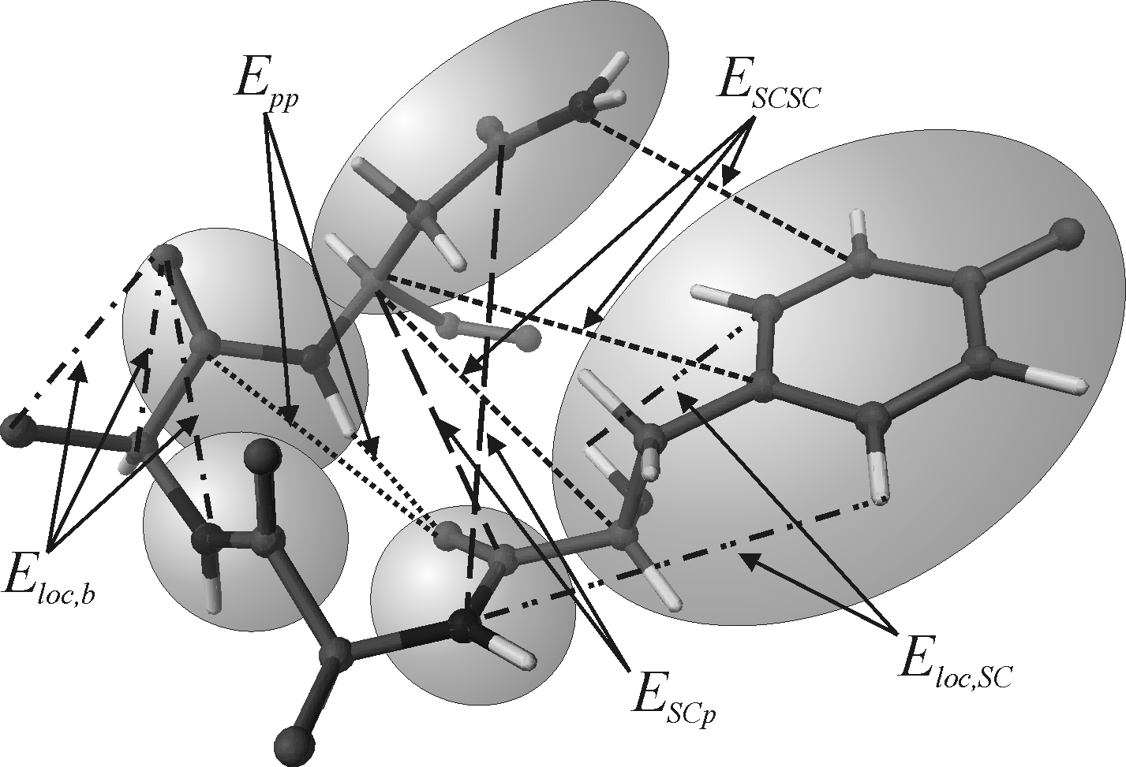
Step 1: Definition of coarse-grained sites and energy partition

Slide 51
Prototype of the effective energy function in a coarse-grained representations

Slide 52
Step 2: Factorization of the RFE in terms of component energies
A. Liwo, C. Czaplewski, H.A. Scheraga, J. Chem. Phys., 115, 2323-2347 (2001).

Slide 53
Example: the first three factors

Slide 54
Step 3: Expansion of the RFE factors in the generalized cumulant series

Slide 55
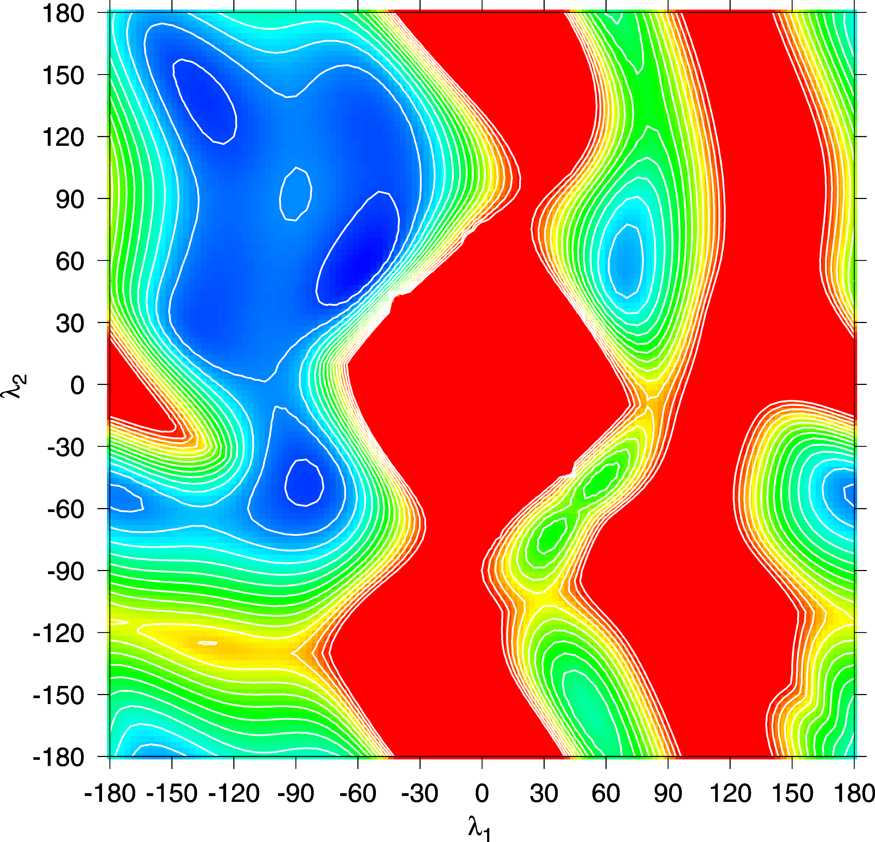
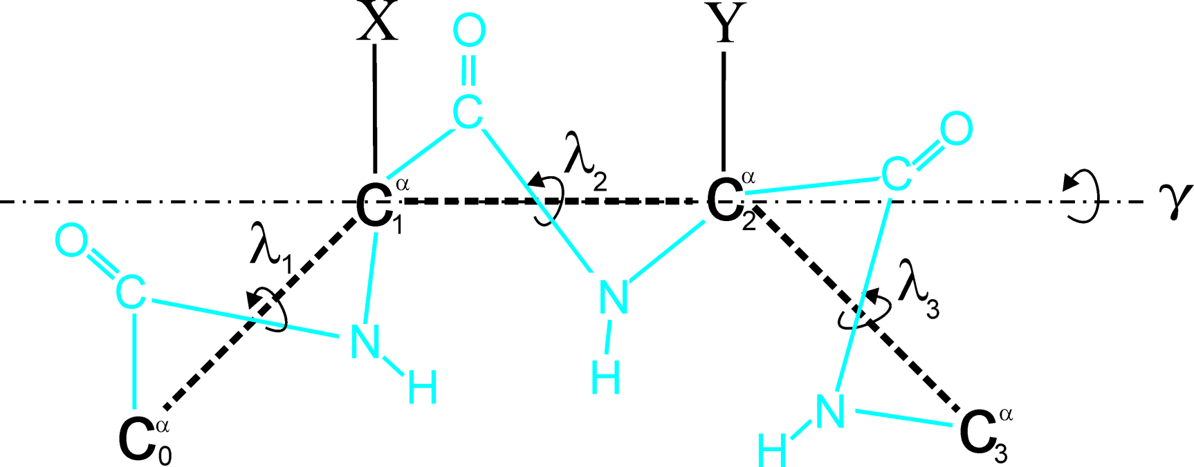
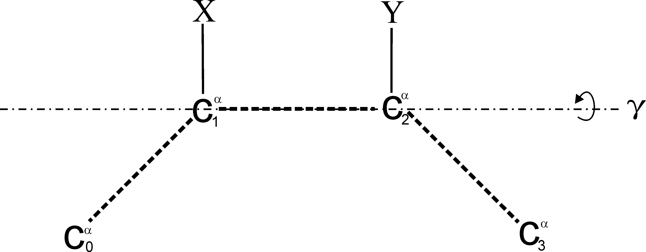
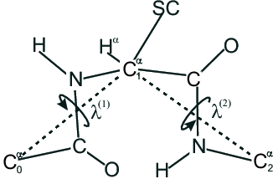
Example: torsional potentials for the rotation about the C^{α}…C^{α} virtual bonds

Slide 56
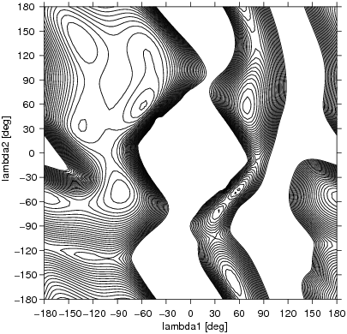
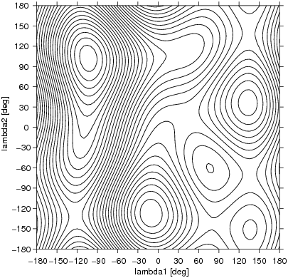
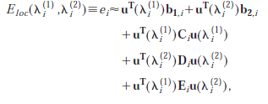

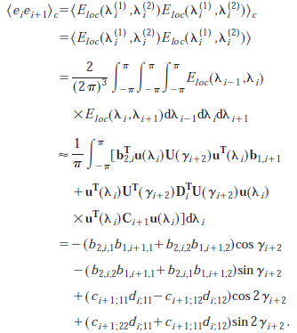
X=Y=Ala; ECEPP3 force field
Liwo et al., J. Chem. Phys., 115, 2323 (2001)

Slide 57
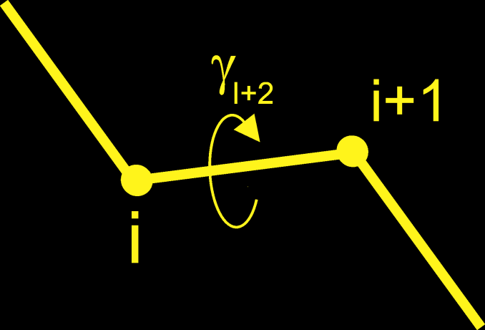
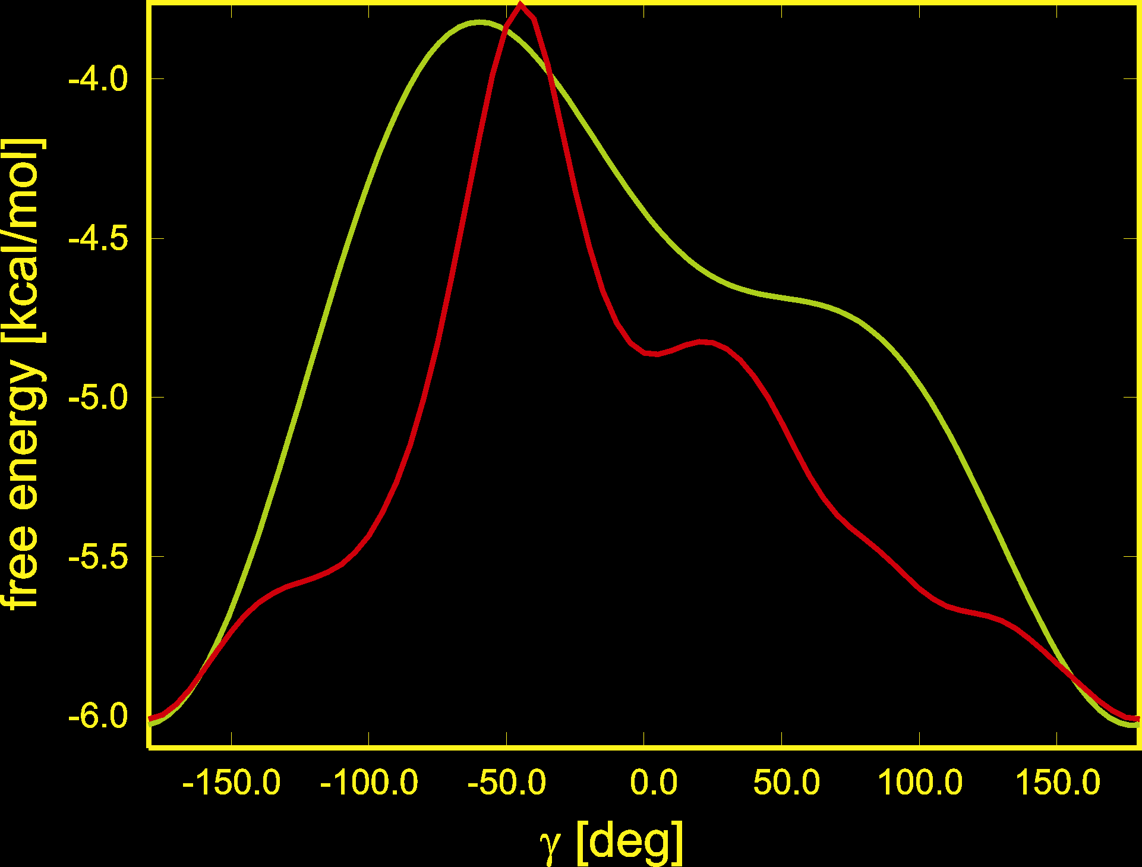
Can we trust this truncated expansion for the RFE ?
Comparison of the torsional RFE curves of the rotation about the C^{α}...C^{α} virtual bond in Ac-Ala-Ala-NHMe calculated by numerical integration (red) and directly from cumulant expansion (green)

Slide 58
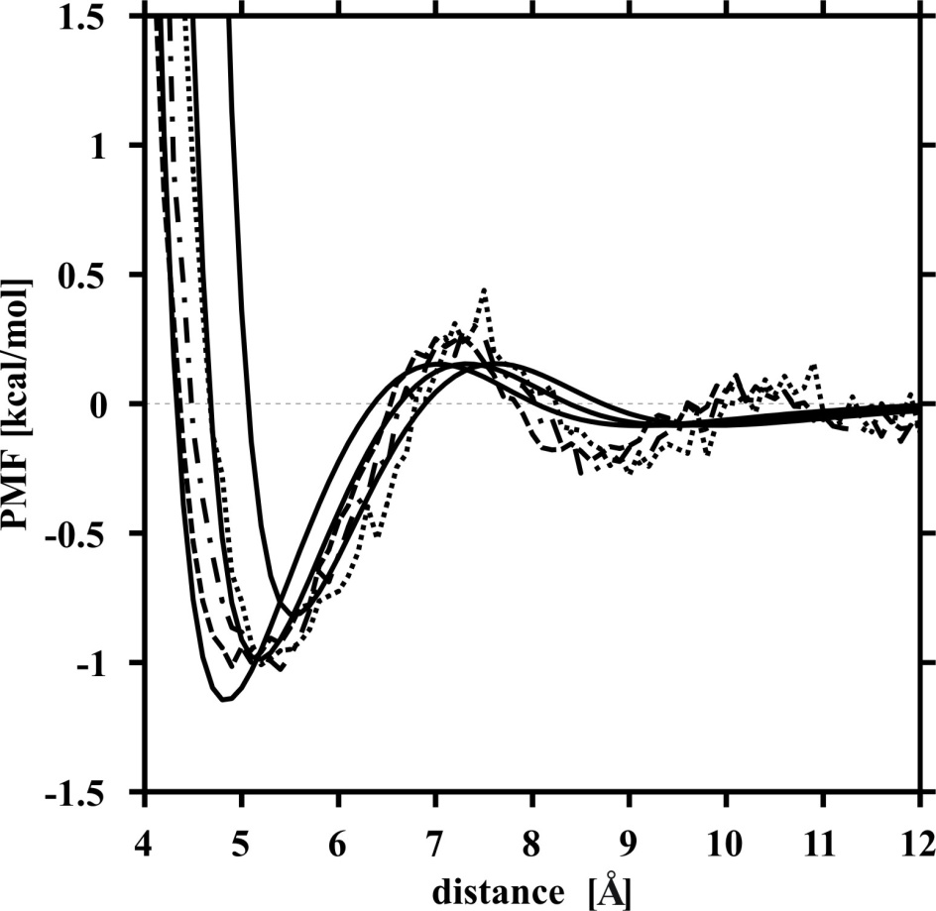
Step 4: Parameterization of functional expressions for RFE factors
Example: SC-SC interaction potentials
Method: Umbrella-sampling MD of models of side-chain pairs in water; WHAM to compute PMFs from simulation results.
Makowski et al., J.Phys.Chem. B, 111, 2925 (2007).
U_{SCSC}(Val-Val) (solid lines: fitted)

Slide 59
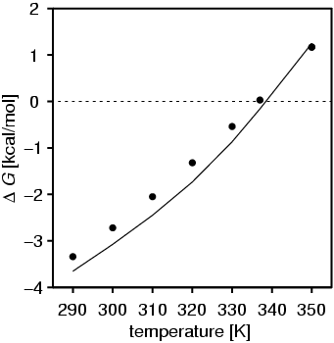
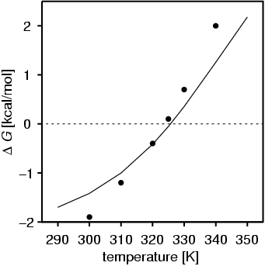
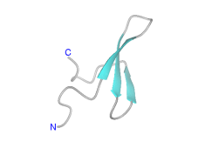
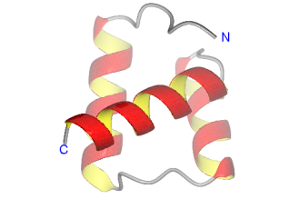


Step 5: Calibration of the force field
1E0L (37 residues)
1ENH (54 residues)

Slide 60
The Multiscale Coarse Graining Method
(Force Matching) (Voth and coworkers)
The prototype of the CG energy function is the RFE.
Coordinates of the centers of masses of the CG sites are the CG degrees of freedom.
The sites interact with pairwise central potentials.
A force field is parameterized by least-square fitting of the CG forces to the average forces acting on the CG sites determined by MD simulations of a given system.
Explicit water (a single site per each water molecule).

Slide 61
Average Forces

Slide 62
Approximations and Fitting
Each dφ/dr_{IJ} is represented by values on a grid in r_{IJ,,} a spline, or as a linear combination of analytical functions. The values on the grid or the coefficients of spline/analytical function are determined by solving a linear least—squares problem. Afterwards, the φ’s are obtained by integrating dφ/dr over r.

Slide 66


Slide 70
Thorpe et al., J. Phys. Chem.B, 2008, 112, 20, 13079-13090

