Slide 1
HYDROPHOBIC INTERACTIONS

Slide 2
Hydrophobicity: dislike of water
Pliny (Plinius) the Elder (1st Century), Benjamin Franklin (1773), Lord Raileigh (1891):
oil stills water waves.
Taube (1891): amphiphilic molecules concentrate on water/air interface.
Agnes Pockels (1892) developed a prototype of Langmuir throug (the work was later published in Nature on Langmuir’s recommendation).

Slide 3
Franklin’s experiments on a pond at Clapham
“I fetched out a cruet of oil and dropped a little of it on the water. I saw it spread itself with surprising swiftness upon the surface… Though not more than a teaspoonful, produced an instant calm over a space several yards square which spread amazingly and extended itself gradually till it reached the lee side, making all that quarter of the pond, perhaps half an acre, as smooth as a looking glass. After this I contrived to take with me, whenever I went into the country, a little oil in the upper hollow joint of my bamboo cane, with which I might repeat the experiment and I found it constantly to succeed."

Slide 4
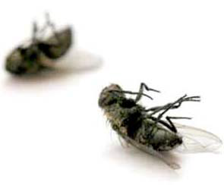
Another experiment
„Mr. Jessop was about to clean a little cup in which he kept oil, and he threw upon the water some flies that had been drowned in the oil. These flies presently began to move and turned around on the water very rapidly as if they were vigorously alive, though on examination he found they were not so.”
Findings were published in Philosophical Transactions in 1774, one of the world’s 1stscientific journals“I immediately concluded that the motion was occasioned by the power of the repulsion and that the oil issuing gradually from the spongy body of the fly

Slide 5
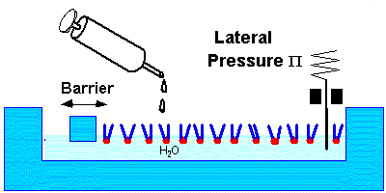
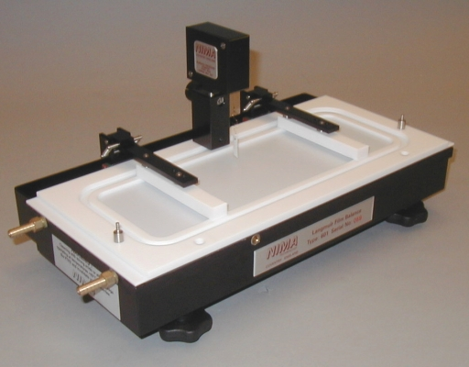
Langmuir through

Slide 6
Meyer and Overton (1898): direct proportionality between direct proportionality between oil/water partition coefficients and anesthetic potency of drugs
McBain and Salmon (1920): reversible formation of micelles in soap solution.
Gorter and Grendel (1925): lipids from blood cells for bilayers (Langmuir through experiments).
Dawson and Danielli (1935): proteins associate with bilayers through nonpolar interactions.

Slide 7
Bull (1941): “proteins contain a large number of
nonpolar groups and it might be that upon denaturation these hydrophobic groups are exposed”.
Walter Kauzmann (1954): hydrophobic bond
(The Mechanism of Enzyme Action; McElroy, W.
D., Glass, B., Eds.; The John Hopkins Press: Baltimore, 1954, pp 70-110)

Slide 8
Hydrophobic effect
Hydrophobic hydration (non-polar solvents in water).
Hydrophobic interaction (indirect solvent-induced forces between solute molecules in water).

Slide 9
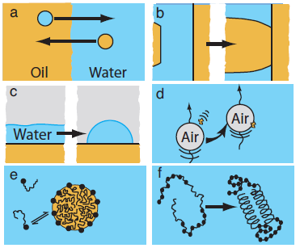
Manifestations of hydrophobic effect

Slide 10
Characteristics of hydrophobic effect
Entropy-driven (at room temperature)
Specific temperature dependence
Heat capacity significantly higher than that of regular solutions.

Slide 11
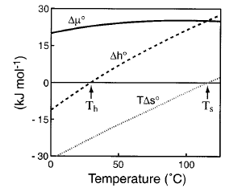
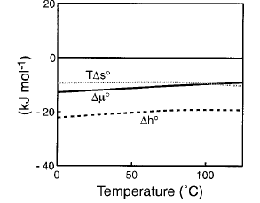
Thermodynamic characteristics of hydrophobic hydration
Transfer of neopentane from liquid neopentane to water phase
Transfer of neopentane from the gas phase to liquid neopentane phase
Southall, Haymet, Dill, J. Phys. Chem. B 2002, 106, 521-533

Slide 12
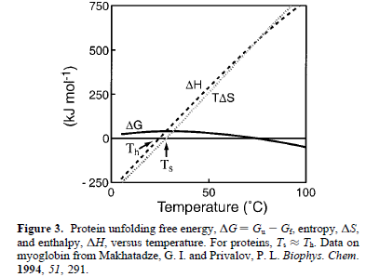

Slide 13
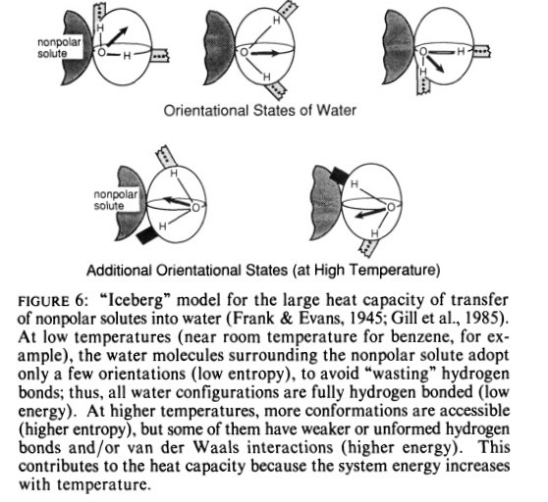

Slide 14
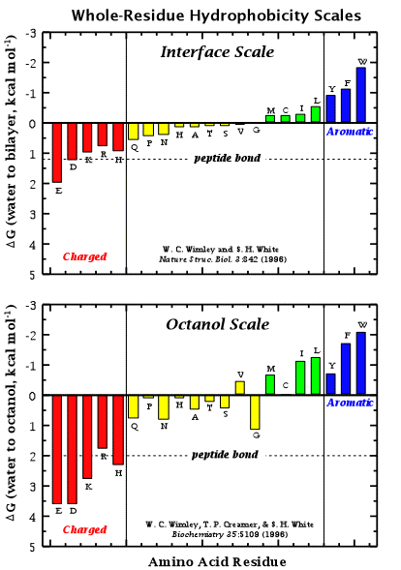
Hydrophobicity scales
Partition between ethanol/dioxane and water (Nozaki & Tanford, 1971)
Partition between n-octanol and water (Pliska et al., 1981)
Partition between water and micellar phases (Fendler et al., 1975)
Hydration free energies (Eisenberg and McLachlan, 1986)
Solvent accessible surface area (Chothia, 1976)

Slide 15
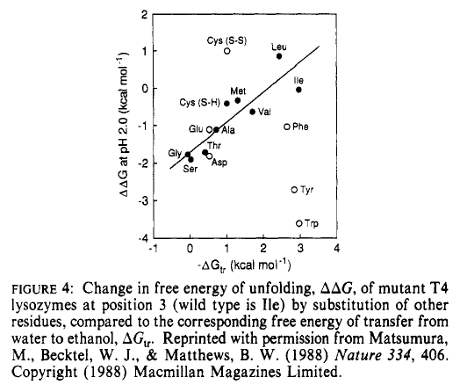

Slide 16
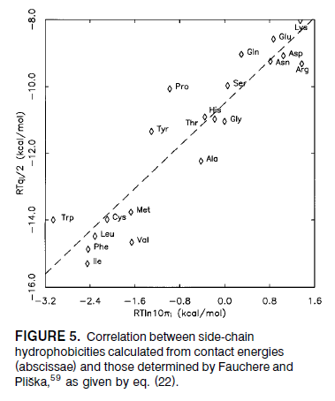

Slide 17
Hydrophobic interactions

Slide 18
Methods of PMF determination
Thermodynamic integration
Umbrella sampling
Particle insertion (both hydration energies and PMFs)

Slide 19
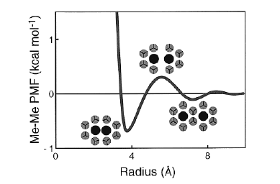
PMF of two methane molecules in water
Desolvation barrier
Contact minimum
Solvent-separated mimimum

Slide 20
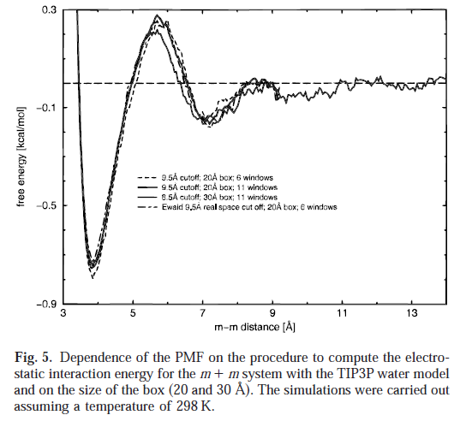

Slide 21
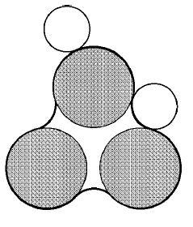
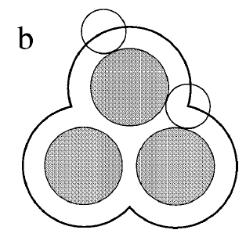
Models of hydrophobic hydration
Molecular surface model
Solvent-accessible surface (SASA) model

Slide 22
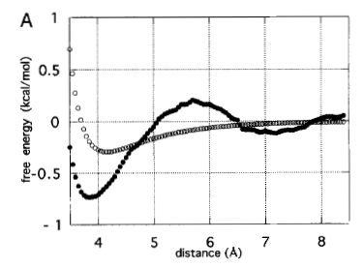
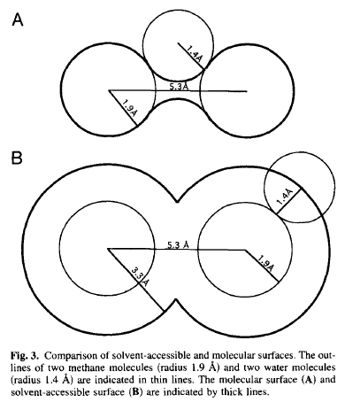
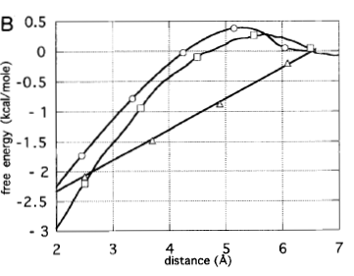
Comparison of the performance of the two models
Rank and Baker, Prot. Sci., 1997, 6, 347-354

Slide 23
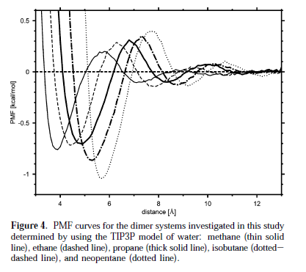
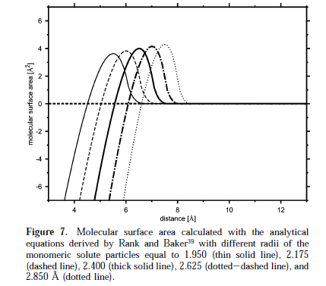
Sobolewski et al., J.Phys.Chem., 111, 10765-10744 (2008)

Slide 24
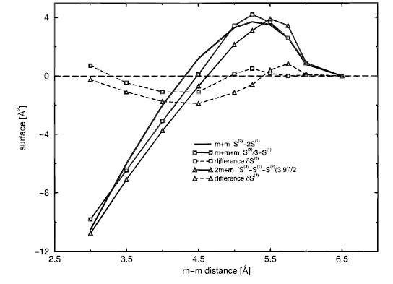
Cooperativity

Slide 25
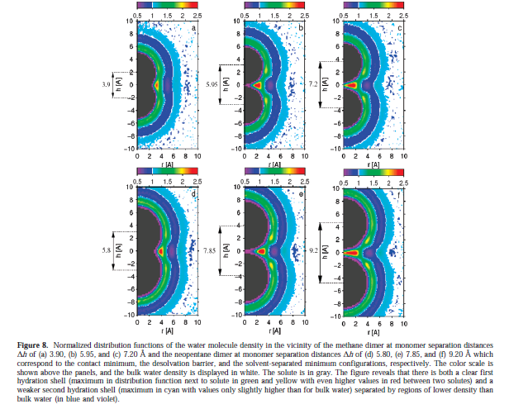

Slide 26
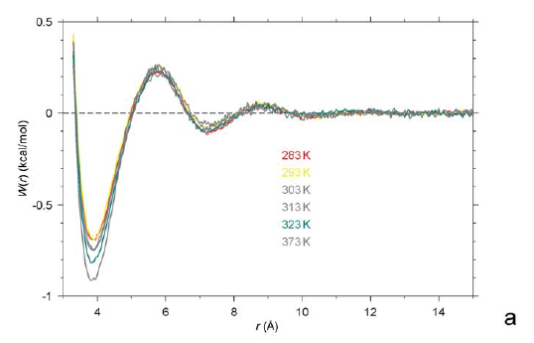
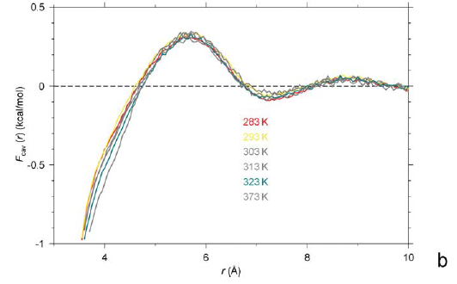
Dependence of the PMF and cavity contribution to the PMF of two methane molecules on temperature (Sobolewski et al., PEDS, 22, 547-552 (2009)

Slide 27
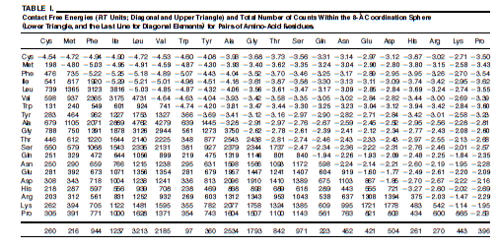
S. Miyazawa & R.L. Jernigan, R. L. 1985. Estimation of effective interresidue contact energies from protein crystal structures: quasi-chemical approximation. Macromolecules, 18:534-552, 1985.

